Slide 1
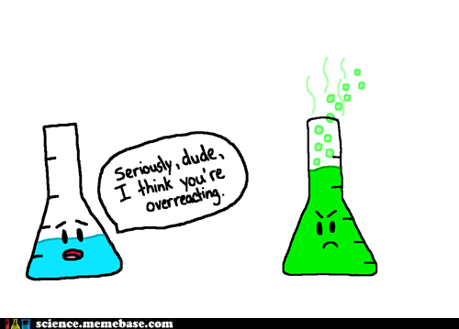
5 Types of Chemical Reactions

Slide 2
Chemical reactions
despite there being millions of different possible chemical reactions, they follow certain patterns
most reactions can be grouped into one of five categories:
Formation reactions (also called synthesis reactions)
Decomposition reactions
Hydrocarbon combustion
Single replacement reactions
Double replacement reactions

Slide 3
Overview of the 5 types of chemical reactions

Slide 4
Reaction #1: Formation (Synthesis)
Two elements combine to form a compound
element + element → compound
A + B → AB
These reactions are exothermic - they occur without the need of added energy
E.g. 2K(s) + Cl₂(g) → 2KCl(s)

Slide 5
Reaction #1: Formation (Synthesis)
How you recognize this reaction:
It’s the only reaction where both reactants are elements (not compounds)
What’s the challenge?
watch for polyatomic elements (e.g. O₂, H₂. etc.)
if the compound produced is an ionic compound, remember to balance your charges
if the compound includes a multivalent metal, unless otherwise specified, assume the common ion charge (the one listed first on the periodic table)

Slide 6
examples:
Write the balanced equation for the formation of lithium oxide from its elements.
4 Li (s) + O2 (g) → 2 Li2O (s)
Write a balanced chemical equation for each unfinished formation reaction:
calcium + nitrogen → . . .
3 Ca (s) + N2 (g) → Ca3N2 (s)
silver + oxygen → . . .
4 Ag (s) + O2 (g) → 2 Ag2O (s)

Slide 7
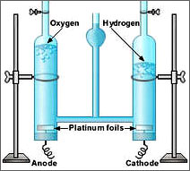
Reaction #2: Decomposition
A compound breaks down into its composite elements
compound → element + element
AB → A+ B
These reactions are endothermic
because the compound form is more stable than the elements, decomposition reactions require energy to occur
e.g. electrolysis of water
E.g. H₂O(l) → O₂(g) + H₂(g)

Slide 8
Reaction #2: Decomposition
examples:
Write the balanced equation for the decomposition of solid magnesium sulfide into its elements.
8 MgS (s) → 8 Mg (s) + S8 (s)
Write the balanced equation for the decomposition of solid nickel (II) chloride into its elements.
NiCl2 (s) → Ni (s) + Cl2 (g)

Slide 9
Reaction #2: Decomposition
How you recognize this reaction:
It’s the only reaction where there is only one reactant
What’s the challenge?
watch for polyatomic elements (e.g. O₂, H₂. etc.)

Slide 10
Reaction #3: Hydrocarbon combustion
Hydrocarbons are molecular compounds containing hydrogen and carbon
e.g. octane C8H18(l), glucose C6H12O6(s), methane CH4(g)
“Combustion” means to burn
Like all fuels, hydrocarbons require oxygen in order to burn
Because they produce heat and light, combustion reactions are always exothermic
C_{x}H_{x} + O₂ → CO₂ + H₂O
CH_{4 (g)} + 2 O_{2 (g)} → CO_{2 (g)}+ 2 H₂O _{(g)}

Slide 11
Reaction #3: Hydrocarbon combustion
Regardless of what hydrocarbon is burning, the products are carbon dioxide and water vapour
hydrocarbon fuel + oxygen → carbon dioxide + water
C_{x}H_{y} + O₂(g) → CO₂(g) + H₂O(g)

Slide 12
Reaction #3: Hydrocarbon combustion
How you recognize this reaction:
The reactants are a hydrocarbon and oxygen, or in the description of the reaction, it says “combusts” or “burns”
What’s the challenge?
while these reactions always produce the same two products, they are the hardest equations to balance
start by balancing the carbons, then the hydrogen, and leave the O₂ coefficient to last

Slide 13
Reaction #4: Single replacement
An element reacts with a compound, and produces a new element and a new compound
element + compound → compound + element
A + BC → AC + B
If the reacting element is a metal, it will replace the metal cation from the compound
e.g. Na(s) + KCl(s) → NaCl(s) + K(s)
If the reacting element is a non-metal, it will replace the non-metal anion from the compound
e.g. Br₂(l) + MgCl₂(s) → MgBr₂(s) + Br₂(l)

Slide 14
Reaction #4: Single replacement
examples: Write the balanced equations.
Chlorine gas is added to a solution of aqueous nickel (III) bromide and the mixture is stirred. This produces aqueous nickel (III) chloride and liquid bromine.
3 Cl2 (g) + 2 NiBr3 (aq) → 2 NiCl3 (aq) + 3 Br2 (l)
Zinc metal is placed into a solution of silver nitrate and allowed to sit. This produces aqueous zinc nitrate and solid silver metal.
Zn (s) + 2 AgNO3 (aq) → Zn(NO3)2 (aq) + 2 Ag (s)

Slide 15
Reaction #4: Single replacement
How you recognize this reaction:
The reactants are a compound, and an element that is NOT oxygen
What’s the challenge?
make sure you balance the charges in the new ionic compound
if the new element is a non-metal, watch for polyatomic elements
if the reaction occurs in solution, you will need to check the solubility table for the solubility of the new compound

Slide 16
Reaction #5: Double replacement
Two compounds exchange ions to form two new compounds
compound+ compound→ compound + compound
AB + CD → AD + CB
“A” and “C” are both cations (+ ions) so they will always appear first in the formula
“B” and “D” are both anions (- ions) so they will always appear second in the formula
H₂SO_{4(aq)} + 2 NaOH_{(aq)} → Na₂SO_{4(aq)} + 2H₂O_{(l)}

Slide 17
Reaction #5: Double replacement
examples: Write the balanced equations.
When aqueous copper (I) nitrate and aqueous potassium bromide are mixed, a precipitate of solid copper (I) bromide forms. Another product also forms.
CuNO3 (aq) + KBr (aq) → CuBr (s) + KNO3 (aq)
When aqueous aluminum chloride and aqueous sodium hydroxide are mixed, a precipitate of solid aluminum hydroxide forms. Another product also forms.
AlCl3 (aq) + 3 NaOH (aq) → Al(OH)3 (s) + 3 NaCl (aq)

Slide 18
Reaction #5: Double replacement
How you recognize this reaction:
It’s the only reaction where both reactants are compounds
What’s the challenge?
Because you will be dealing with two new ionic compounds, you will have to balance the charges for both compounds
You will also have to check the solubility table for both new compounds

Slide 19
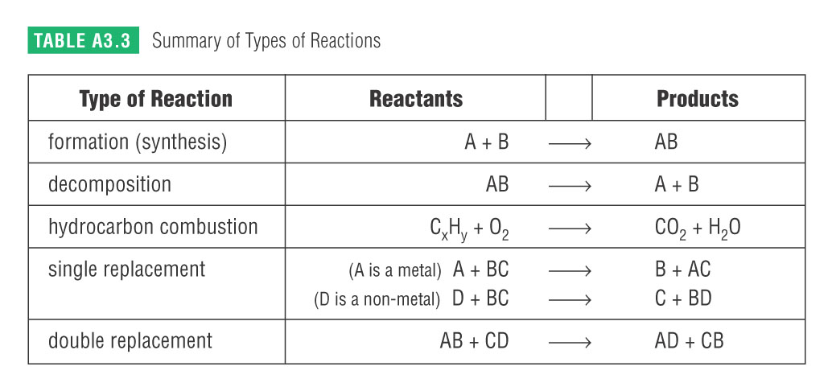
This table is found in your data booklet! USE IT!

Slide 20
Practice problems :
Classify the reactions below as F, D, HC, SR or DR
a) C₆H₁₂(l) + 9O₂(g) → 6CO₂(g) + 6H₂O(g)
b) CaCl₂(aq) + Na₂SO₄(aq) → CaSO₄(s) + 2NaCl(aq)
c) 2Fe(s) + O₂(g) → 2FeO(s)
d) Be(s) + 2LiBr(aq) → BeBr₂(aq) + 2Li(s)
e) MnI₄(aq) → Mn(s) + 2I₂(s)

Slide 21
Review
read pages 91 – 105
Worksheet “Classifying and Balancing Chemical Equations”

