Slide 1
Unit B – energy flow in technological systems
Chapter B3 – Energy conservation & Thermodynamics

Slide 2
Systems
In order to investigate energy transfers in machines, natural environments, or even the entire planet, we need to set some boundaries – called a system
A system refers to a set of interconnected parts

Slide 3
Three types of systems
There are three types of systems:
Open systems
have the most interaction between the system and its surroundings
Exchange both energy and matter with the surroundings
Examples include an ecosystem, the human body, a house
Closed systems
Exchange energy, but not matter with the surroundings
Examples include a sealed container
Isolated system
A system that exchanges neither matter nor energy with the surroundings
Other than the entire universe, no real-life examples exist

Slide 4
The First Law of Thermodynamics
Recall, a scientific law is an idea, such as a theory, that has been repeatedly tested and NOT disproved
There are three Laws of Thermodynamics: laws that describe the behaviour of energy within systems
The First Law of Thermodynamics is actually the Law of Conservation of Energy, which states
The total energy in a system remains constant
Whenever energy is added to a system, some will be used to power the system, but an equal amount of energy is lost in some other form (usually heat)

Slide 5
A perfect machine
The more useful energy a machine uses, the less is lost to the surroundings – this is referred to as the machine’s efficiency
A perfect machine is one that converted 100% of the energy input into useful energy
Because such a machine would run forever without the need for more energy input, they are sometimes also called perpetual motion machines
While no true perpetual motion machine has ever been invented, some have come close – this one is thought to run for a few years

Slide 6
Why don’t Perpetual Motion Machine’s work
https://www.youtube.com/watch?v=A-QgGXbDyR0

Slide 7
The Second Law
The Second Law of Thermodynamics describes the direction of energy flow in a natural process
Unless forced to do otherwise, energy will naturally flow from hot objects to cold objects
This is like floating downstream
A machine that uses this flow of energy to accomplish a mechanical task (e.g. turn a turbine) is called a heat engine

Slide 8
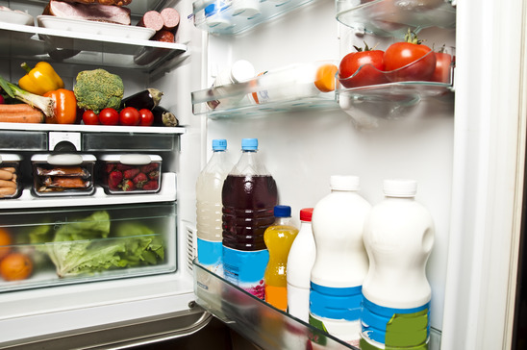
Heat pumps
In order to force energy to go in the opposite direction, work must be done
A device that forces heat from cold to hot is called a heat pump
An example would be your refrigerator, which pumps heat from inside the fridge (cooler) into the kitchen (warmer)
This can only be done with the help of additional energy (ie – the fridge must be plugged in)
This is like swimming upstream

Slide 9
Useful energy
The energy that goes into a system to make it run is referred to as the input energy
Of that input energy, a portion of it will go toward the desired function of the machine, called useful energy (or work output) and the rest will be wasted, usually in the form of heat
The closer the useful energy is to the input energy, the less energy is wasted, and the more the efficient the machine

Slide 10
Efficiency
Efficiency, then is a measurement of how effectively a machine converts energy input into useful energy input
It is described as a percentage, with a perfect machine being 100%
The formula, then is as follows:
Efficiency = useful work output x 100%
energy input

Slide 11
Examples
A standard automobile with an internal combustion engine is usually 12-15% efficient
Electric engines can be up to 95% efficient
An incandescent light bulb runs at about 4% efficient, a CFL about 12% and an LED could be as high as 95%

Slide 13
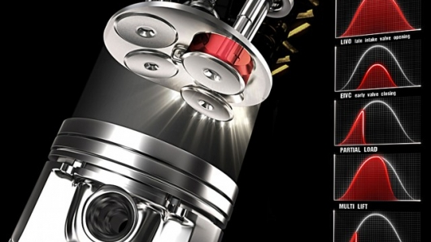
B3.2
An overview of Engine Technology

Slide 14
The value of an efficient machine
In the 1600s, the demand for coal increased beyond the ability of humans to extract it
Machines became necessary to accomplish tasks that humans and animals couldn’t accomplish
As the demand for coal grew, the depth of mines increased
This caused a need to be able to pump water out of the mines
Previous pumps were only able to lift water 9m

Slide 15
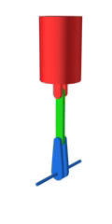
One step forward, one step back
In order for a pump to be useful, it needs to be able to push a piston forward and draw it back again
Without both of these steps, a pump would need to be reset after each cycle

Slide 16
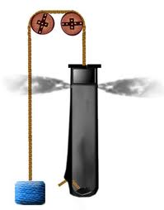
The Gunpowder Engine
Description
Drawbacks
Developed in 1680, the gunpowder engine was the first attempt to improve on pump designs that had existed for centuries
The gunpowder engine is so named because it uses an explosion of gun powder to drive the piston forward
It lacked a mechanism to pull the piston back
The gunpowder made it extremely dangerous due to the serious risk of explosion

Slide 17
The Heat Engine
Description:
Drawbacks:
Heated water to create steam that would be used to drive the piston forward
This is an effective strategy because the volume of water expands by 1300x when heated to steam
The theory behind the heat engine was sound, but Papin couldn’t produce a drum large enough to do useful work

Slide 18
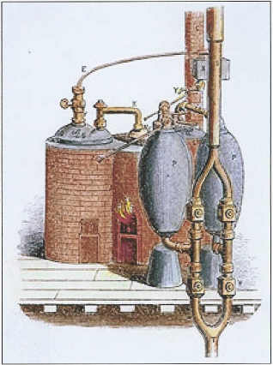
The Savery Engine
Description:
Drawbacks:
The first steam-powered pump to be successfully used in a mine to pump water
Could only generate enough force to pump water a distance of 6m

Slide 19
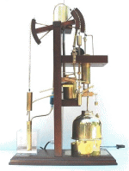
Newcomen Engine
Description:
Drawbacks:
Also used steam to drive the piston forward
To draw the piston back, cold water was sprayed on the water chamber, which cooled the water and caused it to condense, drawing the piston back
This engine was very inefficient, as it required large amounts of energy to heat and cool the water

Slide 20
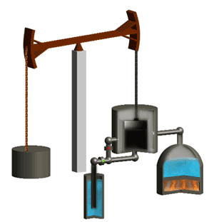
Watt engine
Description:
Drawbacks:
An improvement on the Newcomen engine, the Watt engine used separate chambers for the hot and cold water
this improved the efficiency of the design about three-fold
Used in mines, mills and on ships for 100+ years as the dominant engine
Their large size prevented widespread application
Still not very efficient

Slide 21
Internal Combustion Engine
Description:
Drawbacks:
Though the Watt engine had been improved, it could still not be made small enough to be really useful
In 1794, Robert Steele revived the idea of the Gunpowder engine of using an explosion to drive the piston forward
Instead of gunpowder, Steele’s engine used the gas produced from burning tar and oil which weren’t the easiest fuels to obtain

Slide 22
Internal Combustion Engine
Description:
Drawbacks:
In 1801, Lebon improved Steele’s design by replacing the fuel with coal gas ignited by an electrical spark
While the basic design of the internal combustion engine is still in use today, Lebon’s engine was too weak and inefficient to be useful

Slide 23
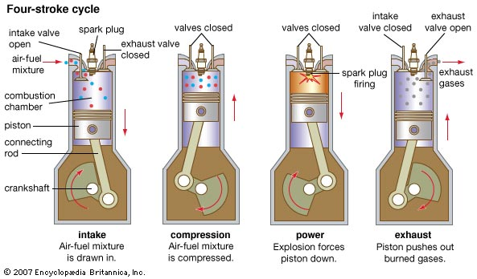
The four-stroke engine (Otto Engine)
Description:
Drawbacks:
improved the efficiency of the ICE by compressing the coal-gas mixture before igniting it
this increased pressure from the gas compression increased the force produced by the engine
Still used coal as its fuel and only produced about 1 horsepower of force
Animation

Slide 24
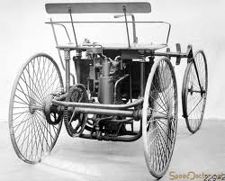
The gasoline engine
Description:
Drawbacks:
in 1883, Daimler made an engine that ran on gasoline instead of coal
Because petroleum burns much hotter than coal, greater power was produced
It also allowed the engine to be small enough to be used in vehicles
still less efficient than an electric engine
relies on a non-renewable resource

Slide 25
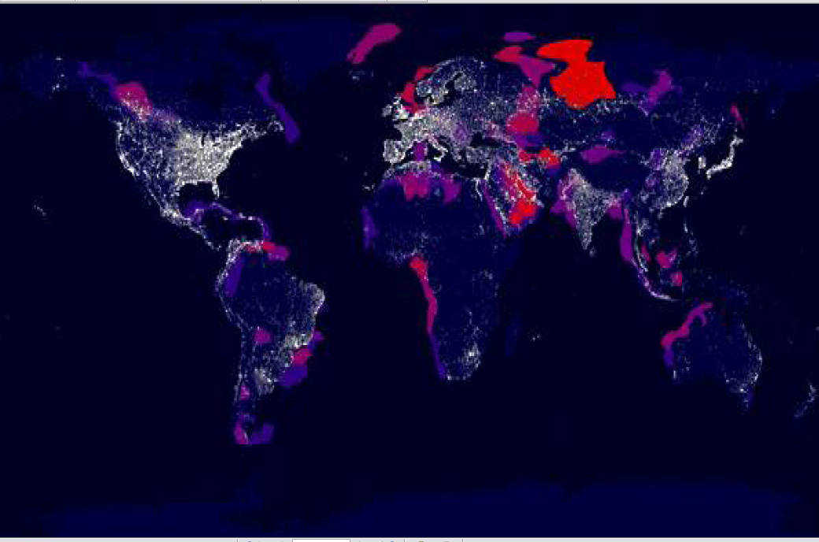
B3.4 – Energy Supply and Demand

Slide 26
Energy sources
Energy sources are types of energy input that can generate electricity
There are eight methods of power generation that have been made to produce a electricity on a large scale
They can be divided into
solar and non-solar energy sources
renewable or non-renewable sources
Fossil fuels (coal & petroleum)
Nuclear
Hydroelectric
Photovoltaic (solar)
Wind
Biomass (e.g. biodiesel, ethanol, biogas)
Geothermal
Tidal

Slide 27
Solar energy sources
Solar
Energy Sources
need the sun as the original energy source
the input may be current sunlight (e.g. a photovoltaic cell) or stored sunlight from millions of years ago (e.g. fossil fuels)
fossil fuels
photovoltaic
wind
hydroelectric
biomass

Slide 28
Non-solar energy sources
Non-solar
Energy Sources / Input
these have some other form of energy input, and do not require sunlight
nuclear
nuclear potential energy of radioactive elements naturally found on Earth
geothermal
caused by heat produced from nuclear reactions within the Earth’s core
tidal
movement of the ocean tides, caused by the gravitational pull of the moon

Slide 29
Renewable and non-renewable energy sources
Renewable energy sources
Non-renewable energy sources
do not deplete as they are used
may still have serious environmental impacts
they are:
tidal
hydro
wind
solar
geothermal
biomass*
deplete as they are used
they are:
fossil fuels
nuclear

Slide 30
Global energy crisis
The term energy crisis refers to the possibility that the planet runs out of energy sources to meet its electricity needs
There are three factors contributing to this issue:
over-reliance on non-renewable resources
increasing energy demand
exponential global population growth

Slide 31
Energy demand
our ancestors used an average of 10 MJ (10 million joules) of electricity a day
today the average resident of an industrialized nation uses 1000 MJ

Slide 32
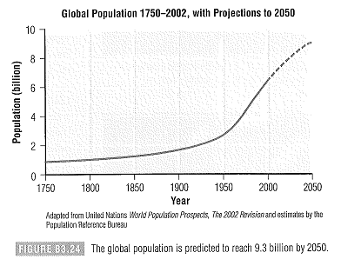
Global population growth
it took about 6000 years for the world population to reach one billion
to go from 6 to 7 billion took less than 10 years

Slide 33
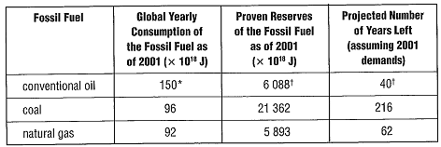
The consequences of our actions
While fossil fuels are still available and relatively inexpensive, there are serious consequences to our current reliance on fossil fuels:
permanent environmental damage
a lack of development of alternative fuels

Slide 34
Cogeneration & sustainability
One initiative that may extend the supply of fossil fuels is cogeneration, the process of using the waste energy from one process to power another
Example: use the waste thermal energy from a power plant to heat nearby businesses
Sustainable development refers to the ability of our generation to meet its energy needs without compromising the needs of future generations

