Slide 1
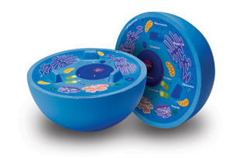
Unit B – Section 2.0
The Cell

Slide 2
C2.1 The cell as an open system
A human muscle cell in the midst of cell division.

Slide 3
Systems
A system refers to a set of interconnected parts
three types, depending on what is exchanged with the surrounding environment
open system – exchanges both matter and energy with the environment (e.g. human body)
closed system – exchanges energy but not matter (e.g. a sealed glass jar)
isolated system – exchanges neither energy nor matter (does not exist in reality)

Slide 4
Systems – practice problems
Practice problem 1:
what type of system would a house be if the windows and doors were open?
what about just the windows?
what if they were both closed?
Practice problem 2:
name two types of matter the human body takes in
food, gases (O_{2(g))}, water
name two types of matter the human body gets rid of
waste, gases (CO_{2(g)})
name a type of energy the human body takes in
chemical energy
name a type of energy the human body produces
thermal energy

Slide 5
A cell as an open system
because it exchanges both matter and energy with its surroundings, the cell would be classified as an open system
Coming in:
oxygen gas
water
nutrients
chemical energy
solar energy (plants)
Going out:
carbon dioxide
water
waste
chemical energy
kinetic energy
thermal energy

Slide 6
Human body vs. cell
Human survival needs & the organ systems that meet those needs:
intake and use of nutrients – digestive
movement & growth – musculoskeletal
response to stimuli – nervous
exchange of gases – respiratory, circulatory
waste removal – excretory
reproduction – reproductive
The cell has tiny organs, called organelles to perform the same set of functions on a smaller scale

Slide 7
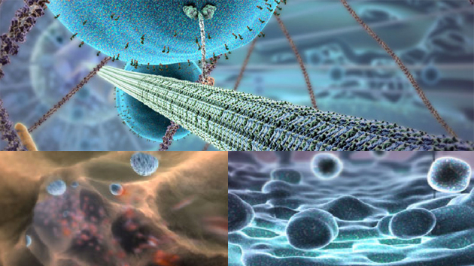
The Inner Life of a Cell

Slide 8
Cell organelles
each organ in your body, (e.g. your heart or lungs) is part of an organ systems (e.g. circulatory, respiratory)
in a similar way, the organelles in your cells can be divided into groups according to major function:
structure and support
control and cell management
storage and transport
protein production
fat production
defense
energy conversion

Slide 10
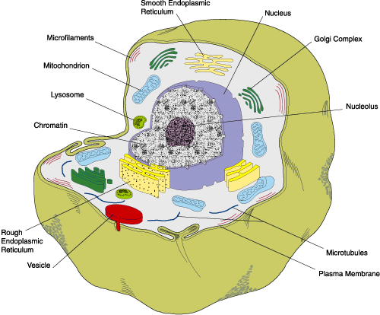

Slide 12
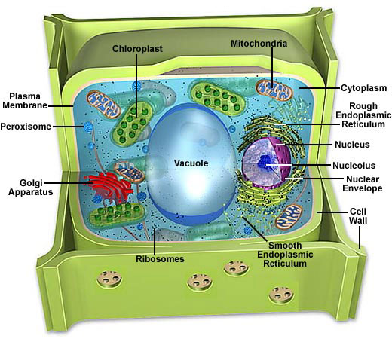

Slide 13
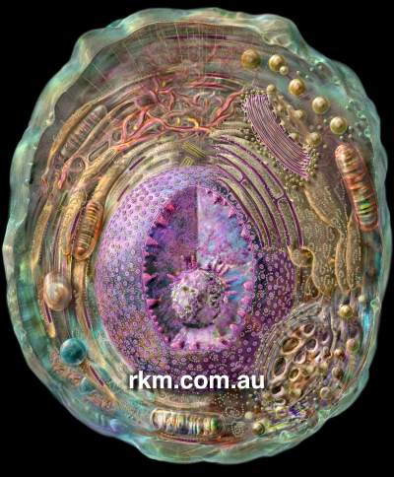
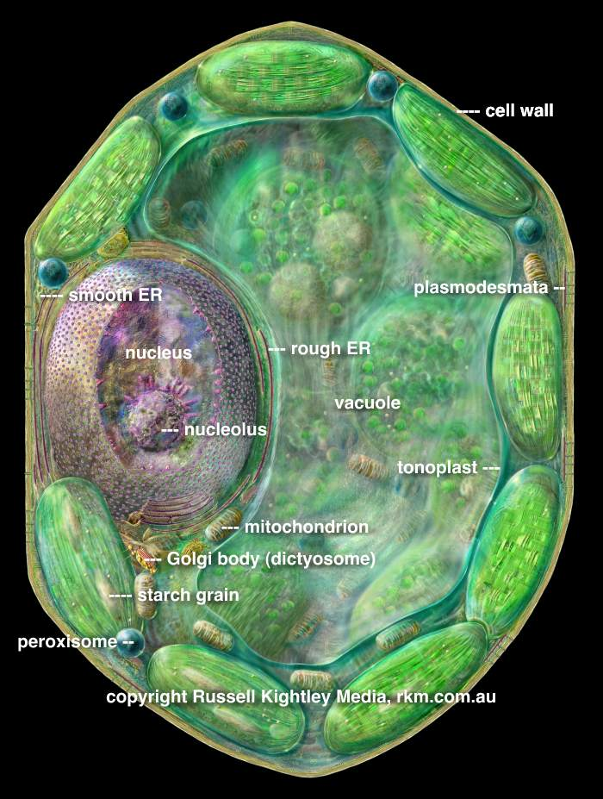
Animal and plant cells

Slide 14
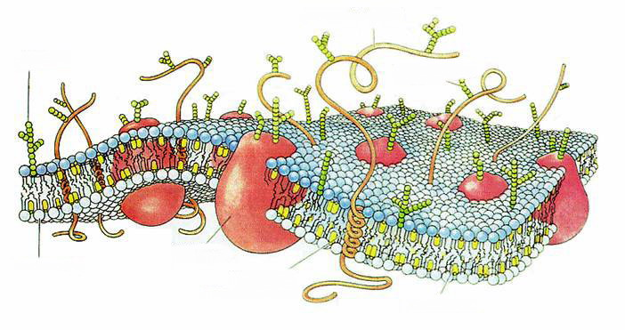
Structure and support
cell membrane
acts as a protective barrier
allows for transport of materials into and waste out of the cell
because its outer layer has receptor proteins, it is important in cell communication

Slide 15
Structure and support
cell wall
found only in plants and bacteria
a rigid frame that gives plant cells strength and support
is part of what allows plants to grow very tall but remain strong

Slide 16
Structure and support
cytoplasm
a gel-like substance that gives the cell structure
the organelles are suspended in the cytoplasm and can move around through the process of cytoplasmic streaming
stores nutrients until organelles are ready to use them

Slide 17
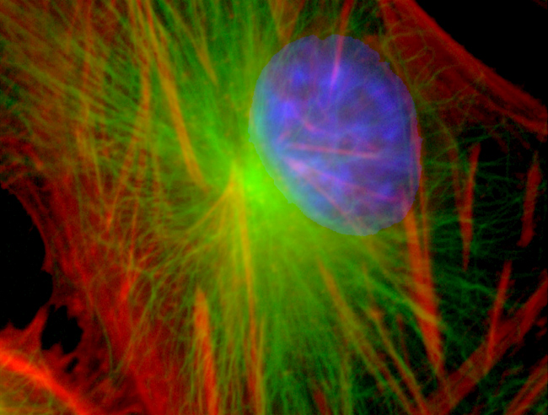
Structure and support
cytoskeleton
filaments inside the cytoplasm that act like a framework
similar to the role that your skeleton plays in your body

Slide 18
Control and cell management
nucleus
contains DNA, the genetic material of the cell
directs all cellular activities, including mitosis
surrounded by the nuclear envelope

Slide 19
Storage and transport
vacuole
membrane-bound structures that store water in plants
turgor pressure makes the plant cell firm (or turgid)
if the vacuole is not full, the cells become weak and the plant wilts

Slide 20
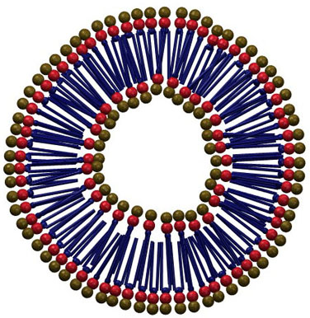
Storage and transport
vesicles
small bubbles with the same structure as the cell membrane
transport substances throughout the cell

Slide 21
Storage and transport
Golgi apparatus
flat discs involved in packaging and transport
receives the products assembled in the ER and transports them out of the cell

Slide 22
Protein synthesis
endoplasmic reticulum
series of tubes branching off the nuclear envelope
rough ER
has a grainy appearance due to the attached ribosomes
responsible for synthesizing proteins
ribosomes
granules attached to the ER
take amino acid building blocks and assemble them into proteins

Slide 23
Fat synthesis
smooth endoplasmic reticulum
has a smooth appearance
takes lipid building blocks and assembles fats (animal cells) and oils (plant cells)

Slide 24
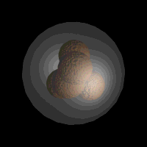
Defense
lysosomes
membrane-bound sacs containing strong digestive enzymes
kill invading bacteria and destroy damaged cell organelles
if a cell malfunctions, its lysosomes will burst and kill the cell before an infection spreads
sometimes called suicide sacs

Slide 25
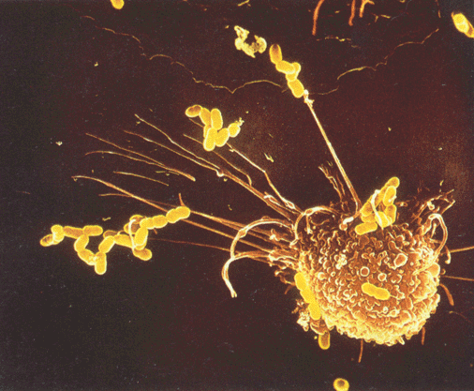
Got defense?
In this electron micrograph, a human white blood cell is trapping bacterial cells.
This type of cell defends the body against pathogens by engulfing them, delivering them to the lysosome of the cells, and destroying them with the help of the lysosomal enzymes.

Slide 26
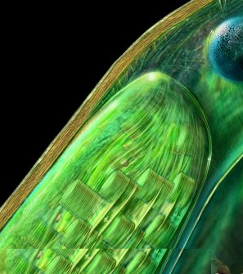
Energy conversion
chloroplasts
found only in plants
contain a green pigment called chlorophyll
site of photosynthesis
converts the sun’s energy into glucose and water

Slide 27
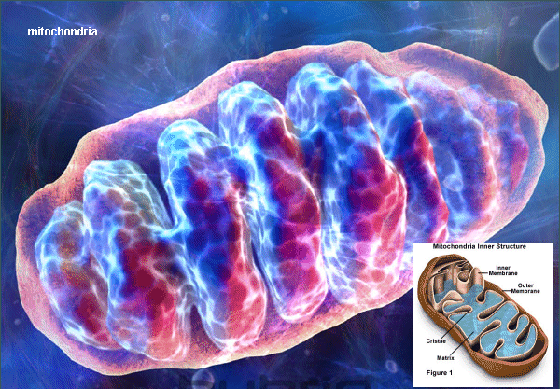
Energy conversion
mitochondria
site of cellular respiration
chemical energy (glucose) is converted into usable energy for the cell
cells with higher energy needs (e.g. muscle cells, sperm cells) are packed with mitochondria

Slide 28
Practice problem
Name five differences between plant and animal cells.
plants have cells walls
plants store energy as starches and oils, animals as glycogen or fats
plant cells have a large central vacuole
animal cells have more mitochondria because their energy needs are higher
Plant cells have chloroplasts & chlorophyll

Slide 29
Chemical composition
all cells are made up of organic compounds, which have carbon as their building block
other common elements found in organic compounds are hydrogen, oxygen and nitrogen
different combinations of these four elements give us four major groups of organic compounds

Slide 30
Four types of organic compound
lipids
fats and oils
carbohydrates
sugars
starches
glycogen
protein
nucleic acids
make up our DNA (deoxyribonucleic acid)

Slide 31
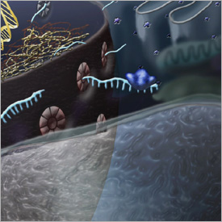
C2.2 – The Role of the Cell Membrane in Transport

Slide 32
Importance of the cell membrane
structure – contains the cell contents
equilibrium (balance) – controls what enters and exits the cell
communication – uses receptor proteins to identify materials and relay messages
protection & defense – recognizes foreign invaders and bars them from entry, or destroys them
transportation – is the barrier through which all material must pass

Slide 33
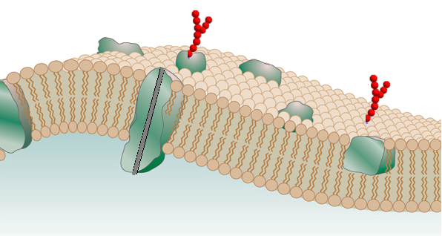
Fluid Mosaic Model
The Fluid Mosaic model is the accepted model for the structure of the cell membrane
fluid, because the membrane is flexible
mosaic, because it is a collection of different substances that are held together

Slide 34
Fluid mosaic model
extracellular fluid (outside of cell)
proteins (help in transport)
sugar molecules (act as receptors)
phospholipid bilayer
cytoplasm (inside of cell)

Slide 35
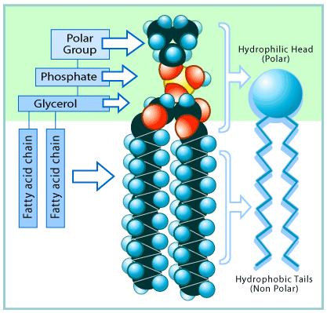
Phospholipid bilayer
“phospho-” = phosphate
“lipid” = fat
“bi-” = two
as the name implies, the membrane is made of two layers of fats that have phosphates attached

Slide 36
Particle model of matter
particles:
include any individual molecules of water, nutrients, waste and gases traveling across the membrane
the particles of a substance are always moving
how far and how fast they move depends on:
the relative concentration of that substance on either side of the membrane
the state of the substance (solid, liquid or gas)

Slide 37
Particle model of matter
solids:
have a definite shape and volume
do not flow or compress readily
have the least amount of motion, mainly only vibrational
liquids:
take the shape of their container, but have a definite volume
do not compress readily but flow readily
have some vibrational, rotational and translational motion
gases:
take both the shape and the volume of their container
highly compressible and flow readily
have the highest amount of motion, mainly translational

Slide 38
Particle model of matter
Four main points:
All matter is made of particles, but they may be different in size and composition
The particles are constantly moving, and move least in solids and most in gases. Heating particles makes them move faster.
The particles of matter are attracted to one another or are bonded together.
Particles have spaces between them, and are typically greatest in gases and smallest in solids.

Slide 40
Concentration gradient
concentration refers to the amount of a substance dissolved in a solvent, usually water
a concentration gradient exists when there is a difference in the amount of solute on either side of a membrane
solutes naturally move down the gradient, which means from an area of high concentration to an area of low concentration

Slide 41
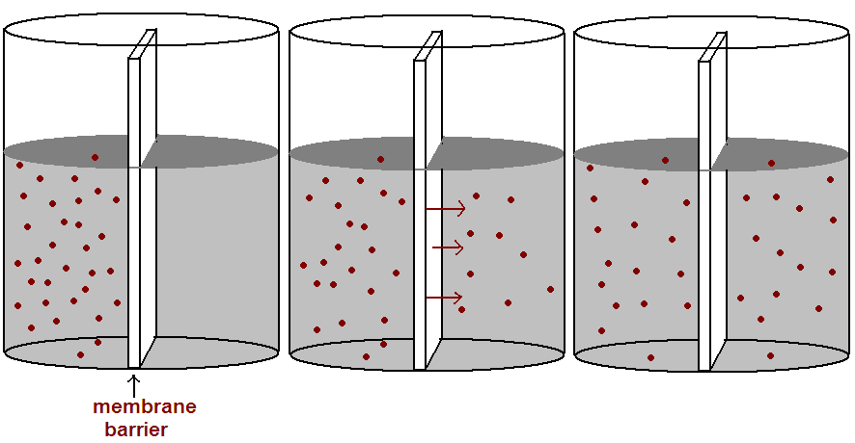
Concentration gradient
concentration gradient exists
solute moves from high area to low area
equilibrium is reached

Slide 42
Particles are always moving
recall, according to the particle model, particles are always in motion
when the concentration of solute is equal on both sides of the membrane, equilibrium is reached
this does not mean that the particles stop; it means the net movement is zero
the same number of particles cross this way → as this way ←

Slide 43
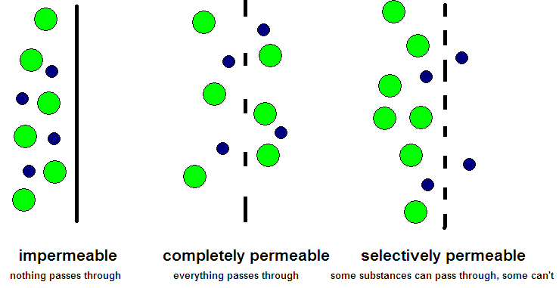
Semi-permeable membranes
the cell membrane is referred to as semi-permeable because it allows some substances to pass through, but not everything
sometimes also called selectively permeable

Slide 44
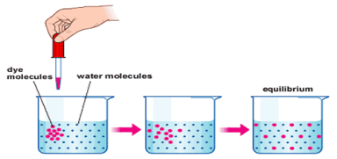
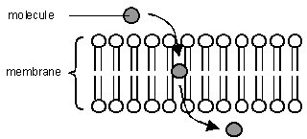
Diffusion
method of transport for molecules that are fat-soluble, or very small molecules like O₂ and CO₂
because these molecules can dissolve or pass right through the barrier, their movement is not restricted by the cell membrane

Slide 45
Diffusion
diffusion is classified as passive transport because it flows down the concentration gradient
passive transport is like floating downstream; it requires no extra energy

Slide 46
Osmosis
another form of passive transport
osmosis is similar to diffusion, except deals solely with the movement of water molecules
osmosis occurs when there is a solute concentration difference, but the membrane is not permeable to the solute

Slide 47
Osmosis
because the solute is not free to move, particles of water will move until the relative concentrations are equal on either side of the membrane
when there is a movement of water, the volume of solution on either side of the membrane changes
this can have an adverse effect on the cell

Slide 48
Tonicity
refers to the concentration of solutes outside the cell, relative to the concentration inside the cell
3 Types:
isotonic solution: concentration inside and outside the cell is equal
when a cell is placed in an isotonic solution, there is no net movement of water in and out of the cell
that means water is flowing in at the same rate at it is flowing out
this cell will appear normal and healthy

Slide 49
Tonicity – isotonic solution
water is flowing in and out in equal amounts
animal cells will appear normal
plant cells will appear slightly limp due to a lack of turgor pressure

Slide 50
Tonicity
hypotonic: the concentration of solutes outside the cell is lower than inside the cell
hypo = “lower”
(e.g. hypothermia = low body temperature)
in an effort to find equilibrium, water will flow from the extracellular fluid (ECF) into the cell
the cell becomes bloated and “overfull” and can eventually rupture (called plasmolysis)

Slide 51
Tonicity – hypotonic solution
water is flowing into the cell faster than it is flowing out
animal cells will appear swollen, and may burst
plant cells will appear turgid, and the plant will appear healthy

Slide 52
Tonicity
hypertonic: the concentration of solutes outside the cell is higher than inside the cell
hyper = “higher”
(e.g. hyperactive = high energy levels)
in an effort to find equilibrium, water will flow from the cell into the ECF
the cell becomes shriveled and dried up

Slide 53
Tonicity – hypertonic solution
water is flowing out of the cell faster than it is flowing in
animal cells will appear shriveled, and may die
plant cells membrane will pull away from the rigid cell wall
as it loses turgidity, the plant will appear wilted and limp
VIDEO (CLICK)

Slide 54
Facilitated Diffusion
the word “facilitate” means “to assist”
facilitated diffusion is diffusion that is helped along by proteins embedded in the cell membrane
it is still a form of passive transport – like floating downstream on a raft
facilitated diffusion is for substances that are water soluble, so they can’t pass through the lipid portion of the membrane

Slide 55
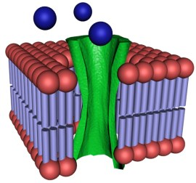
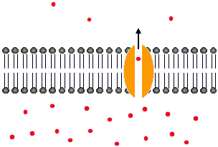
Facilitated Diffusion
two types of proteins assist in this process:
channel proteins
shaped like tubes
form tunnels through the membrane through which the water-soluble molecules can pass

Slide 56
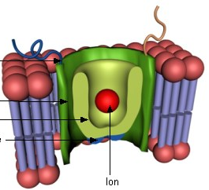
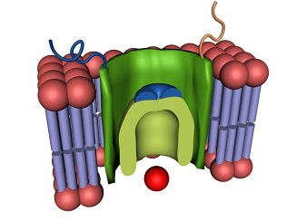
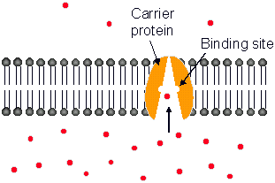
Facilitated Diffusion
carrier proteins
attach to larger molecules that can’t fit through the protein channels
the protein will attach to the molecule on the outside of the cell, then roll over to deposit the molecule inside the cell

Slide 57
Active transport
in some cases, it is necessary for the cell to move molecules against the concentration gradient
it is called active transport because it requires extra work and energy by the cell
like swimming upstream, against the current
it is accomplished by the channel proteins, which pump the molecules from an area of low to high concentration

Slide 58
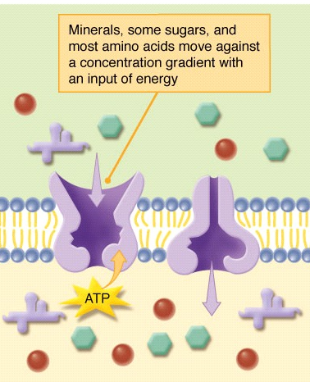
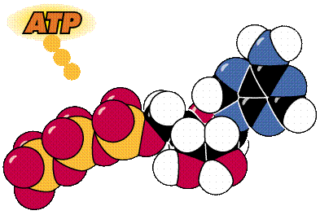
Active transport
the energy that is supplied to the proteins to carry out this task is produced in the mitochondria
created through the process of cellular respiration
this energy is packaged into a substance called ATP (adenosine triphosphate)

Slide 59
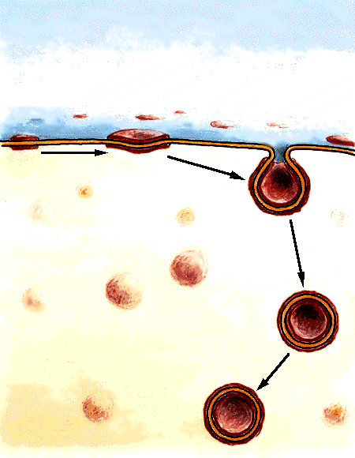
Endocytosis
even with the help of proteins, some molecules are simply to big to fit through the membrane
instead, the cell will use a process called endocytosis
endo = in
cyto = cell

Slide 60
Endocytosis
in endocytosis, a vesicle forms around the solute
the vesicle has the same phospholipid structure as the cell membrane
because it requires rearranging the cell membrane, this process requires ATP

Slide 61
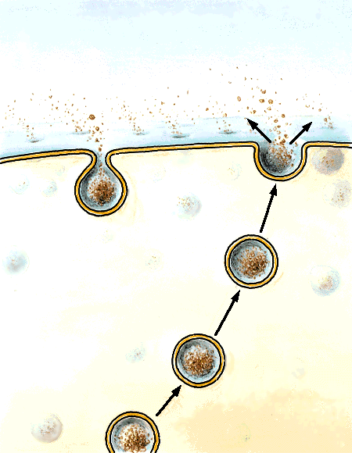
Exocytosis
the reverse of endocytosis (exo = out)
used when a cell needs to rid itself of a large waste product
a vesicle formed by the Golgi apparatus surrounds the molecule and transports it to the membrane
the vesicle merges with the membrane, releasing the molecule into the ECF

Slide 62
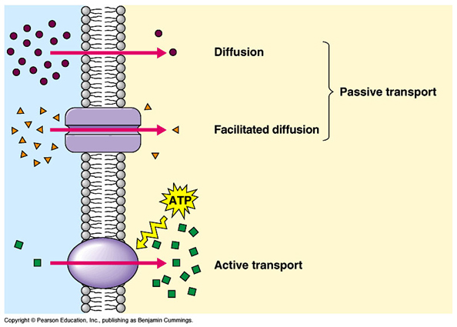
Active & Passive Transport VID
HERE

Slide 64
Complete the following table:
Type of transport | Type of molecule transported? | Requires ATP? | With or against the gradient? | Requires membrane proteins?
Diffusion | Small or fat soluble | No | With | No
Osmosis | Water | No | With | No
Facilitated diffusion | Large or water soluble | No | With | Yes
Active transport | Anything going vs. the gradient | Yes | Against | Yes

Slide 65
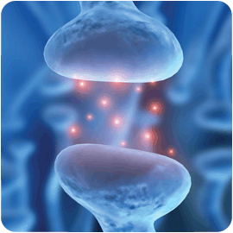
C2.3 - Applications of Cellular Transport in Industry and Medicine
Neurotransmitter chemicals passing from one brain cell to another

Slide 66
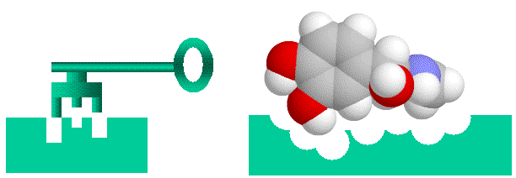
Recognition Proteins
on the outside of the cell membrane, there are sugar and protein complexes called recognition proteins
in order for some substances to enter the cell, they must dock at these receptor molecules first
like a lock-and-key mechanism
if the shape of the molecule does not fit with the receptor, it will not gain access to the cell

Slide 67
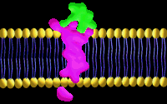
Receptor proteins
in contrast, receptor proteins will bind with the substance and physically move it across the membrane by endocytosis

Slide 68
Receptor proteins
the pharmaceutical industry is interested in these receptor molecules because medication cannot work unless it can get into the cell
the closer the match between the shape of the medication and the receptor molecule, the more targeted the medication can be, and therefore the more effective
for example, new pain relievers that treat migraines instead of providing overall pain relief

Slide 69
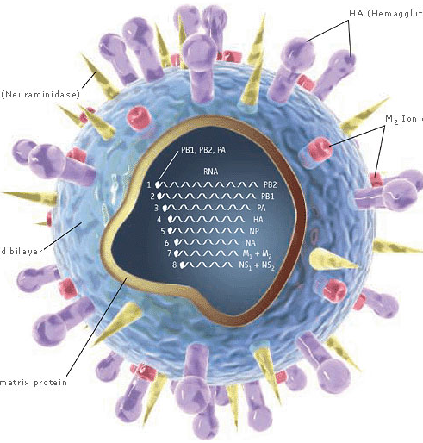
Viruses
some viruses, like HIV, gain access to the cell by mimicking the shape of a harmless substance
they bind to the receptor proteins and “trick” it into gaining access to the cell
by discovering the shape of the viruses protein coat, researchers can produce medication which binds to the virus and blocks it from entering the cell
the reason HIV is so hard to treat is because its protein coat is constantly mutating and changing shape
new research looks at blocking off the receptor proteins on the human cells to cover the “keyhole”

Slide 70
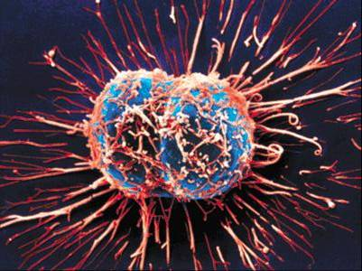
Cancer
common treatments for cancer do not target only the cancerous cells, but target healthy cells as well
new research looks at ways to identify only the cancerous cells and develop drugs specific to the protein coat of the cancerous cells
this would also provide the immune system with a way of recognizing and attacking cancerous cells

Slide 71
Synthetic membrane technology
liposomes
a form of medication that surrounds a fluid-filled sac with a phospholipid bilayer
this mimics a vesicle produced by the cell – the medicine is able to dissolve directly through the cell membrane
liposome medication can be introduced intravenously and are able to deliver the medication much quicker

Slide 72
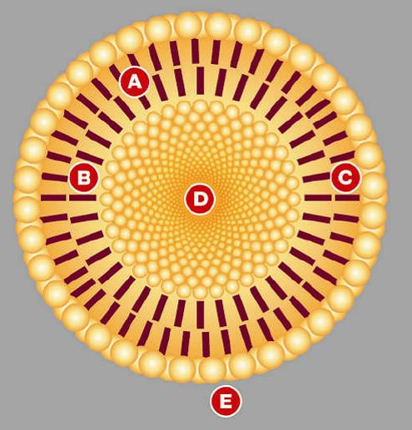
Liposomes
A – phospholipid bilayer
B – inner lipid layer
C – outer lipid layer
D – aqueous core in which medication is dissolved
E – extracellular fluid

Slide 73
Transport of hormones
hormones are chemical messages produced by one part of the body that act on another part
insulin is produced by the pancreas, and acts on all body cells to tell them to pick up glucose for cellular respiration
diabetics are either not able to produce insulin, or it is not properly used by the body
by understanding how hormones are transported and used by cells, diabetes treatments are improved
synthetic insulin can now be produced that mimics the shape of human insulin, as an alternative to pig or cow insulin

Slide 74
Dialysis
dialysis treatments are used by patients who have malfunctioning kidneys
your kidneys filter your blood and remove excess water and waste, which is then removed from the body in the form of urine
when a patient has kidneys that don’t work, their blood needs to be filtered artificially

Slide 75
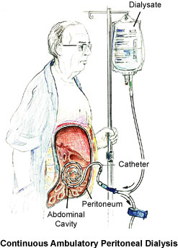
Peritoneal dialysis
a catheter is inserted into the abdominal cavity
a sterile fluid containing water, glucose, and electrolytes is pumped into the cavity
the concentration of waste in the blood is much higher than in the dialysate fluid
nutrients from the fluid diffuse into the blood, and waste diffuses out
the “dirty” fluid is pumped back out of the body and disposed of

Slide 76
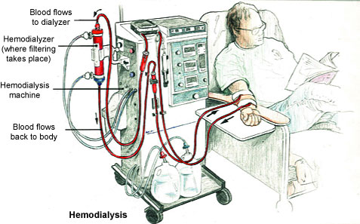
Hemodialysis
a patient’s blood is physically removed from the body, cleaned using dialysate fluid, and returned to the body
this procedure is much more invasive and requires the patient to be in the hospital

Slide 77
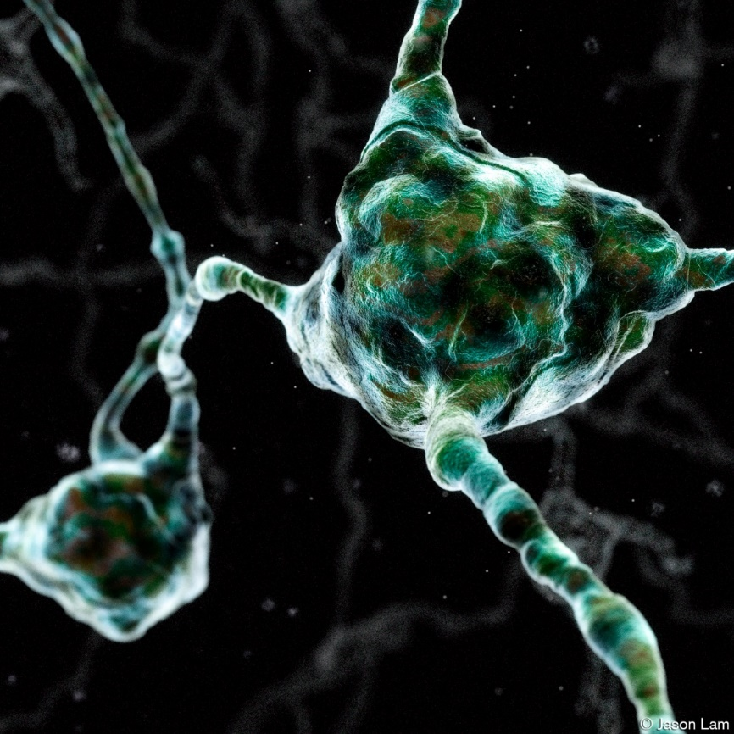
C2.4 – Is bigger better?
The largest known body cell is a giant squid’s neuron.

Slide 78
Questions to answer:
is there a survival advantage for a cell to be large or small?
if a large cell is able to pull in more nutrients through its membrane, why are most cells small?

Slide 79
Surface area
the surface area of a cell refers to the total area of the outside of the cell membrane
a cell with a large surface area will have more membrane in contact with the ECF, so will better be able to pull in nutrients and get rid of waste
calculating surface area involves adding up the area of all sides of the cell
typically we assume cells are cubes or rectangular prisms for ease of calculation

Slide 80
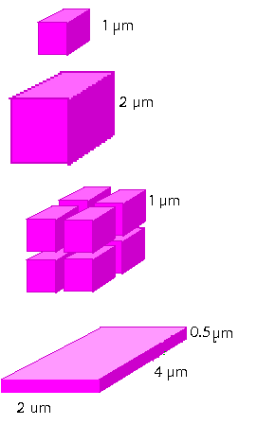
Practice problems
What is the surface area of the following cells?
area of one side: 1 μm x 1 μm = 1 μm²
area of all six sides: 6 x 1 μm² = 6 μm²
area of one side: 2 μm x 2 μm = 4 μm²
area of all six sides: 6 x 4 μm² = 24 μm²
area of one cell: 6 μm²
area of eight cell complex: 8 x 6 μm² = 48 μm²
area of side A: 2 μm x 0.5 μm = 1 μm²
area of side B: 2 μm x 4 μm = 8 μm²
area of side C: 4 μm x 0.5 μm = 2 μm²
two of each side: 2(1 μm² + 8 μm² + 2 μm²) = 22 μm²

Slide 81
Cell volume
the volume of a cell refers to the volume of the contents of the cell
a larger cell has a larger volume, which means larger nutritional needs and greater waste production
to calculate volume, multiply the dimensions of the sides

Slide 82
Practice problems
What is the volume of the following cells?
volume: 1 μm x 1 μm x 1 μm = 1 μm³
volume: 2 μm x 2 μm x 2 μm = 8 μm³
volume of one cell: 1 μm³
volume of 8 cell complex: 8 x 1 μm³ = 8 μm³
volume: 2 μm x 4 μm x 0.5 μm = 4 μm³

Slide 83
Surface area to volume ratio
a larger cell has a larger surface area but also a larger volume
though it can take in more nutrients, it also has higher nutritional needs
though it can get rid of waste faster, it also produced more waste
to predict which cell is favored for survival, you have to look at the surface area to volume ratio

Slide 84
Practice problems
What is the surface area to volume of the following cells?
Which one is most likely to survive?
surface area: 6 μm² volume: 1 μm³
surface area to volume ratio= 6:1
surface area: 24 μm² volume: 8 μm³
surface area to volume ratio= 24:8 = 3:1
surface area: 48 μm² volume: 8 μm³
surface area to volume ratio= 48:8 = 6:1
surface area: 22 μm² volume: 4 μm³
surface area to volume ratio= 22:4 = 5.5:1
the first cell, or the cell complex are most likely to survive

Slide 85
Surface area to volume ratio
generally speaking, a smaller cell will have a better chance of survival due to a higher surface area to volume ratio
however, in multicellular organisms, some cells perform specialized functions that require them to take on a larger size

Slide 86
Maximizing potential
multicellular organisms have several strategies for maximizing their chance of survival
internal transport system
blood in animals and xylem/phloem in plants designed to deliver nutrients to all cells
this reduces the cells’ reliance on diffusion and osmosis

Slide 87
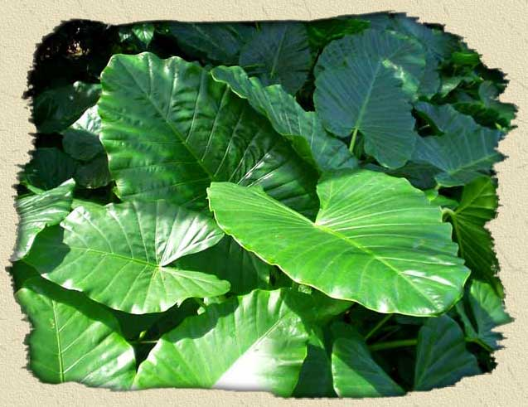
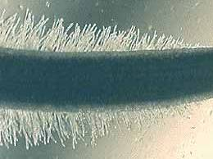
Maximizing potential
specialized structures that increase surface area
plants
in areas where there is lots of sunlight, plant leaves are large and broad to maximize exposure to sun’s rays
root hairs increase surface area of cells in contact with the soil

Slide 88
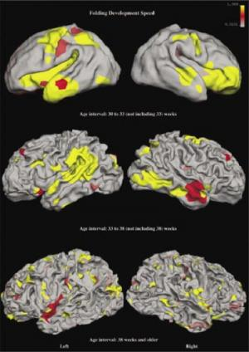
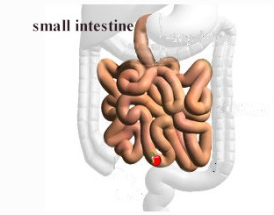
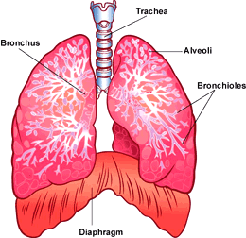
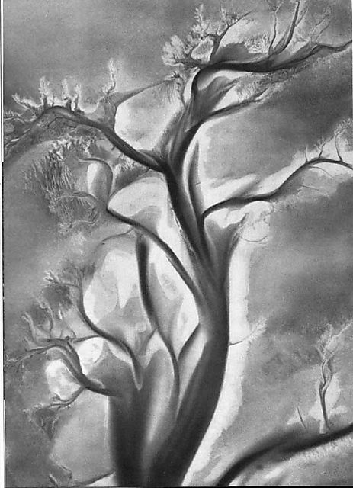
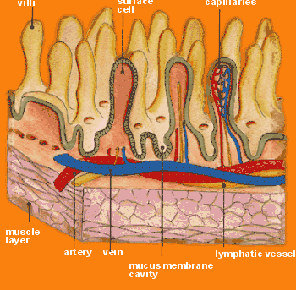
Maximizing potential
animals
brain folding
small intestines
alveoli in lungs

Slide 89
Example #1
Calculate the surface area:volume ratio
Side length: 1.0 cm
Area of each side: 1.0 cm x 1.0 cm = 1.0 cm²
Surface Area: 1.0cm² x 6 sides = 6.0cm²
Volume: 1.0cm x 1.0cm x 1.0cm = 1.0cm³
Answer: 6.: 1

Slide 90
Example #2
Surface Area: Volume for a cube:
Each side is 2.5 cm
Area: 2.5cm x 2.5cm = 6.25cm²
6 sides x 6.25cm² = 37.5cm²
Volume: 2.5cm x 2.5cm x 2.5cm = 15.63cm³
Answer = 38 : 16 reduce it = 19: 8

Slide 91
Example #3
Surface Area: Volume for a cube:
Each side is 4.0 cm
Area: 4.0cm x 4.0cm = 16cm²
6 sides x 16cm² = 96cm²
Volume: 4.0cm x 4.0cm x 4.0cm = 64cm³
Answer = 96 : 64 reduce it = 3 : 2

