Slide 1
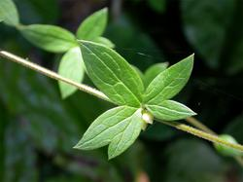
Science 10 – Unit C BIOLOGY
Chapter 3 - Plants

Slide 2
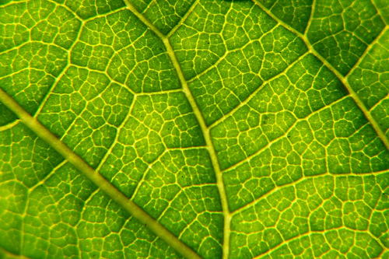
C3.1 Cells, Tissues, and Systems

Slide 3
Chapter 3: Learning Outcomes
By the end of this section you should be able to…
describe why multicellular organisms need a level of organization to survive
describe how leaf cells of plants have specialized structures and functions
explain the gas exchange system in plants
explain the transport system in plants
describe phototropism and gravitropism

Slide 4
Cells, Tissues, and Systems
In all living systems, co-operation ensures that needs are met, that all cells:
get required nutrients
convert available energy into a useable form
have the ability to divide
get rid of waste

Slide 5
Unicellularity vs Multicellularity
Unicellular Organisms
All life processes occur in a single cell
Large surface area to volume ratio
Short life
Multicellular Organisms
Contain specialized cells that perform special functions
tissues,
organs,
organ systems
Small surface area to volume ratio
Longer life

Slide 6
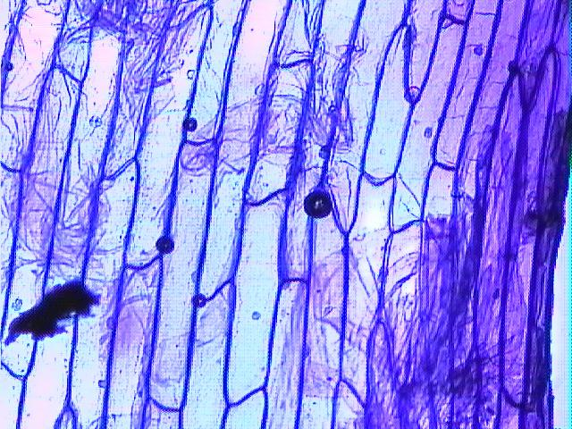
Plant Organization
Like animals, plants have an organization
Cells - perform a specific job
Tissues - group of specialized cells working together
Organs - tissues contributing to the same function
Organ System - group of organs working together

Slide 7
Practice problems:
Put these terms in order from smallest (most specific) to largest (least specific)
lungs, bronchiole, mitochondria, respiratory system, lung cells
mitochondria → lung cell → bronchiole → lung → resp. system
leaf cell, chloroplasts, palisade tissue, shoot system, leaf
chloroplast → leaf cell → palisade tissue → leaf → shoot system
in each example above,
what is the organ?
what is the organ system?
what is the tissue?
lung/leaf, respiratory system/shoot system, bronchiole/palisade

Slide 8
Plant Organ Systems
Plants have two organ systems
The shoot system:
includes stem, leaves, buds, flowers and fruits
also includes tubers
contains photosynthetic organs that absorb CO₂ and release O₂

Slide 9
Plant Organ Systems
Plants have two organ systems
The root system:
everything underground
also includes aerial roots
absorbs water and minerals from the soil

Slide 10
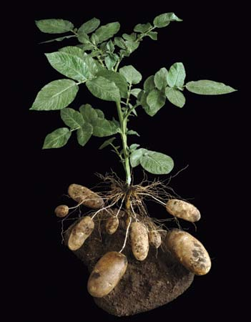
Practice problem:
Put the letter S next to any part of the plant that is part of the shoot system, and R for the root system
S
S
S
S
R
S
S
R
R

Slide 11
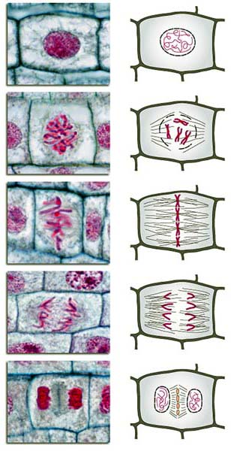
Plant Growth
Plant cells divide for new growth and to repair damage
mitosis: process of cell division where one cell divides into two cells
unlike in animal cells, mitosis in plants requires growing a new section of cell wall to divide the two cells

Slide 12
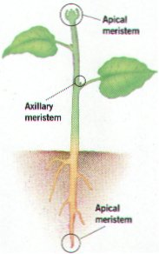
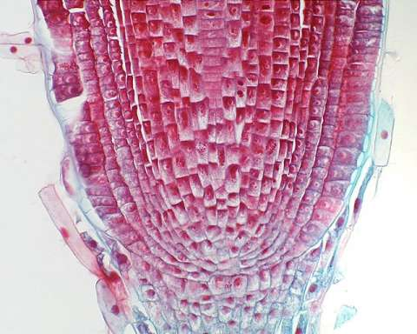
Plant Growth
Cell division occurs in growth areas called meristems.

Slide 13
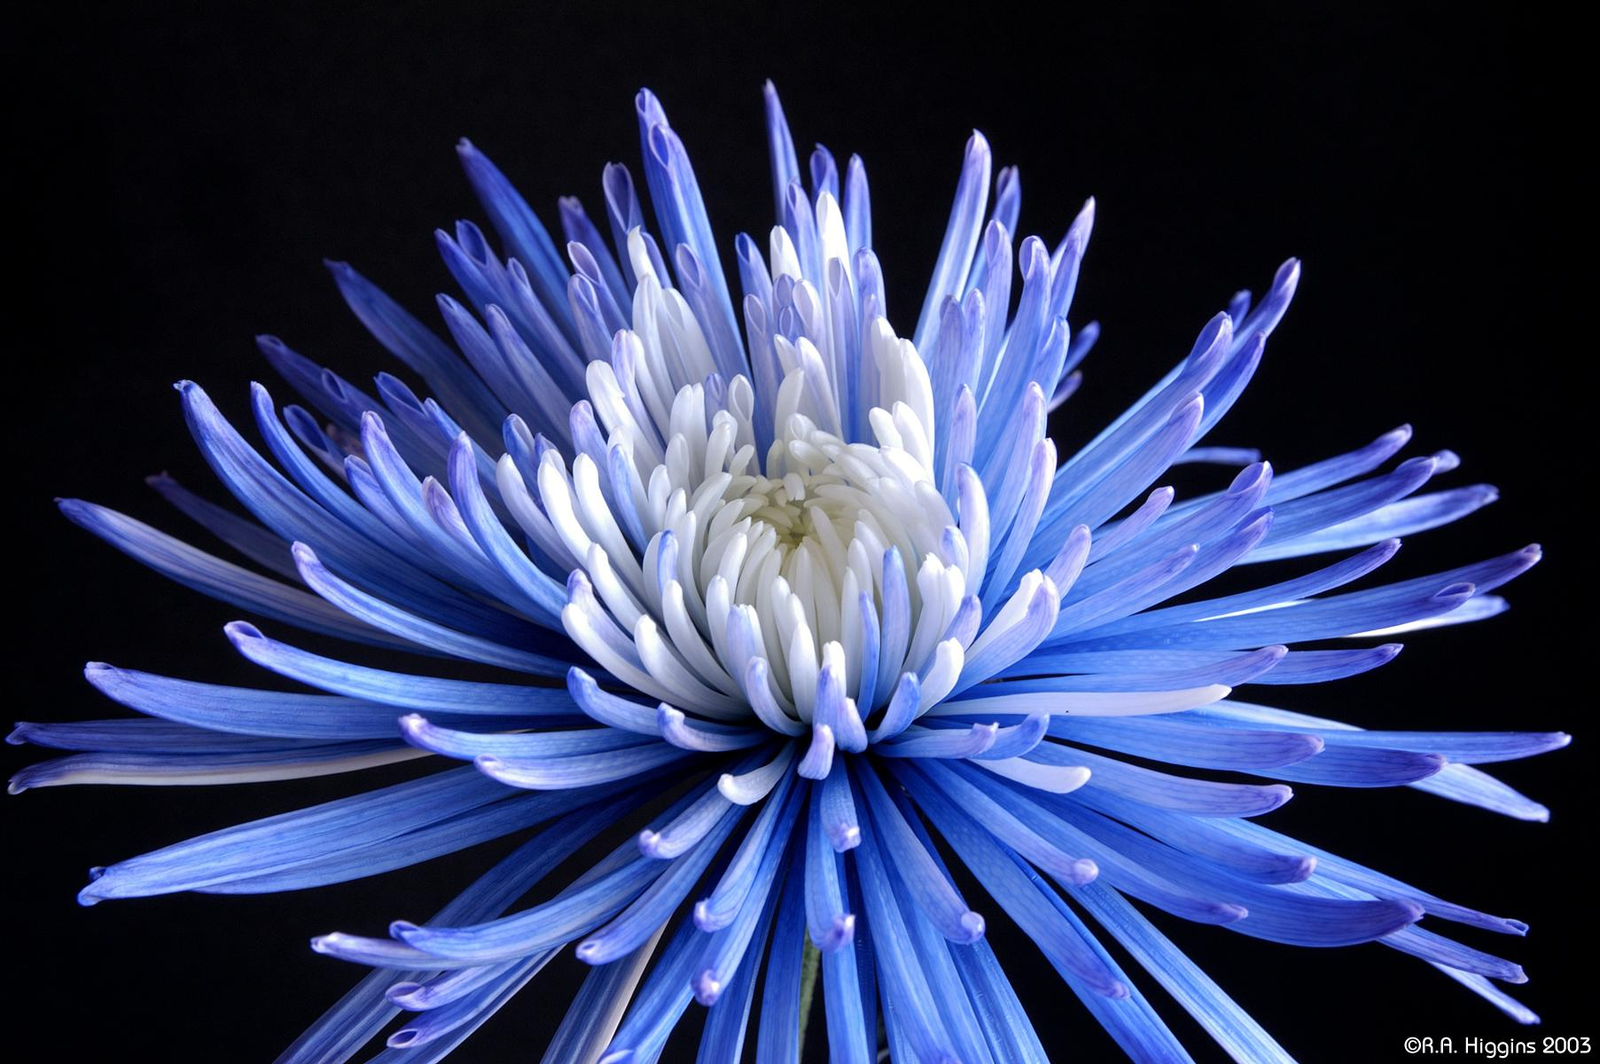
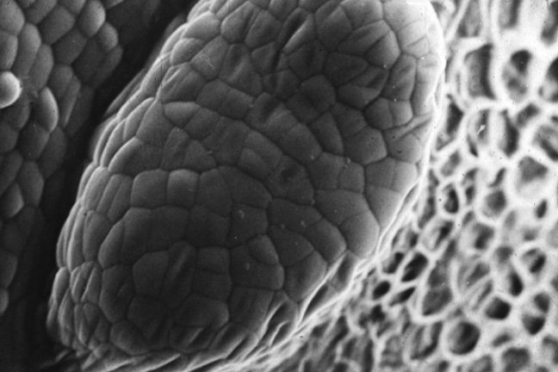
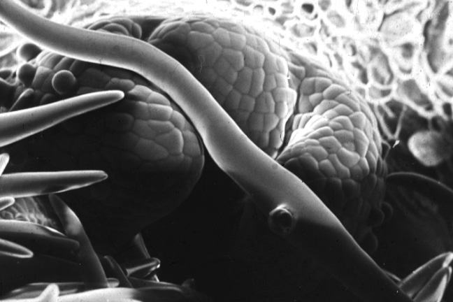
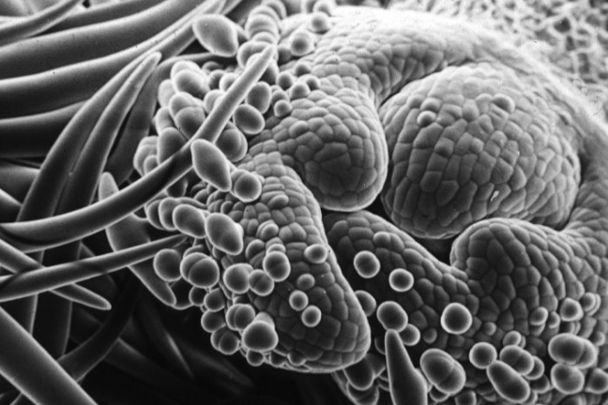
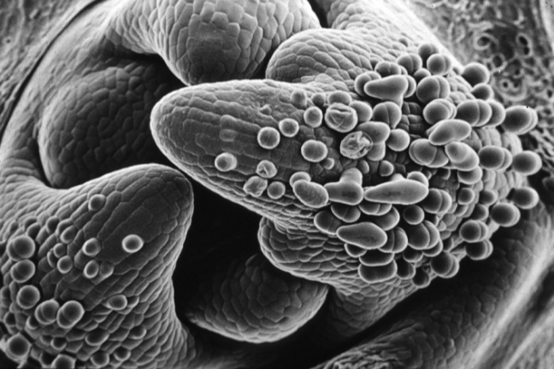
Plant Growth
when new cells are produced in the meristems, they have the potential to become any specialized cell in that organ system

Slide 15
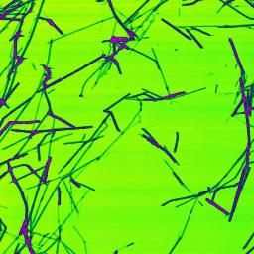
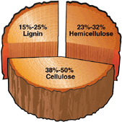
Plant Structure
Plants contain materials which give them strength and support
cellulose gives plant cell walls structure
lignin is another supportive material found in plants
newsprint made from trees with a high lignin content, and it is the lignin that it is responsible for the yellowing of newsprint over time
high quality, bright white paper has had the lignin removed from the pulp

Slide 16
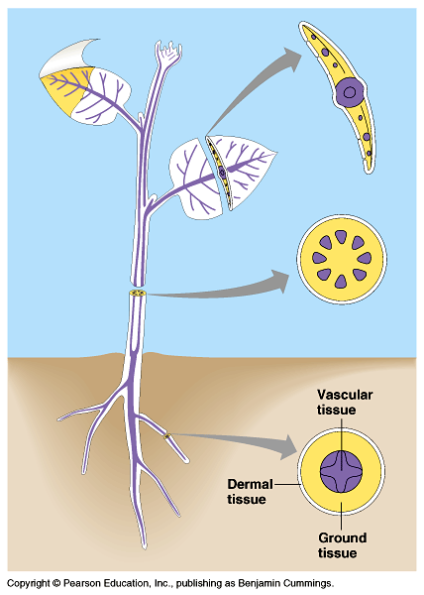
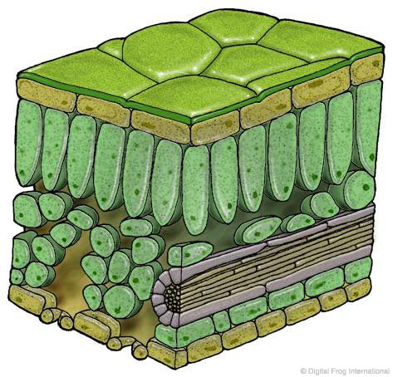
Plant Tissues
Three main types of plant tissue…
Dermal tissue
Ground tissue
Vascular tissue

Slide 17
Plant Tissue
Dermal tissue (epidermis)
found on the outside of herbaceous plants (non-woody)
one cell thick
produces a cuticle: a waxy covering to protect the plant from water loss and insect attack
involved with matter and gas exchange

Slide 18
Plant Tissue
Ground tissue
layer beneath the epidermis
responsible for photosynthesis and food & water storage
makes up most of the body of the plant
some cells are tightly organized along the surface to gain access to sunlight for photosynthesis
some cells are loosely packed to allow for storage of gases

Slide 19
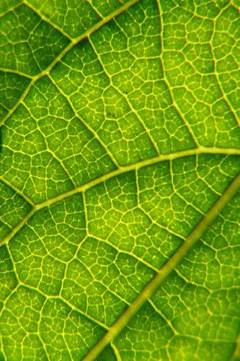
Plant Tissue
Vascular tissue
responsible for the transportation of materials
Xylem: moves water and dissolved minerals from the roots up to the rest of the plant
Phloem: distributes sucrose and other sugars from the leaves to the rest of the plant
vascular bundles are visible as the veins on the underside of a leaf

Slide 20
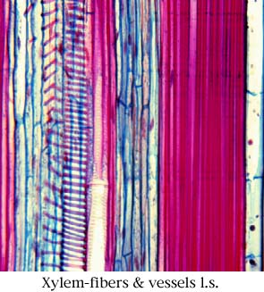
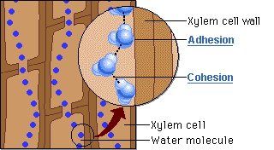
Vascular Tissue
Xylem tissue: moves water and dissolved minerals
movement from roots to stem and leaves
transports water and nutrients for photosynthesis
made of long individual cells which grow holes at each end and fuse together like a long straw
xylem cells die, but leave their cell walls intact, forming a transportation network

Slide 21
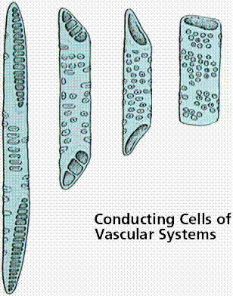
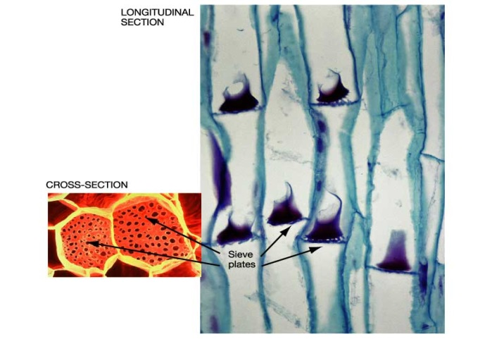
Vascular Tissue
Phloem tissue: moves dissolved sugars (food)
formed with long individual sieve tube cells
perforated ends and sides to allow transfer of nutrients by osmosis
companion cells located in the phloem tissue use ATP to move and transport nutrients
from the source (leaves)
to the sink (other parts of the plant)

Slide 22
Vascular Tissue
Cambium: a single layer of cells in the tree’s trunk that produces the new wood and bark

Slide 23
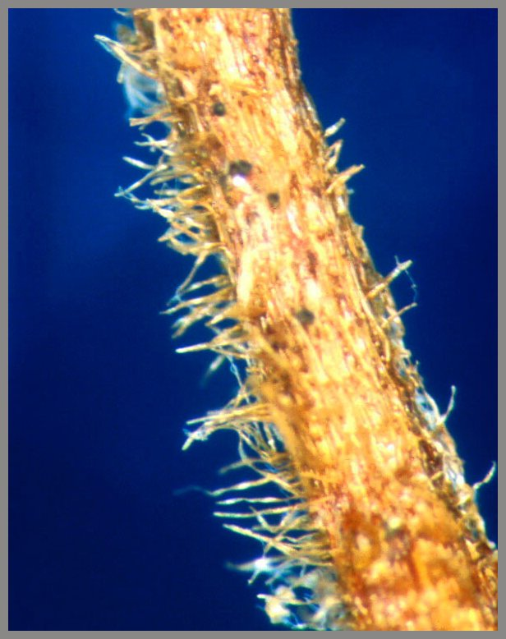
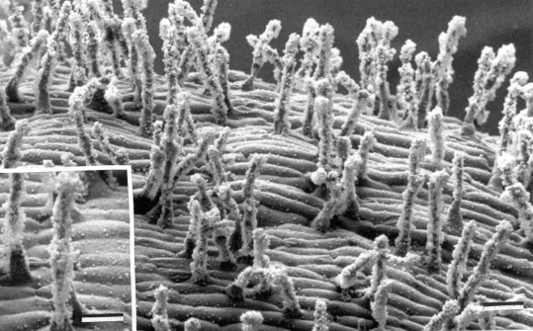
Specialization in Plant Cells
Specialized cells make products that are needed for them to perform their function
Example 1:
cells in the root system are responsible for absorbing water and minerals
these cells grow tiny hairs called root hairs to maximize surface area.

Slide 24
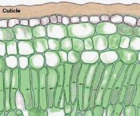
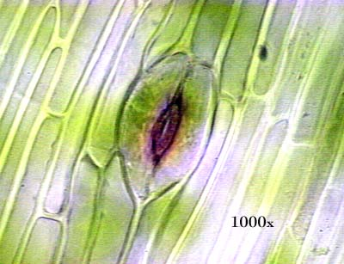
Specialization in Plant Cells
Example 2:
dermal cells produce a cuticle to protect the plant from water loss and insect attack
Example 3:
guard cells form tiny pores called stomata on the underside of plant leaves
formed from the plant’s lower epidermis
stomata are involved in gas exchange

