Slide 1
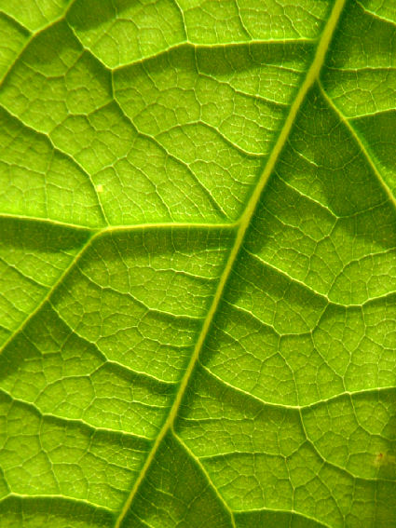
3.3 Leaf tissues and gas exchange

Slide 2
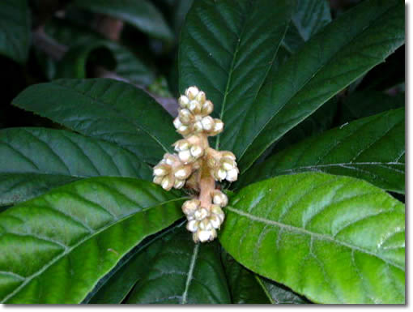
Leaf Tissues and Gas Exchange
With a waxy cuticle, how do the cells inside the plant get air?
Plants have specialized cells which allow more efficient gas exchange within the leaf called guard cells which surround the stomata

Slide 3
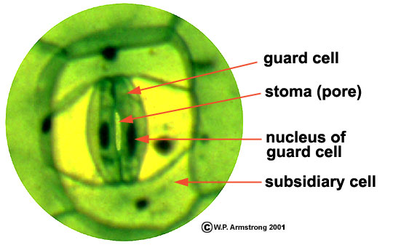
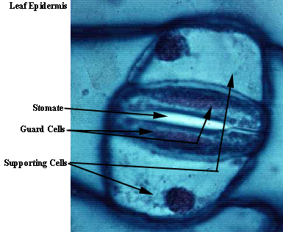
Entry of gases into the leaf
Air enters plant cells through passive diffusion
Guard cells open into ground tissue to allow for efficient gas exchange
Movement of gas depends on the concentration gradient

Slide 4
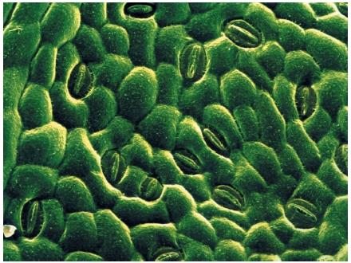
Stomata
singular = stoma
The majority of stomata on a leaf are found on the underside of the leaf
Depending on conditions the guard cells will open or close
stomata must be open in order for gas exchange to occur
however, open stomata also allow for loss of water through the open pores
proper regulation of opening/closing is important for the survival of the plant

Slide 5
Opening the stoma
light hits the top of the leaf
this stimulates potassium ions (K⁺) ions to enter the guard cell by active transport
there is now a higher concentration of K⁺ ions inside the cell
the cell is in a hypotonic solution

Slide 6
Opening the stoma
water from the ECF floods into the cell by osmosis
cells become turgid, which causes them to change shape and form an opening
the stoma is now open

Slide 7
Closing the stoma
when sunlight is no longer available, K⁺ is no longer pumped by active transport
K⁺ diffuses back out of the guard cells along the concentration gradient

Slide 8
Closing the stoma
with more K⁺ ions in the ECF, the guard cells are now in a hypertonic solution
water flows out of the guard cells by osmosis
the cells lose turgor pressure, become limp, and close the stoma

Slide 9
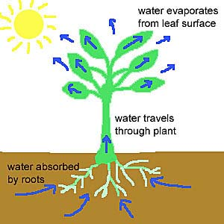
Transpiration
Stomata allow for easy movement of gases but also protect plant from water loss
Plants need water because…
it is one reactant in photosynthesis
all gas in the leaf is absorbed into the cells by dissolving in a thin film of water
this thin film of water causes plants to lose water vapor
this water loss is called transpiration

Slide 10
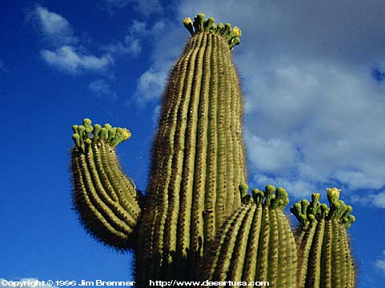
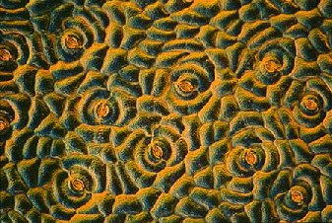
Adapting to environmental conditions
Stomata are sensitive to environmental conditions
Plants that live in hot, dry climates have adapted to having fewer stomata
Plants in environments with little carbon dioxide have adapted by keeping stomata as wide open as they can and for long periods of time

Slide 11
Adapting to environmental conditions
other adaptations plants can make:
colour
plants in tropical climates tend to be dark green, due to an abundance of chlorophyll
leaf size
plants in tropical climates also have big broad leaves, and grow tall to maximize sun exposure
plants in very dry climates have small, specialized leaves called needles
cuticle
plants in dry climates have a very thick cuticle to reduce the amount of water loss

Slide 12
Ground tissue
recall, the ground tissue is located between the upper and lower epidermis
two types of cells in the ground tissue
Palisade tissue cells
found directly below upper epidermis
long, rigid rectangular cells tightly packed together (maximizes number of cells in contact with the sun)
responsible for photosynthesis
Spongy mesophyll tissue
between palisade tissue cells and lower epidermis
loosely packed with space in between
maximizes diffusion of gases

Slide 13
Lenticels
While most gas exchange occurs through the stomata, openings through the bark of woody plants also allow entry of gases
these “slashes” on the tree bark are called lenticels

