Slide 1
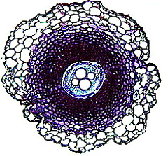
3.4 Transport in plants
cross-section of a fern stem

Slide 2
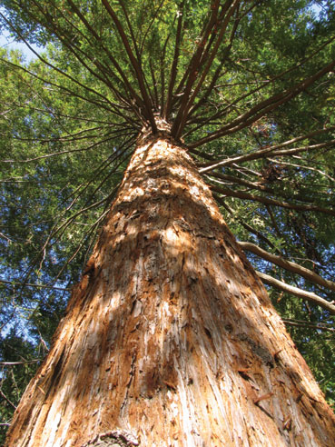
The challenge:
The tallest tree recorded is a Redwood tree in California, measuring over 115m (= a 42 storey building)
How can such a large tree transport water from its roots up into its top branches?
We might guess it costs the tree a lot of energy!

Slide 3
Transport in plants
We have already learned about transport mechanisms which help move water in a plant
Osmosis
Diffusion
Active Transport
Transpiration
We can now put all the pieces together to get a clearer picture of material movement in plants

Slide 4
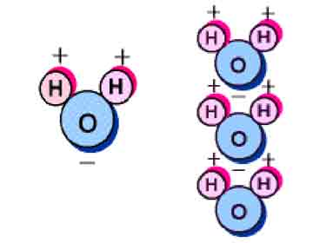
Polarity of water
plants act as pumps to deliver water from the roots to the leaves
the properties of water help plants use it efficiently
recall, water is a polar molecule
the hydrogen end is slightly positive
the oxygen end is slightly negative

Slide 5
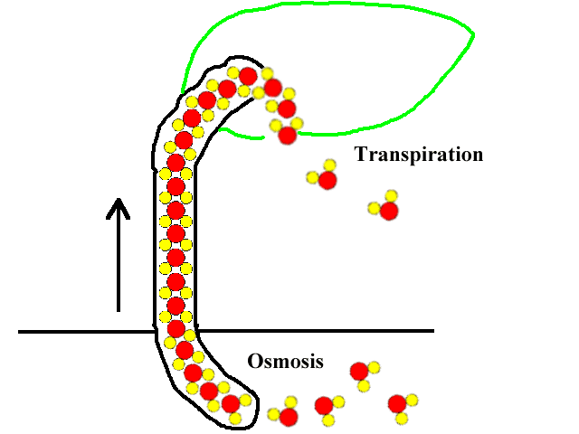
Cohesion
water molecules are attracted to each other
when one water molecule rises up the xylem tube, it pulls other water molecules with it

Slide 6
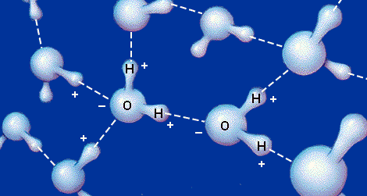
Adhesion
Since water is polar, it attracts itself to molecules of other substances.
water molecules “stick” to other substances.
this called adhesion
in a plant the water molecules would adhere to the walls of the xylem

Slide 7
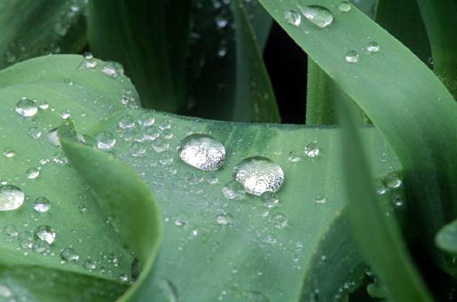
Cohesion and adhesion
it is these two forces together that allow water to stay in much larger droplets compared to non-polar substances

Slide 8
Root pressure
Plants actively transport minerals into the root cells
as a result, the root becomes hypertonic to its surroundings, causing water to follow
the water moving into the roots creates root pressure
as water moves into the roots, it pushes other water molecules up the xylem tube
This can be tested by cutting a plant and seeing the water seep up into the cut of the stem

Slide 9
Transpirational Pull
as water evaporates out of the leaves by transpiration, it leaves an empty space behind it
new water molecules will rush up to fill the void
transpiration pull refers to the pulling of water molecules up the plant by the vacuum created by transpiration
this pull is primarily responsible for bringing water from the xylem into the ground tissue
Transpiration depends on temperature; high temperatures increase transpiration

Slide 10
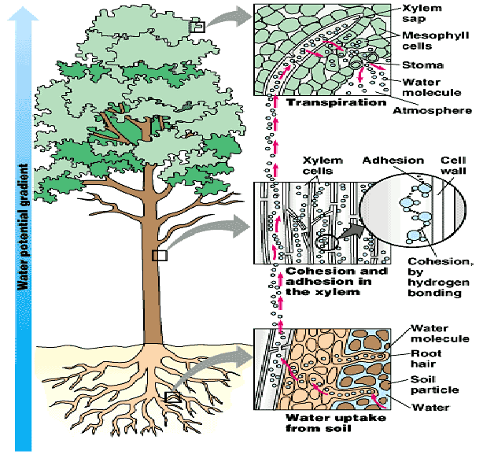
Summary of the four forces
cohesion
adhesion
root pressure
transpirational pull

Slide 11
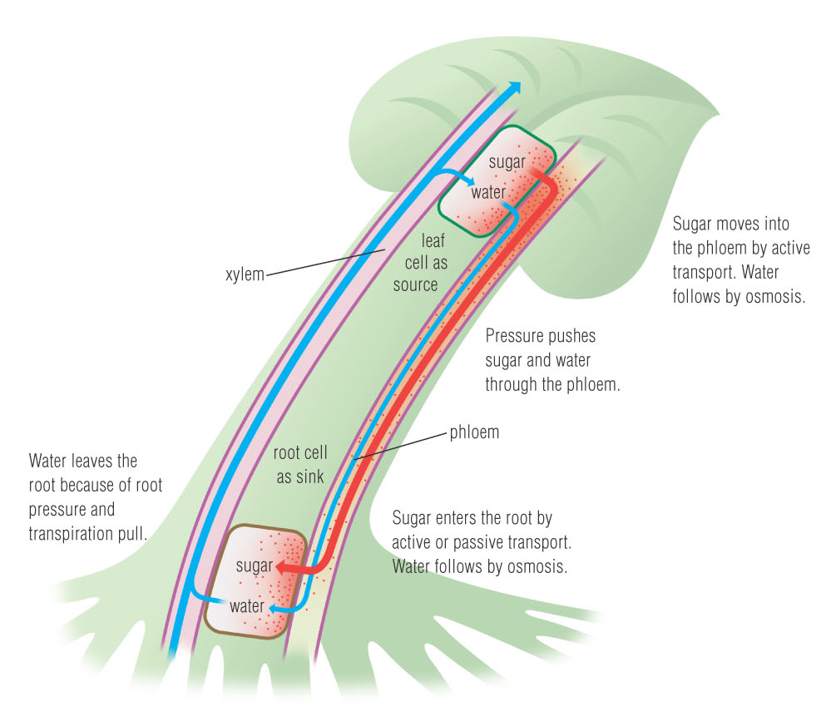
Movement of sugar in plants
Sugar is produced in the leaves - the source
Sugar must move in the plant to a place where it will be used or stored - the sink
The movement of materials in and out of the phloem is called the pressure-flow theory

