Slide 1
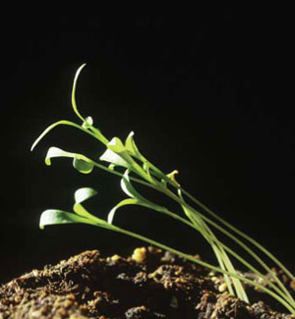
3.5 Control systems in plants

Slide 2
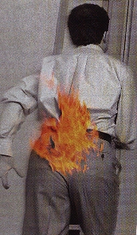
Can plants respond to their environment?
As humans, we can respond to stimuli in our environment.
A stimuli is a change in the environment which creates a response within an organism
What about plants? Can they respond to their environment?
How do they know they know what direction their roots should go?
How do plants grow up toward the light?

Slide 3
Phototropism
plants need to carry out photosynthesis to survive
In order for plants to be successful, they must be efficient at gathering the materials necessary for photosynthesis
though not strictly a reactant, sunlight is one necessary ingredient in photosynthesis
phototropism refers to the tendency of a plant to grow toward the light
photo = light; tropism = response to stimuli
stems show positive phototropism because grow toward the light
roots show negative phototropism because they grow away from the light

Slide 4
Darwin’s experiment on phototropism
Charles Darwin was a scientist best known for his theory of evolution
another important discovery Darwin made was in relation to phototropism
together with his son Francis, Darwin set out to discover what part of the plant was responsible for positive phototropism
he did this by setting up five different trials

Slide 5
Darwin’s experiment on phototropism
Trial 1: the control
the plant in trial one was not altered in any way
this gave Darwin something to compare the other trials to
it also ensured that all the plants had the necessary conditions to grow at all
Result: the plant bent toward the light

Slide 6
Darwin’s experiment on phototropism
Trial 2: tip removed
suspecting that it was receptors in the stem responsible, Darwin removed the tip of the 2nd plant
Result: the plant did not bend

Slide 7
Darwin’s experiment on phototropism
Trial 3: tip covered with opaque cap
to test if the plant was simply damaged by removing the tip, Darwin performed a third trial
this time, the tip was covered by an opaque (non-transparent) cap
Result: the plant did not bend

Slide 8
Darwin’s experiment on phototropism
Trial 4: tip covered with transparent cap
to test if the plant bending was hindered by the cap, Darwin covered the next plant’s tip with a transparent cap
Result: the plant bent toward the light

Slide 9
Darwin’s experiment on phototropism
Trial 5: base covered by shield
lastly, Darwin needed to verify that it was only the tip, and not the entire stem responsible for phototropism
to test this, he covered the base of the plant with an opaque shield
Result: the plant bent toward the light

Slide 10
Darwin’s conclusions:
the Darwins concluded that
phototropism occurred most in the cells in the tip of the plant, which could most readily access the sun’s energy
these cells were somehow communicating with the cells in the area of bending

Slide 11
Practice problem:
In Darwin’s experiment:
identify the manipulated variable
identify the responding variable
identify four controlled variables (controls)

Slide 12
Boysen-Jensen’s experiment
though the Darwins had identified the cell’s tip as the photoreceptor, the actual mechanism for the bending was still unknown
in 1913, Peter Boysen-Jensen investigated how the tip and the seedling communicated

Slide 13
Boysen-Jensen’s experiment
Boysen-Jensen snipped off the tip of the seedling and paint gelatin on the end, then put the tip on - the seedling followed the light
He then snipped the tip and placed a piece of thin mineral called mica in-between the tip and the seedling - no phototropism was observed
Peter Boysen-Jensen hypothesized that whatever was responsible for communicating between the tip and the seedling must be able to diffuse through gelatin but not mica

Slide 14
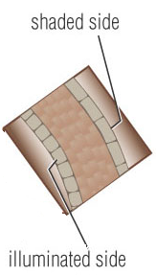
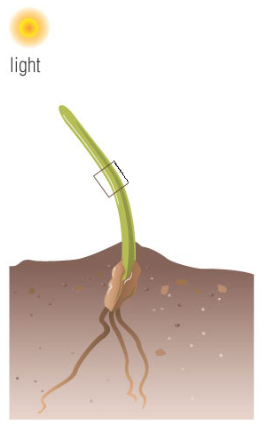
Area of elongation
the area of the plant which bends toward the light was called the area of elongation because the cells on the “dark side” of the stem became longer, causing the plant to bend

Slide 15
Auxin
In 1926, F.W. Went isolated the substance that was responsible for communication of phototropism responses
The substance was called auxin, a hormone which is produced in a plant and then transported to cells which elongate upon its contact

Slide 16
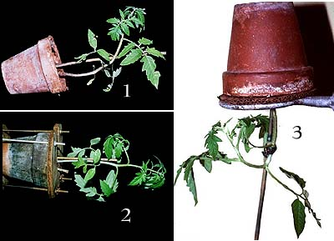
Gravitropism
Plants also respond to another stimulus: gravity
direction of plant growth in response to gravity is called gravitropism
Stems show negative gravitropism because they grow against gravity
Roots show positive gravitropism because they grow downwards

Slide 17
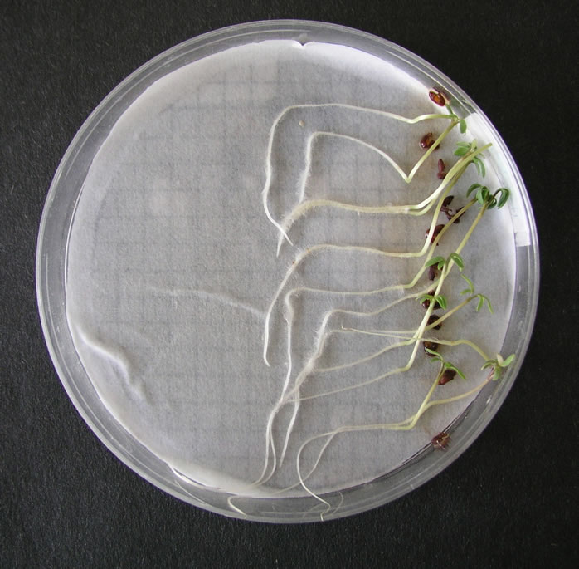
Mechanisms of gravitropism
Scientist believe that plants rely on heavy starch particles as an indicator of gravity
If a plant is knocked over – the starch grains shift and settle in a new location
after movement is detected, then a growth response results
in this picture, the dish was turned a 90º turn to the left, then a 90º turn to the right a few days later

Slide 18
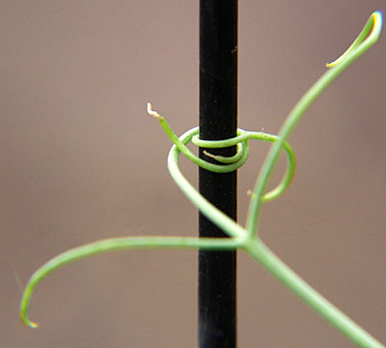
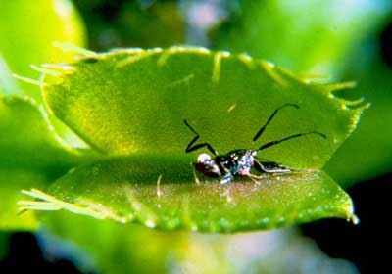
Other controls
Response to touch
some plants have the ability to respond to touch
e.g. a pea plant responds to a rough surface by anchoring itself, allowing it to climb
e.g. a Venus fly trap closes when it registers the presence of an insect

Slide 19
Other controls
response to light availability
e.g. Poinsettias actually respond to long periods of darkness by blooming

