Slide 1
Unit D
Energy flow in Global Systems

Slide 2
ECOLOGY
A study of Life on Earth

Slide 3
What is this unit about?
How does climate affect the species of Earth
What is the biosphere? What are the different parts of it?
How is energy transferred through the atmosphere
What are different biomes in the world
climatographs
Climate change is a “hot” topic – how do we know what we know and why are we worried?

Slide 4
LIFE ON EARTH
All life on earth is part of a “system”.
System
- objects, organisms, processes or things that have some ​ relationship or influence on each other.
Open system: a system which continuously interacts with its environment.
Closed system: a system that exchanges energy (heat & work) but not matter with its surroundings.
Isolated system: a system that cannot exchange either energy or matter with its surroundings.
Subsystem
- part of a system that performs tasks to ensure the whole system ​ operates properly.
The system that represents life on earth is called the “BIOSPHERE”.

Slide 5
Biosphere
- the totality of regions of the earth, soil, and sky that support life.
- a relatively thin layer of the Earth,
has the conditions suitable for supporting
life.

Slide 6
Subsystems of our biosphere are called “ECOSYSTEMS”.
Ecosystem
– group of living organisms and their environment that form a self regulating subsystem of the biosphere through which energy flows.
Examples: a pond, an island, the prairies, rain forests
Systems depend on energy. Energy in our biosphere flows in and ​flows out.

Slide 7
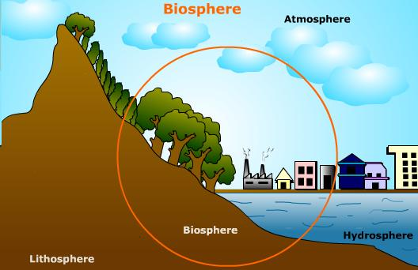
Earth-Our Biosphere
subdivided into three components that interact:
Atmosphere – layer of gases that surround the Earth
Lithosphere – a.k.a. Earth’s crust – the solid portion off the Earth (includes the land under the oceans)
Hydrosphere – all the water on Earth (includes liquid, vapour and ice)

Slide 8
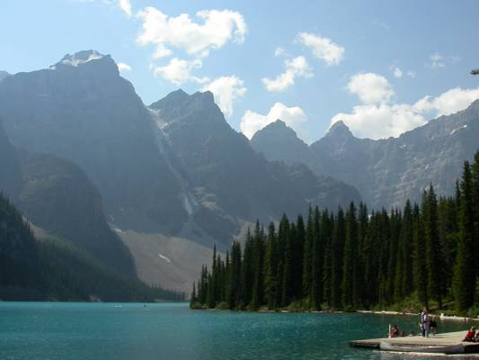
Weather and climate result from interactions between the different parts of our biosphere.
BIOSPHERE: the parts of earth that have the conditions suitable for supporting life. It is made up of three parts.
ATMOSPHERE: air
ENERGY FROM THE SUN
LITHOSPHERE: earth
HYDROSPHERE: water

Slide 9
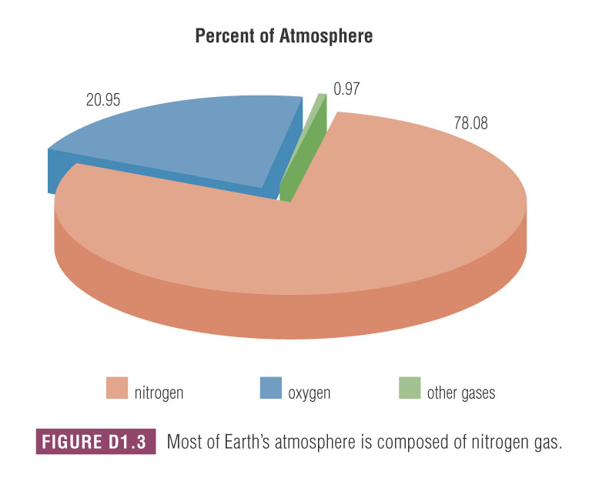
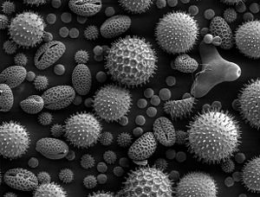
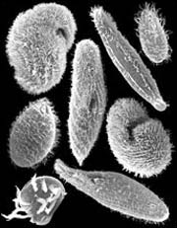
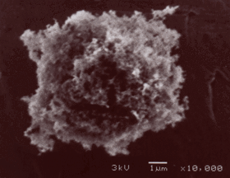
Atmosphere
Made up of a mixture of gases,
78% N_{2(g)}, 21% O_{2(g)}, 1% other
“other” includes Ar, CO₂, Ne, He, CH₄ and Kr
does not include H₂O because it is considered to be part of the hydrosphere
Also includes tiny solid particles called atmospheric dust.
including living things (e.g. pollen, micro-organisms) and non-living (e.g. soot)

Slide 10
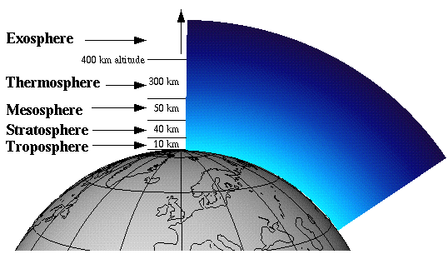
Atmosphere
Divided up into four layers based on altitude (distance from sea level)

Slide 11
Atmosphere Layer #1 - Troposphere
From 0 to 10 km
Temperature 15ºC to – 60ºC
only layer of the atmosphere with a mix of gases and temperature to support a variety of life (including humans).

Slide 12
Atmosphere Layer #1 - Troposphere
contains most of the CO₂, H₂O and atmospheric dust present in the atmosphere.
where most of our weather occurs, including wind and precipitation

Slide 13
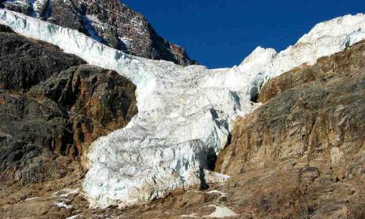
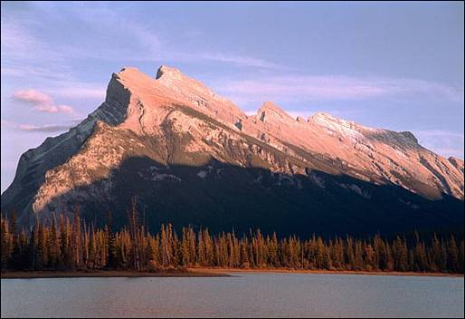
Altitude and Temperature
In the troposphere, temperature decreases with altitude.
This is one reason for the upper limit of plant growth on mountains and the formation of glaciers at high altitudes.

Slide 14
Atmosphere Layer #2 - Stratosphere
From 10 to 50 km
Temperature – 60ºC to 0ºC
only isolated clumps of living cells found living in this layer

Slide 15
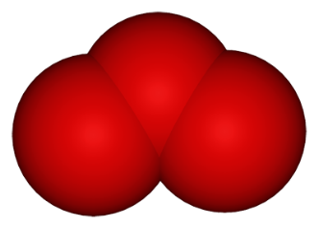
Atmosphere Layer #2 - Stratosphere
contains most of the ozone layer
ozone is a molecule made up of three oxygen atoms (O_{3(g)})
protects living organisms from sun’s UV radiation

Slide 16
Atmosphere layer #3 - Mesosphere
From 50 to 80 km
Temperature 0ºC to – 100ºC

Slide 17
Atmosphere layer #4 - thermosphere
From 80 to 300 km
Temperature – 100ºC to 1500ºC
named for the high temperatures near the edge of the layer (closest to the sun)

Slide 18
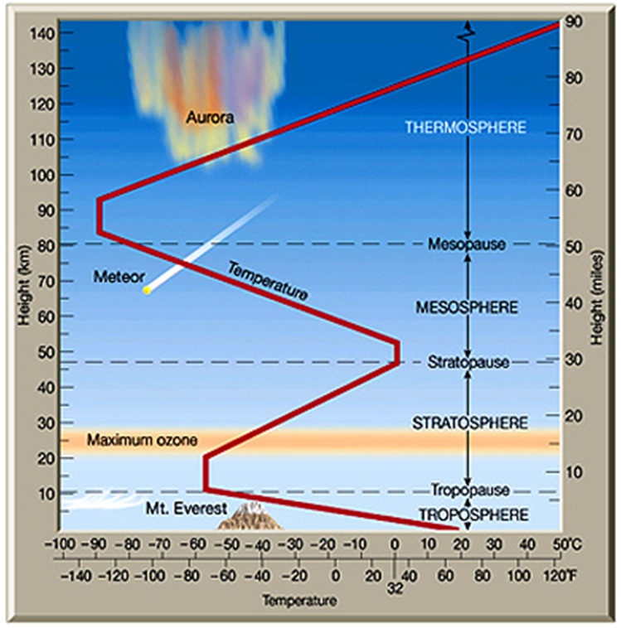

Slide 19
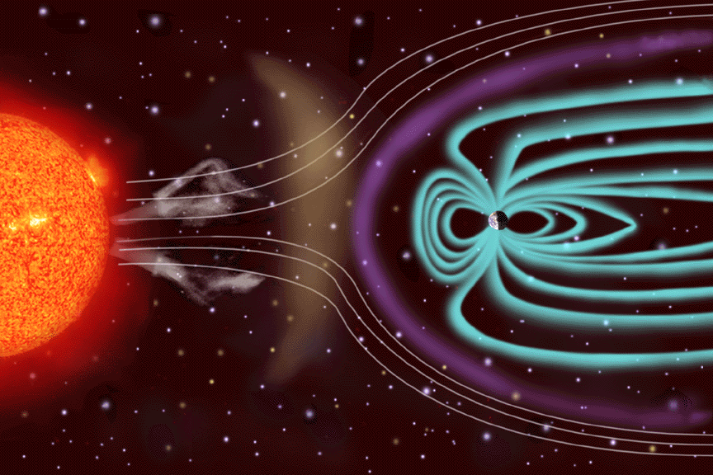
Auroras are caused by charged ejected by the sun. Thankfully, these particles are deflected by the Earth’s magnetic field.
These particles accumulate at the poles where they excite air molecules to produce beautiful streams of plasma called “auroras”.

Slide 20
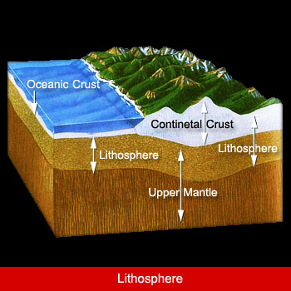
2.0 Lithosphere
Floats on top of the fluid layer called the mantle.
Extends from the Earth’s surface inward.
as thin as 5 km, as thick as 100 km in places.
Warmed both by the heat from the sun and the heat from Earth’s core.

Slide 21
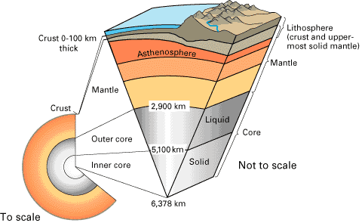
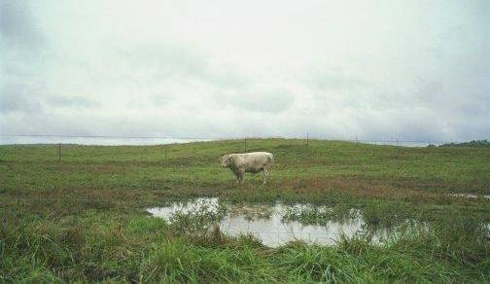
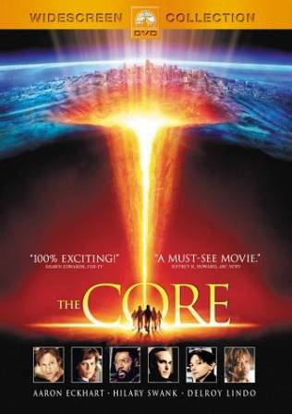
The Lithosphere
The solid part of the earth – floats on the semi-molten mantle layer
Life is found to depths of several kilometers

Slide 22
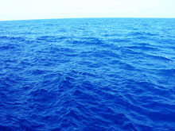
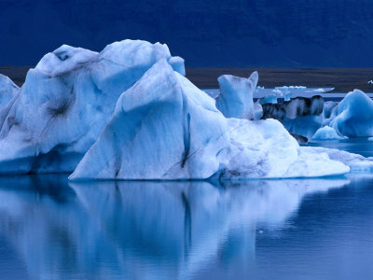
3.0 Hydrosphere
about 97% is salt water in the oceans
the other 3% fresh water, but is mostly frozen in snow and glaciers

Slide 23
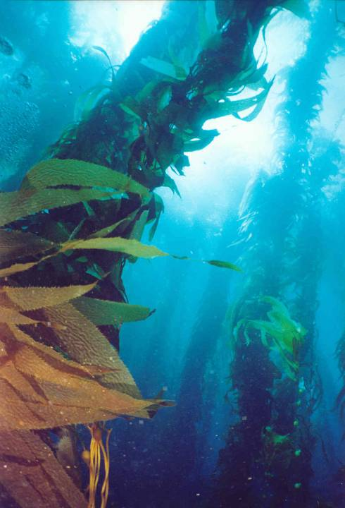
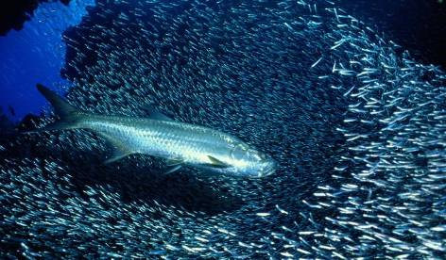
Hydrosphere
The total amount of water on Earth remains constant.
Warmed mostly by the sun, but also by the Earth’s core.

Slide 24
1.2 Climate

Slide 25
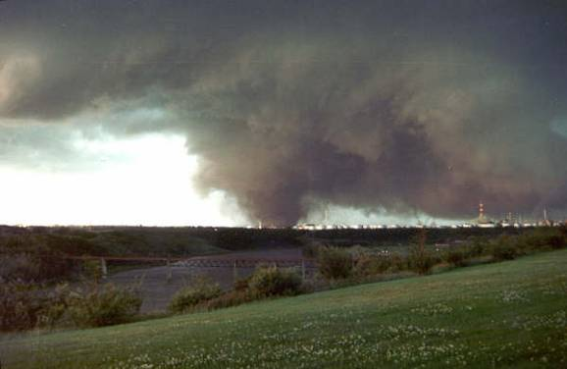
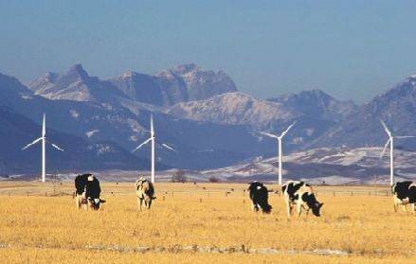
Which photo is about weather? Which is about climate?
Biosphere & Climate
WEATHER: conditions of temperature, air pressure, cloud cover, precipitation, humidity, etc that occur at a particular place at a particular time.
CLIMATE: the average weather conditions of a region over a long time (at least 30 years).

Slide 26
Which comment refers to Weather? Climate?
I can’t believe it’s snowing on May 11th!
weather
My grandma says never to plant the garden til the May long weekend.
climate
Don’t put your tomatoes in the garden yet as we often get frost this time of year.
climate
A tornado hit the golf course yesterday.
weather

Slide 27
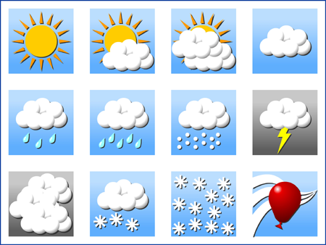
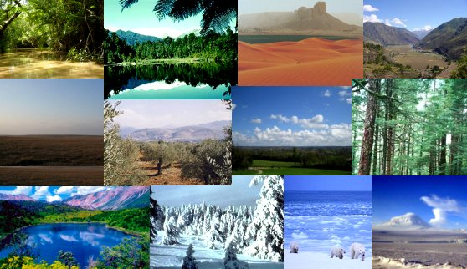
Weather vs. Climate
Weather
Climate
Average conditions occurring over a period of 30 years or longer
e.g. Alberta has a relatively cold and dry climate compared to Brazil, which is warm and humid
Day-to-day conditions, including
temperature & air pressure
cloud cover & humidity
precipitation

Slide 28
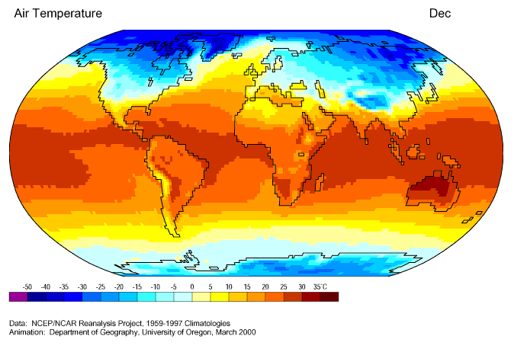
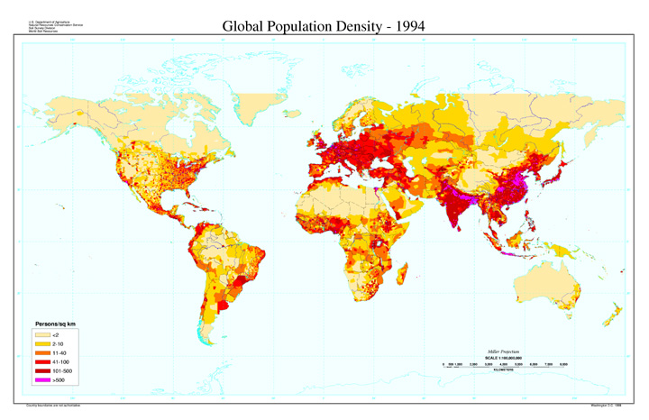
Effect of Climate on Humans
The climate of a region (map #1) - average air temperatures) has several effects on the humans that live there, including
population distribution (map #2)
clothing & shelter considerations

Slide 29
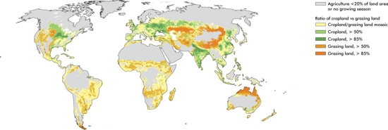
Effect of Climate on Humans
heating & cooling requirements
food availability & agricultural options (map)
economic opportunities

Slide 30
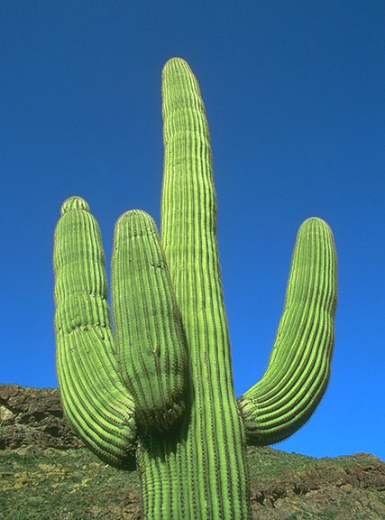
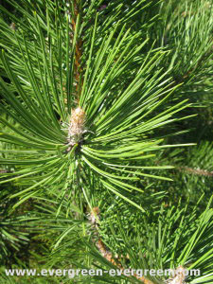
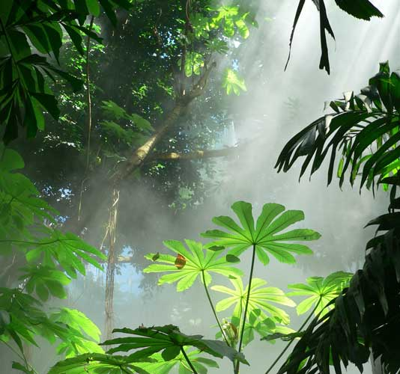
Effect of Climate on Other Organisms
The better suited to its climate an organism is, the better its chances of survival.
an adaptation is a change in the structure or functioning of an organism that makes it more suited to its environment.

Slide 32
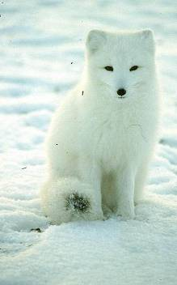
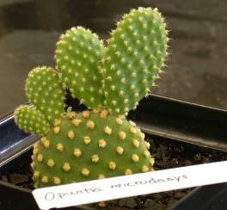
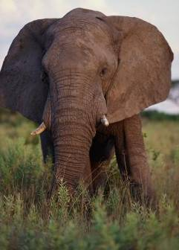
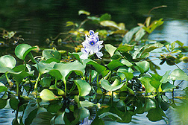
Organisms are Adapted to Deal with Climate
Describe the climate that goes with each adaptation:
Cold: Tiny ears prevent heat loss
Dry: fat leaves prevent water lose
Wet: air filled bladders for floatation
Hot: large, thin ears maximize heat loss

Slide 33
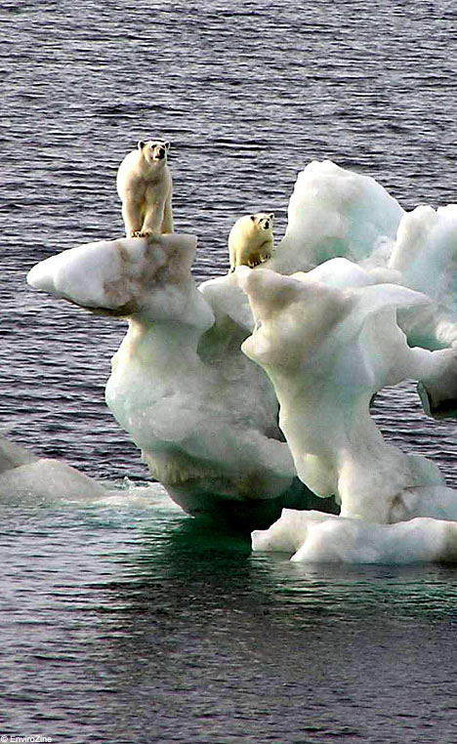
Climate Change
Climate is long term – climate change refers to a noticeable change in average temperatures in a region over time.
A few common questions arise when discussing climate change:
is climate change really happening, or are environmentalists using scare tactics?
if climate change is occurring over such long terms, how do we know for sure?
if climate change has occurred several times over Earth’s history, why are we so worried now?

Slide 34
Climate Change
Global warming IS happening – no educated scientist, politician or environmentalist disputes this
what IS up for debate is why it is happening and if it is cause for concern.

Slide 35
Climate Change
Since 1990, the global average temperature has risen by 0.6ºC,
the northern hemisphere is substantially warmer than at any point during the past 1,000 years
the key is that its GLOBAL AVERAGE temperatures – it doesn’t necessarily mean all regions of the world will experience warming at all
in Canada, it could actually result in cooling temperatures and more extreme weather events

Slide 36
Changing Climates
A variety of evidence exists to demonstrate that the climate of the Earth has varied throughout its history.
This change continues today, and is often referred to as global warming.
some of the evidence we use depends upon humans, so only describes the last few thousand years
some of the evidence allows us to look back at the Earth’s conditions prior to humans arriving

Slide 37
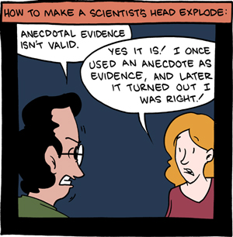
Types of Evidence
Two general categories of evidence exist:
1. anecdotal evidence
evidence based on stories people tell,
from the word “anecdote”, meaning a short, personal story of an individual’s experiences
is most often qualitative in nature

Slide 38
Types of Evidence
2. instrumental evidence
includes any evidence that comes as a result of measurement
may require special equipment,
is most often quantitative in nature
Which one is more reliable? Why?

Slide 39
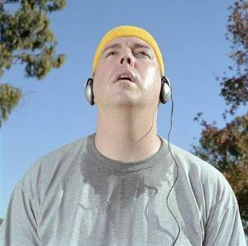
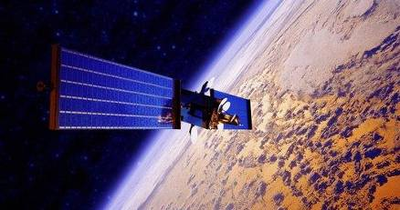
Evidence of Increasing Global Temperature
Anecdotal evidence | Scientific evidence
Personal experience: “It seems way hotter than when I was kid.” Changes over months, years, decades. Subject to personal opinion and bias | Quantitative, standardized measurements (e.g. weathers stations around the world, satellites) Changes over thousands, millions of years Based on the burden of proof and international consensus

Slide 40
Instrumental Evidence
When trying to measure something, there are two approaches:
measure the factor directly (e.g. if you want to find out how far it is to Calgary, measure the distance)
measure some other factor, and use it to make conclusions (e.g. calculate the distance based on your speed of travel and the time it takes).

Slide 41
Instrumental Evidence
Tracking climate change is the same way:
direct evidence
explicitly indicates global warming is occurring, based on an actual measured change in global temperatures.
indirect evidence
evidence that seems to support the idea of climate change but does not involve a direct measurement of temperature.

Slide 42
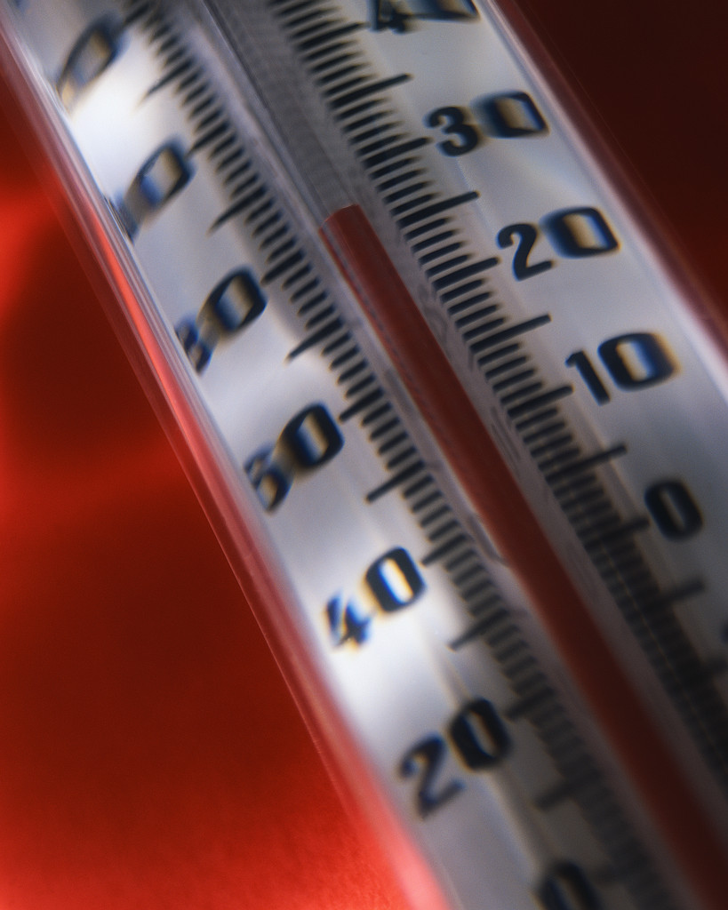
Direct Evidence
Uses historical data
from scientists to farmers, people have been recording weather and temperature information for hundreds of years
patterns emerge and are often used to predict future weather, such as in the Farmers’ Almanac
limited in how far back a written record goes; restricted only to the last few hundred years

Slide 43
Indirect Evidence
Different types of evidence exist that support the idea of climate change, though are not direct measurement of temperature
These include:
tree ring analysis
ice core sampling
fossil record of insects
pollen sampling from the bottom of lakes

Slide 44
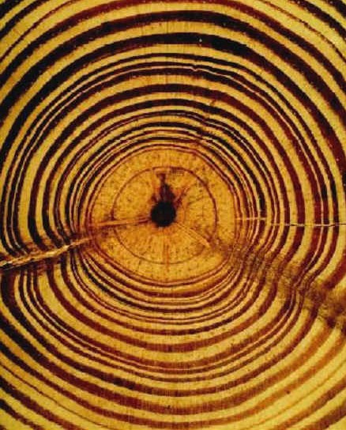
Tree Ring Analysis
Tree rings reflect the changing seasons of cold and drought, warmth and precipitation during the life of a tree

Slide 45
Core Samples

Slide 46
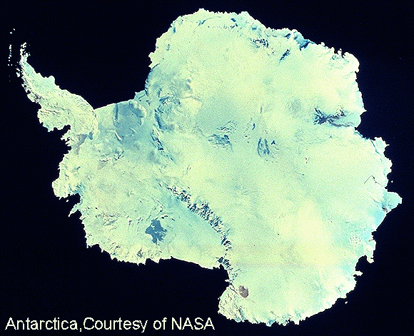
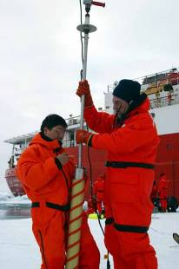
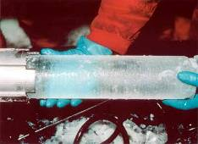
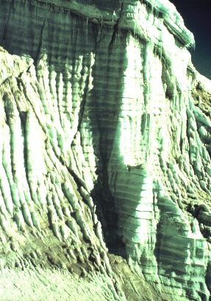
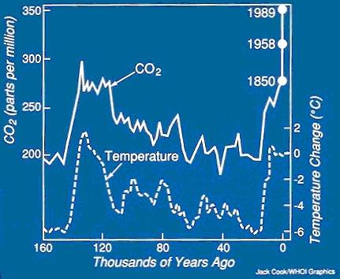
Historical data is collected by analyzing tiny bubbles in yearly layers of ice.
Average yearly temperature can also be measured this way.

Slide 47
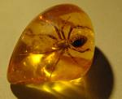
Fossil Records & Pollen Samples
By examining fossil records or pollen samples from the past, we can determine what plants and insects existed at that point in Earth’s history

