Slide 1
Unit D
D3 – Climate Change

Slide 2
Changes in Greenhouses Gases
Recall, water vapour is the most abundant naturally-occurring greenhouse gas.
Other greenhouse gases also play a role, and are produced by human activity, such as industry and agriculture.

Slide 3
Changes in Greenhouses Gases
You can compare the effect of a specific greenhouse gas based on two factors:
Persistence reflects the number of years the gas remains in the atmosphere.
The Global Warming Potential (GWP) of a gas represents its ability to trap thermal energy in the atmosphere.
Gas | GWP | Persistence (years)
carbon dioxide (CO₂) | 1 | 50-200
methane (CH₄) | 23 | 10
nitrous oxide (N₂O) | 296 | 120

Slide 4
Changes in Greenhouse Gases
Although water vapour plays the largest role in the greenhouse effect, it is naturally kept in balance by the hydrologic cycle.
The greenhouse gases that we’re most concerned about, therefore, are the gases that aren’t kept in balance, especially carbon dioxide.

Slide 5
Measuring a Change in Greenhouse Gases
Evidence of increasing atmospheric CO_{2,} N₂O, and CH₄ comes from a combination of ice core samples and atmospheric measurements by weather balloons

Slide 6
Carbon Sinks & Carbon Sources
CARBON SINKS
CARBON SOURCES
Any process that removes carbon dioxide from the atmosphere
The most significant carbon sink is photosynthesis
Other carbon sinks include:
dissolving of CO₂ in the ocean
carbon sequestration initiatives
Any process that releases carbon dioxide into the atmosphere
The most significant carbon source is fossil fuel production and combustion
Other carbon sources include:
cellular respiration
weathering of rock
decomposition of living organisms

Slide 7
Other Sources
Agriculture contributes to the greenhouse effect because
manure and fertilizers release nitrous oxide
livestock contribute methane
Halocarbons are man-made chemicals used in coolants
though their chemical structure makes them ideal for use in fridges and air conditioners, their ability to absorb thermal energy also makes them powerful greenhouse gases
one category of halocarbons, called CFCs, have a GWP of 12 000 (recall, this is 12 000x more than CO₂)
fortunately, CFCs have been banned worldwide since the 1980s, when it was discovered that they break down the ozone layer

Slide 8
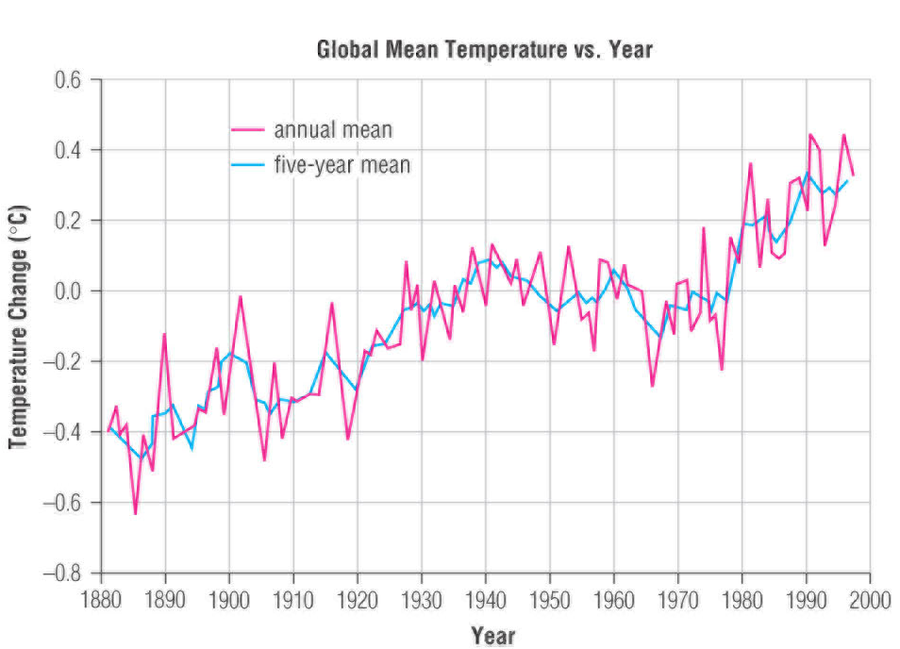
Global Warming
The line at 0.0 represents the global average temperature between 1951 and 1980
From the graph, we can conclude that:
Global temperatures are at a 100 year-high
The start of this change in temperature coincides with the Industrial Revolution

Slide 9
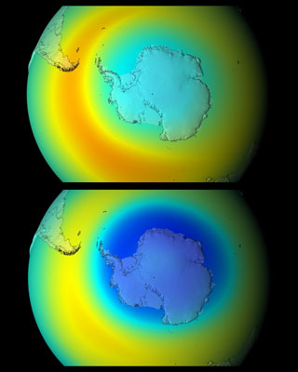
Political Collaboration on Climate Change
The Montreal Protocol was an international agreement signed in 1987 by 182 nations
agreement was made to replace CFCs with less harmful chemicals in products such as refrigerators and air conditioners
CFCs had been found to cause a significant loss in ozone in the stratosphere
this agreement was the first international agreement concerning an environmental issue
Top: The ozone layer in 2008. Bottom: The ozone layer in 2008 had the Montreal Protocol not been signed.

Slide 10
Political Collaboration on Climate Change
United Nations Framework Convention on Climate Change was an agreement to stabilize greenhouse gas emissions caused by human activity
the UNFCCC was not an action plan – it set out a process for future actions on climate change, specifically that future plans
could not threaten global food production
could not jeopardize the economic interests of any nation
must support sustainable development (the meeting of today’s needs without jeopardizing future generations’ ability to meet their needs)

Slide 11
Political Collaboration on Climate Change
Kyoto Protocol
in 1998, 161 countries signed an agreement to reduce the production of greenhouse gases
the countries agreed to reduce their emissions to 5% lower than they were in 1990, by 2012
countries could also earn “credits” toward their reduction by
helping other countries lower their emissions
contributing to a carbon sink (e.g. planting trees)

Slide 12
Canada and Kyoto
Pledging to reduce its emissions below 1990 levels meant that at the time of signing, Canada had to reduce its CO₂ by 6%
However, since we didn’t make any significant changes to our industry practices, the target levels became further and further to meet
In 2010, Canada became the first nation to publicly quit the agreement

Slide 13
Impacts of Climate Change
As a result of climate change, ecologists predict that we will see a change to the distribution of biomes in Canada
These maps illustrate the predicted changes:
the appearance of desert in southern Alberta
the reduction of tundra and taiga biomes
the redistribution of grassland from southern Alberta to Saskatchewan and Manitoba

Slide 14
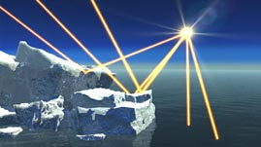
Impacts of Climate Change
With the reduction of permafrost and snow cover, we will also see a significant reduction in albedo
As open water reflects less radiation than ice, global warming is expected to accelerate

Slide 15
Impacts on Alberta
Some of the predicted consequences of global warming that will directly affect our province are:
an increase in the frequency and severity of droughts, which could mean a loss or change in crops
an increase in insect populations
an increased risk of forest fires
a loss of species biodiversity
an increase in diseases associated with warmer climates, such as Lyme disease

Slide 16
Practice Problem
Suggest two methods of reducing greenhouse gases in each economic sector below
Then, refer to page 429 of your textbook to fill in any actions you missed
Sector | Actions
Transportation
Energy
Buildings / infrastructure
Agriculture & Forestry
Industry

Slide 17
Practice Problem
With a partner, brainstorm
Five steps the AVERAGE Canadian could take to reduce their carbon footprint
Five steps that you YOURSELF could take to reduce your carbon footprint

Slide 18
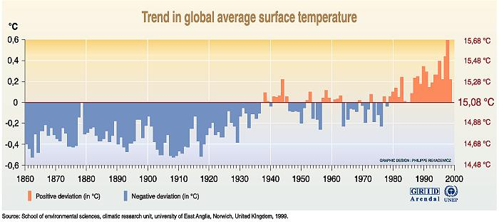
Evidence of Increasing Global Temperature
Average global temperature increased by about one degree C over the last century.

Slide 19
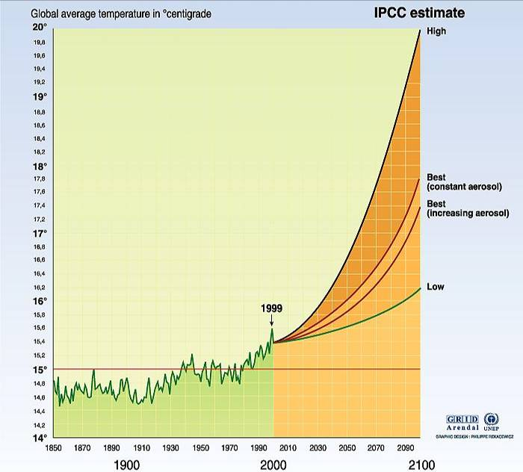
Predicting the Future will Always be Uncertain
Trying to predict how a complex system will behave in the future depends on:
past patterns
knowledge of the present state of the system
understanding how the system works
Scientists use computer models to try to predict how earth’s climate will behave in the future.

Slide 20
Potential Effects of Climate Change

Slide 21
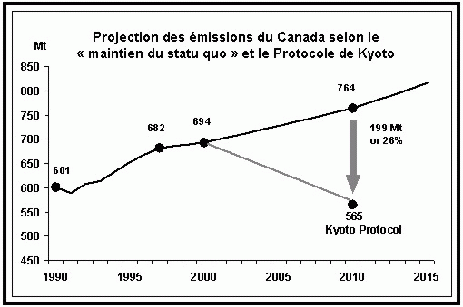
International Efforts
THE MONTREAL PROTOCOL
phase out CFC’s (a GHG)
first major international agreement addressing earth’s atmospheric health
U. N. FRAMEWORK CONVENTION ON CLIMATE CHANGE
laid ground work for an international action plan to address climate change
focused on sustainable development (using resources without endangering future generations)
KYOTO PROTOCOL ON CLIMATE CHANGE
U. N. treaty
Canada agreed to reduce GHG emissions to 6% below 1990 levels.
2006: Canada said it will no longer try to meet it’s Kyoto goals
Emission-reduction credits (if you take GHG’s out of the atmosphere) – can be bought and sold internationally

Slide 22
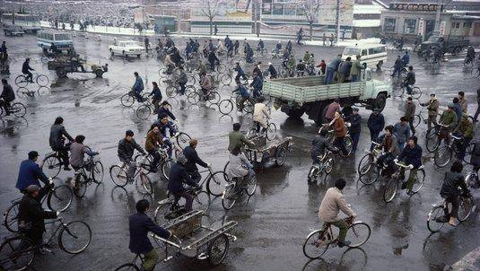
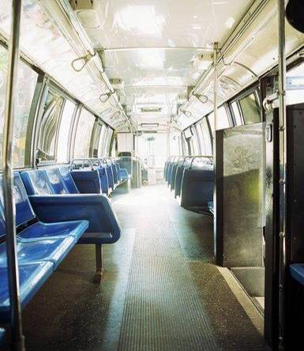
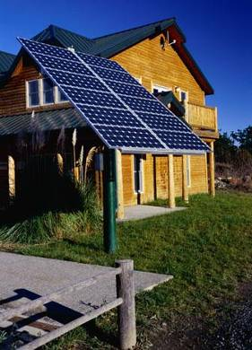
Personal Choices

