Slide 1
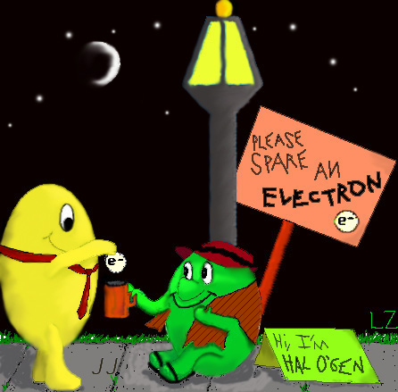
Unit A
Section 2.0

Slide 2
Watch Video:
http://www.youtube.com/watch?v=SmwlzwGMMwc

Slide 3
PERIODIC TABLE OF ELEMENTS: ORGANIZATION
Elements are arranged by increasing atomic number.
ATOMIC NUMBER = NUMBER of PROTONS!
EXAMPLE:
C = 6 protons
U = 92 protons

Slide 4
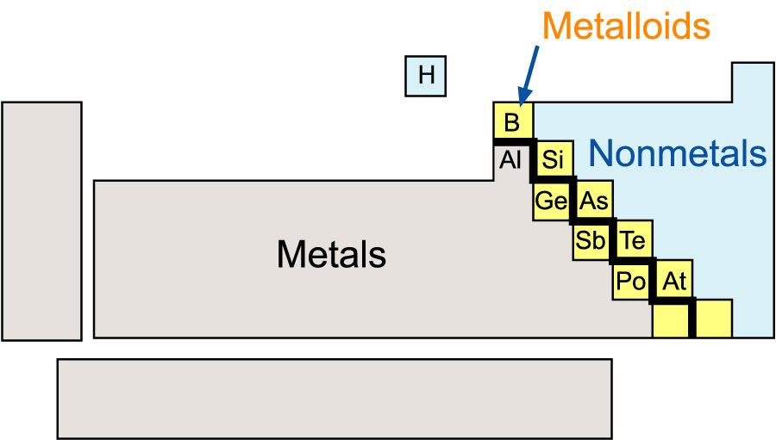
Elements are arranged based on similar properties
  LEFT and RIGHT of the “staircase line”.
    LEFT of the line have properties of METALS.
    RIGHT of the line have properties of NONMETALS. (Normally opposite of metals!)
    Along the staircase line are METALLOIDS

Slide 5
Metals | Non Metals | Metalloids
Strong high density malleable ductile solid at room temp (except Hg) high mp and bp good conductors | low density non malleable non ductile come in all states at room temp low mp and bp poor conductors dull | Have properties of both metals and non metals B Si Ge As Sb Te Po

Slide 6
Periodic Table Arrangement
Organized by atomic number (# of protons) and chemical properties
Periods – horizontal rows
Group/family – the vertical rows
  These have similar physical and chemical properties. You must know the following 4:
    Alkali metals (group 1)
      soft, shiny & reactive (vigorous with water).
      Have one extra electron (valence electron)
    Alkaline-earth Metals (group 2)
      Shiny and reactive but not soft
      Have 2 extra electrons
    Halogens (group 17) second last
      Reactive non- metals
      Missing one electron
    Noble Gases (group 18) last
      Non reactive
      Full outer shell or energy level

Slide 7
Use the following website to help you study the different parts of the periodic table.
  http://www.dayah.com/periodic/

Slide 8
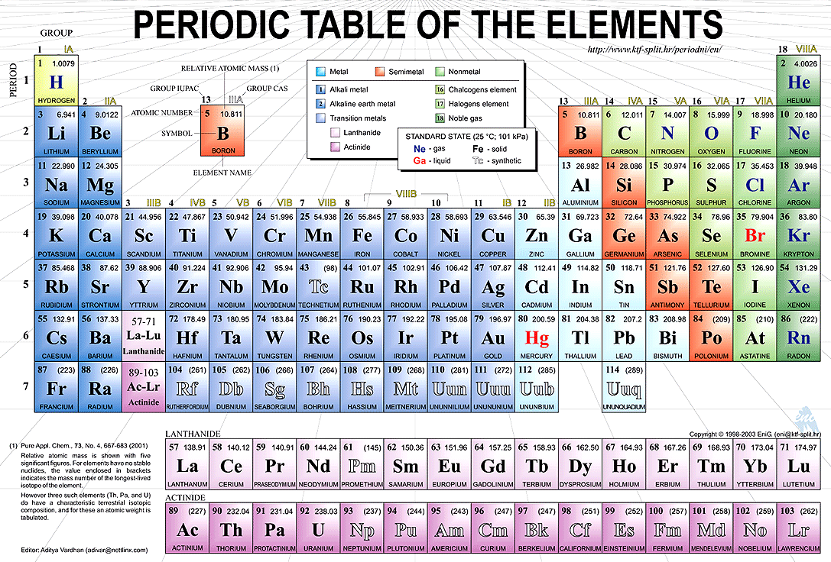

Slide 9
ATOMIC NUMBER (Number of Protons)
Atomic Mass
7
14.01
N
Chemical symbol (nitrogen)

Slide 10
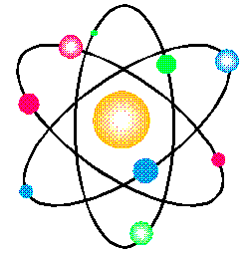
Assignment:
Complete pg 5 of Student Notepack

Slide 11
Element Name |  | IUPAC Symbol | Atomic Number | Group Number | Period Number | Metal (m) or Nonmetal (nm), metalloid (t) | SATP State | Family/Series Name
1. | chlorine | Cl
2. | magnesium
3. |  |  | 30
4. |  | N
5. |  |  |  | 17 | 5
6. |  |  | 79
7. |  |  |  |  | 3 |  |  | Alkali metals
8. | thorium |  |  | ----------
9. |  |  |  | 12 |  |  | Liquid
10. |  | Br
11. | argon
12. |  |  |  | 11 | 5
13. |  |  | 19
14. | calcium
15. |  |  |  | 1 |  |  | Gas
16. |  |  | 58 | ----------

Slide 12

Atomic Theory
The smallest part of an element is an atom. (still retains all the properties of an atom)
Majority of the mass is located in the nucleus (nucleons = protons and neutrons)
Atomic number is the number of protons (for elements it is also equal to the number of electrons.
Example:
Sodium = 11
Chlorine = 17
Lithium = 3
The elements on the periodic table are organized by increasing atomic number!
Radioactive Man sez:

Slide 13
Mass number is protons + neutrons.
(n = m.n. – p)
Differs from Atomic Mass by a miniscule amount.
Number of protons and distribution of electrons give atoms their distinctive chemical and physical properties
Particle | Symbol | Charge | Mass | Location
Proton (atomic number) | p⁺ | 1+ | 1.7x10⁻²⁴g | Nucleus
Neutron | n⁰ | 0 | 1.7x10⁻²⁴g | Nucleus
Electron | e⁻ | 1- | 9.1x10⁻²⁸g | Surrounding nucleus (in orbitals or energy levels)

Slide 14
Example:
Lithium atom: Atomic number is ‘3’
Energy Levels
NUCLEUS of ATOM
e⁻
n
p
p
n
n
e⁻
p
e⁻
… but the diagram
is out of scale

Slide 15
Energy Levels
Electrons can have different energy levels.
An energy level is a region of space close to the nucleus that may contain electrons.
The electrons located closest to the nucleus have the least amount of energy but require the most to pry them lose.
The number of electrons in each energy level follows a pattern: 2,8,8 (18)

Slide 16
Valence electrons
- e⁻ in outer energy level
cation
anion
e=2
e=8
e=8
e=8
e =2
e =2
e =2
P=12 N=12
P=12 N=12
P=9 N=10
Mg
Mg²⁺
F⁻
Both have full outer shells. The outer shell looks like the noble gas neon.

Slide 17
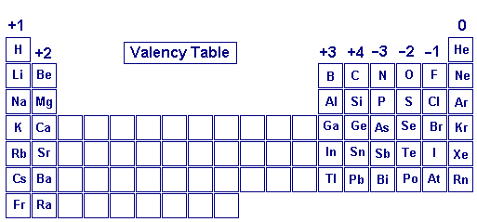
All the elements in a group have the same electron configuration in their outermost shells. Electrons in the outer shell that is not full are called valence electrons.

Slide 18
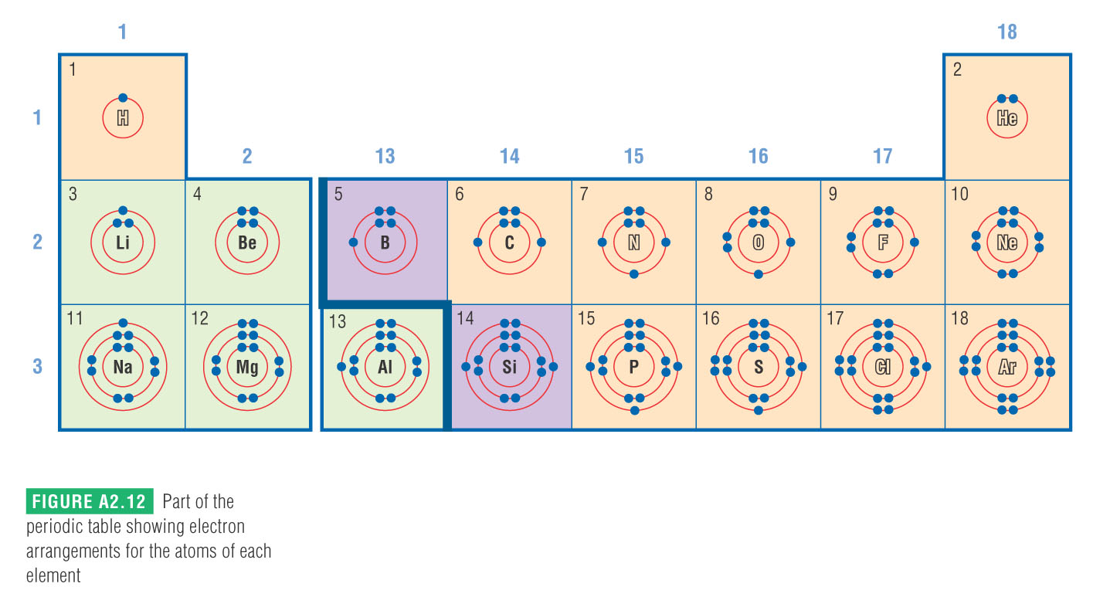
The period number (horizontal row) that an element is the same as the number of energy levels the atom has.

Slide 19
Assignment:
Complete pg 7 in Notepack

Slide 20
Atoms, Protons, and Electrons
Symbol | Number of Protons | Number of Electrons | Electric Charge
Li | 3 | 3 | 0
C | 6 | 6 | 0
F | 9 | 9 | 0
Mg | 12 | 12 | 0
K | 19 | 19 | 0
P | 15 | 15 | 0
S | 16 | 16 | 0
He | 10 | 10 | 0
Ar | 18 | 18 | 0
O | 8 | 8 | 0
Cl | 17 | 17 | 0
Na | 11 | 11 | 0
Ca | 20 | 20 | 0
Fe | 26 | 26 | 0
Ni | 28 | 28 | 0
Au | 79 | 79 | 0
Hg | 80 | 80 | 0
Pb | 82 | 82 | 0
Zn | 30 | 30 | 0

Slide 21

Formation of Ions
Recall that an atom of any element is neutral, so the number of protons equals the number of electrons.
An ion is a an atom (or a group of atoms) that has a positive or negative electric charge.
The formation of an ion is called ionization, and is the result of an atom either gaining or losing electrons.
The number of protons only changes in nuclear reactions, never in the formation of ions.
Keith sez:

Slide 22


Cations
Cations are positively charged ions.
They are formed when a metal atom loses valence electrons (electrons in the outermost energy level). As a result, the ion has more protons than electrons
Ant-ion?
Anions
Anions are negatively charged ions.
They are formed when a non-metal atom accepts electrons into its outer energy level. As a result, the ion has more electrons than protons

Slide 23
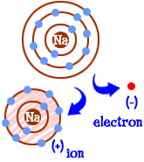
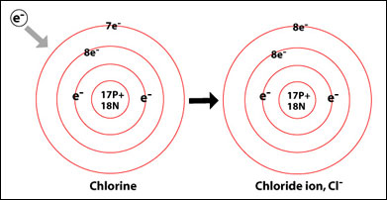
Formation of Cations and Anions
Creation of a sodium cation
Creation of a chloride anion
sodium atom
(11 p+ and 11 e-)
Charged sodium ion
(11 p+ and 10 e-)
Neutral chlorine atom
(17 p+ and 17 e-)
Charged chloride ion
(17 p+ and 18 e-)
Na → Na+ and 1 electron
Cl and 1 electron → Cl-

Slide 24

The Octet Rule
The octet rule says that atoms tend to gain, lose or share electrons so as to have eight electrons in their outer electron shell.
Atoms gain or lose electrons so that they have the same number of electrons as the nearest noble gas.
Some metal atoms, depending on the nature of the chemical reaction, can form stable ions with more than one charge.
For example copper atoms will lose either one or two electrons.
These elements are called multivalent, and the first charge given on the periodic table is the most common.

Slide 25
Assignment:
Complete pg 41-42 in Notepack
Read pages 34 – 38 (except p. 37)
A2.1 Check and Reflect, page 39 #’s 1 – 12
Prep for Quiz on 2.1

Slide 26
Atoms & Ions I
Symbol | Number of Protons | Number of Electrons | Electric Change
Li⁺ | 3 | 2 | 1+
C | 6 | 6 | 0
F⁻ | 9 | 10 | 1-
Mg²⁺
K⁺
Li
S²⁻
He
 | 18 |  | 0
 | 8 |  | 2-
 | 17 |  | 1-
 | 11 |  | 0
Ca²⁺ |  | 18
Fe³⁺ |  | 23
Fe²⁺ |  | 24
 |  | 78 | 1+
 |  | 78 | 2+
 | 82 | 78
 | 30 | 30

Slide 27
Atoms & Ions II
Name | Symbol | Mass Number | Atomic Number | Protons | Neutrons | Electrons | Electric Charge
fluorine atoms | F | 19 | 9 | 9 | 10 | 9 | 0
nitride ion | N³⁻ | 15 | 7 | 7 | 8 | 10 | 3-
boron atom |  | 14
aluminum ion |  |  |  |  | 14 |  | 3+
gold ion |  |  |  |  | 116 |  | 1+
 |  | 40 |  | 19 |  |  | 0
 |  | 79 | 35 |  |  | 35
 |  |  |  |  | 19 | 18 | 1-
 |  |  |  | 16 | 16 |  | 2-
 | Ag | 110
cesium ion |  |  |  |  | 77 |  | 1+
 | I⁻ | 125

Slide 28
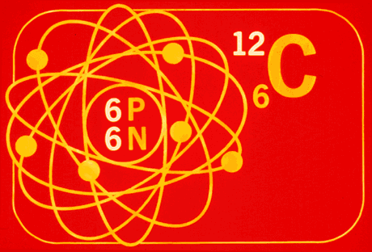
The Atomic Mass Unit
Since the mass of individual atoms is so small, it is not convenient to use a unit like grams (g).
Instead, we use the atomic mass unit (amu).
An atom of carbon-12 was assigned an exact mass of 12.00 amu.

Slide 29
Then the relative masses of all other atoms is determined by comparing each to the mass of an atom of carbon-12.
For example, an atom twice as heavy has a mass of 24.00 amu, and an atom half as heavy has a mass of 6.00 amu.

Slide 30
Example:
NITROGEN has:
        7 protons
        7 neutrons
therefore its atomic mass is equal to:
14 amu
… but the atomic mass on the periodic table is
14.01 amu.
WHY?
  Isotopes:
    elements that have the same atomic number but a different mass number! (Review pg 33 of note pack)

Slide 31

Isotopes
Isotopes are different types of atoms of the same element. How are they different?
  Can’t change # protons as that changes the element
  Can’t change the # of e⁻ as that turns it into an ion
  Only thing left is the # of neutrons. So the only difference between isotopes of the same element is how heavy they are.

Slide 32
Isotope Notation:
Mass Number
Element Symbol
Atomic Number

Slide 33
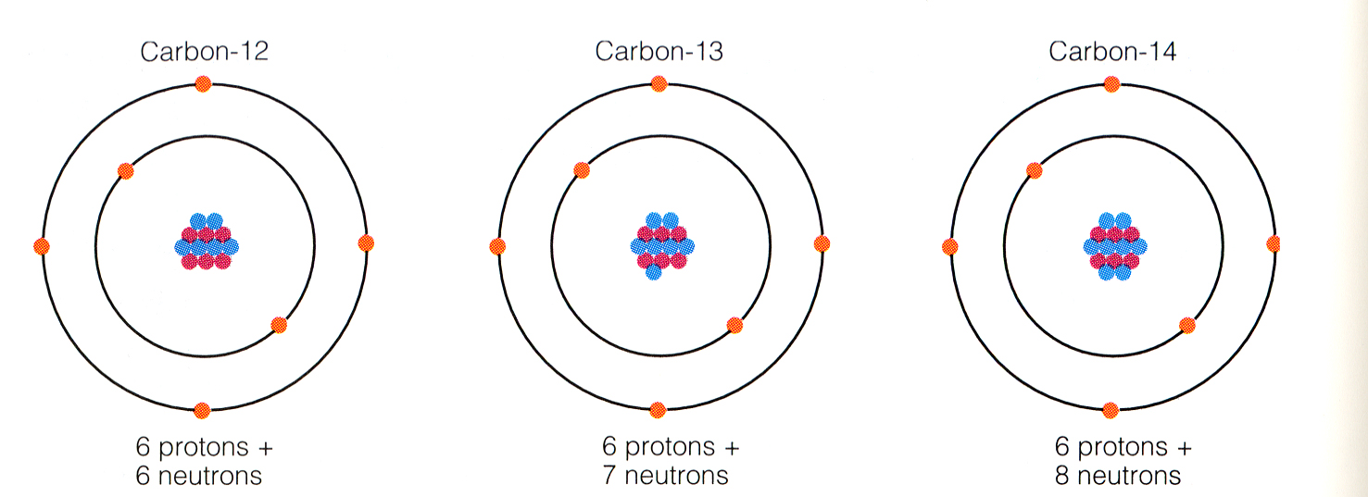
Example:
Three naturally occurring isotopes of carbon:
The bottom number is sometimes not written because you can determine the atomic number from the symbol.

Slide 34
Any sample of an element found in nature is a mixture of different isotopes. Each isotope will occur in different proportions, usually given as a percentage.
For example:
Each of these isotopes contains 50 protons.

Slide 35
The atomic mass of an element that is listed on the periodic table is called the atomic molar mass.
This value is calculated as the average mass of all of the isotopes of an element, taking the percent abundance into account.

Slide 36
Learning Check
An atom has 14 protons and 20 neutrons.
1) Its atomic number is :
A) 14 B) 16 C) 34
2) Its mass number is :
A) 14 B) 16 C) 34
3) The element is:
A) Si B) Ca C) Se
4) Another isotope of this element is :
A) B) C)

Slide 37
Learning Check
Write the atomic symbols for atoms with the following:
A. 8 p⁺ , 8 n⁰ , 8 e⁻
B. 17 p⁺ , 20 n⁰ , 17 e⁻
C. 47 p⁺ , 60 n⁰ , 47 e⁻

Slide 38
Learning Check
An atom of zinc has a mass number of 65.
1) The number of protons in the zinc atom:
A) 30 B) 60 C) 65
2) The number of neutrons in the zinc atom:
A) 30 B) 35 C) 65
3) The mass number of a zinc atom with 37 neutrons is:
A) 37 B) 65 C) 67

Slide 39
Assignment:
Complete pg 9 & 10 in Notepack

Slide 40
Write the Symbol for the energy diagrams given below:
Draw energy level diagrams for the following isotopes:
4 e⁻
8 e⁻
2 e⁻
14 p⁺
12 n⁰
3 e⁻
2 e⁻
5 p⁺
7 n⁰

Slide 41
Atomic Number and Mass Number Chart
Name | Mass number | Atomic number | Number of protons | Number of neutrons
carbon-14 | 14 | 6 | 6 | 8
hydrogen-1 | 1 | 1 | 1 | 0
hydrogen-2 | 2 | 1 | 1 | 1
carbon-12 | 12 | 6 | 6 | 6
oxygen-18 | 18 | 8 | 8 | 10
helium-4 | 4 | 2 | 2 | 2
neon-20 | 20 | 10 | 10 | 10
copper-64 | 64 | 29 | 29 | 35
bromine-80 | 80 | 35 | 35 | 45
nitrogen-14 | 14 | 7 | 7 | 7
sulfur-32 | 32 | 16 | 16 | 16
calcium-41 | 41 | 20 | 20 | 21
fluorine-19 | 19 | 9 | 9 | 10
iron-56 | 56 | 26 | 26 | 30
iodine-127 | 127 | 53 | 53 | 74
calcium-40 | 40 | 20 | 20 | 20
tin-119 | 119 | 50 | 50 | 69
iron-59 | 59 | 26 | 26 | 33
lead-208 | 208 | 82 | 82 | 126
silver-108 | 108 | 47 | 47 | 61
mercury-201 | 201 | 80 | 80 | 121

Slide 42
