Slide 1
Unit A
Section 2.2
Naming Ionic and Molecular Compounds
Notes:
Move hydrates and acids right after ionic compounds.

Slide 2
What are Compounds?
  Compounds form when Chemical Bonds are created.
… this occurs when elements gain or lose electrons and become “charged”…
Bonds resulting from the force of
attraction between atoms

Slide 3
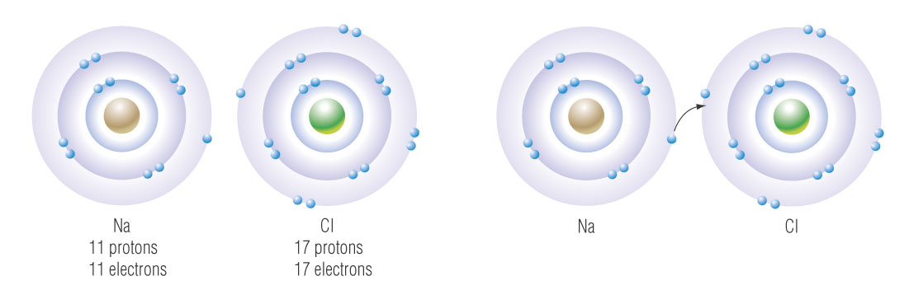
EXPLANATION:
If an atom loses an electron it becomes positive. The atom that accepts the electron becomes negative.
The atoms are now ions and are attracted to each other.
“Remember opposites attract!”
The ions “stick together” and an ionic bond is now formed.

Slide 4
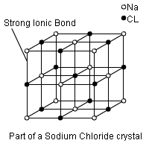
Properties of Ionic Compounds
All solid at room temp NaCl_{(s)} (high melting and boiling points)
Retain crystal shape
Dissolve in water (majority) NaCl_{(aq)}
Always conduct electricity in solution

Slide 5
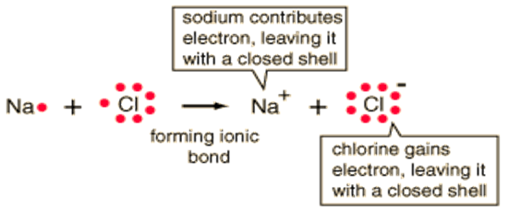
What are Ionic Bonds?
An ionic bond forms when one of the 2 elements loses an electron and the other gains an electron.
Normally when a metal (left of step ladder) meets with a non-metal (right of step ladder)
Once the element has lost or gained an electron to become more stable (full outer shell) it is called an ion.

Slide 6
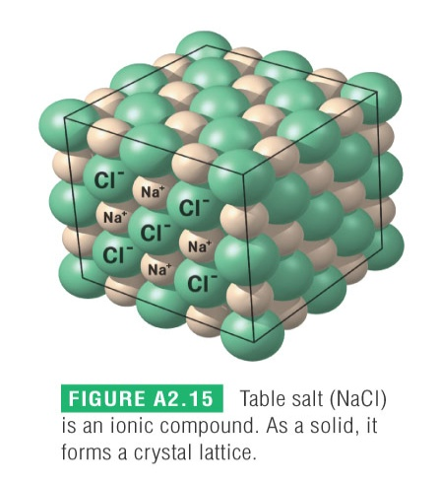
Ionic bonds form crystal lattice due to the alternating +/- ion arrangement.
For sodium chloride, there is one sodium ion for every chloride ion (they are in a 1:1 ratio).
  This is a regular three-dimensional pattern of alternating positive and negative ions producing an electrically neutral compound since electrons can not move This is very stable arrangement, so all ionic compounds are solid at room temperature.
One neutral unit is called a formula unit.
Strongest bond unless water is around
For sodium chloride, there is one sodium ion for every chloride ion (they are in a 1:1 ratio).
Attraction between the opposing charged molecules results in a high melting point

Slide 7
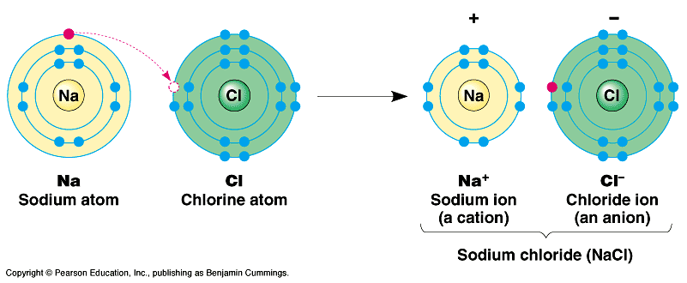
Naming Ionic Compounds
Naming chemicals properly is a very important aspect of Chemistry. If not done properly no one will know which substance you are talking about.
In 1911 the International Union of Pure and Applied Chemistry (IUPAC) came up with a naming system.

Slide 8
Rules for Type 1
1) The first word is the metal or cation
2) The first word is named exactly like the element. EX. Na is sodium
3) The last word is the nonmetal or anion
    It ends in an ide ending
    Ex. Chlorine goes to Chloride
Oxygen goes to Oxide
Selenium to Selenide
Phosphorus to Phosphide

Slide 9
Naming Ions
I) Non Metals – change end to “ide”
i) chlorine
ii) fluorine
iii) oxygen
iv) sulfur
v) iodine
vi) bromine
vii) selenium
chloride … Cl⁻
fluoride … F⁻
oxide … O²⁻
sulfide … S²⁻
iodide … I⁻
bromide … Br⁻
selenide … Se²⁻
Know how to name nonmetal ions!

Slide 10
II) Metals- use the full name and then add “ion” like this:
i) calcium
ii) sodium
iii) cesium
iv) Ag⁺
v) Au⁺
vi) cobalt
vii) Ge⁺⁴
calcium ion … Ca²⁺
sodium ion … Na⁺
cesium ion … Cs⁺
silver ion
gold (I) ion
cobalt (II) ion … Co²⁺
germanium ion

Slide 11
Writing Ionic Compounds
When writing formulas of binary ionic compounds the symbol for the elements are written in the same order as they appear in the name.
Subscript numbers are used to indicate the ratio of the ions in the compound.
The charges on the ions must balance in the chemical formula, since ionic compounds are electrically neutral.

Slide 12
Identify the ions and their charges.
Determine the ratio of charges needed to balance.
The charge on the metal ion crosses to become the subscript on the non-metal ion.
The charge on the non-metal ion crosses to become the subscript on the metal ion.
Reduce the ratio of subscripts in the formula.
Na⁺ Cl⁻
1 : 1
Na⁺ Cl⁻
Na₁ Cl₁
NaCl

Slide 13
Practice Problems
1) aluminum fluoride
2) silver sulfide
3) potassium iodide
4) zinc nitride
Ca ²⁺ O²⁻
CaO _{(s)}
5) calcium oxide

Slide 14
Assignment:
Complete the Practice Problem Chart above
Do the Practice Problems on pg 43 of Text
Do pg 45-48 in NotePack

Slide 19
Rules for Type 2 (Binary Compounds)
Some metals have more than one choice in the amount of electrons they lose.
Ex. Ni²⁺ or Ni³⁺, Au³⁺ or Au⁺
Note the one on the periodic table that is found on the top is the one most commonly found in nature. Normally you will be given enough info to figure out the charge used but if not you can use the top one but be careful.

Slide 20
How to figure out which Charge was used
  In the name it can be shown in 2 ways: systematic (uses roman numerals) or the old method which uses ic (bigger choice) or ous (smaller choice) attached to the latin name of the element.
Ion | Systematic | Alternative
Fe³⁺ | Iron(III) | Ferric
Fe²⁺ | Iron(II) | Ferrous
Cu²⁺ | Copper(II) | Cupric
Cu⁺ | Copper(I) | Cuprous
Co³⁺ | Cobalt(III) | Cobaltic
Co²⁺ | Cobalt(II) | Cobaltous

Slide 21
Compounds With Multivalent Elements
Ionic compounds with multivalent elements must have Roman numerals after the name of the positive (metal) ion to indicate the charge on that ion.
Compound Name | Formula
iron (III) chloride
lead (IV) oxide
nickel (III) sulfide
copper (II) fluoride
chromium (III) sulfide
**Use roman numerals ONLY when the metal element is multivalent.
“Choice of charge”

Slide 22
Naming is the same except for the cation being either the systematic or Old school.
  Ex. Pb²⁺ + Cl⁻ becomes PbCl₂ named Lead (II) chloride
Try the following Examples:
Cu²⁺ + O²⁻
Cr³⁺ + S²⁻
Mn⁴⁺ + O²⁻

Slide 23
Assignment:
Complete above Practice Problems
Do the Practice Problems on pg 44 of text
Do pg 51-53 of NotePack

Slide 26

Polyatomic Ions
When writing the formula for compounds containing more than one of a polyatomic ion, the symbol for the ion must be written in brackets. Beauty eh.
Polyatomic ions consist of a group of atoms combined together that exist as a single unit with an overall electric charge.
Most polyatomic ions have a negative charge, which means they behave as non-metals. This means that they are always written last in the formula.
Don sez:
The one exception:
ammonium ion

Slide 27
Examples:
Compound Name | Formula
barium hydroxide
iron (III) carbonate
copper (I) permanganate
gold (III) nitrate
ammonium phosphate
potassium dichromate

Slide 28
Try these examples yourselves:
Ca(OH)₂
K₂CrO₄
Co(NO₂)₂
Zn(BrO₃)
ammonium phosphide
magnesium borate
barium carbonate
ammonium nitrate
potassium nitrite
calcium phosphate

Slide 29
REMEMBER … Use the same general procedure as you did with binary ionic compounds but … … when you need more than one polyatomic ion …
… USE BRACKETS!
A useful Chart to help you with Naming Ionic Compounds is on page 55 of the note pack!

Slide 30
Hydrates (extra water)
Hydrates – some compounds will have water molecules attached to them. The number of water molecules is denoted by using a prefix.
Examples
CaCl₂ ● 5H₂O
  calcium chloride pentahydrate
MgSO₄ ● 7H₂O
  magnesium sulfate heptahydrate

Slide 31
Assignment:
Complete above Examples
Do the Practice Problems on pg 46 of text
Do pg 30 of notepack

Slide 35
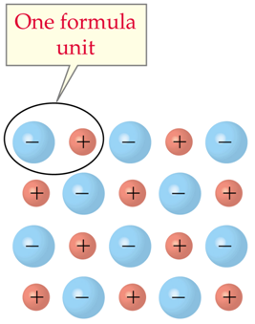
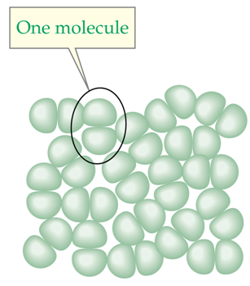
Molecular Compounds
Remember, for ionic compounds, a formula unit is a ratio of the number of ions in a crystal lattice.
Ionic compounds do not form independent units.
ionic compound
A molecule is two or more non-metal atoms bonded together. Each molecule is independent of the next, and is not part of a lattice.
molecular compound

Slide 36
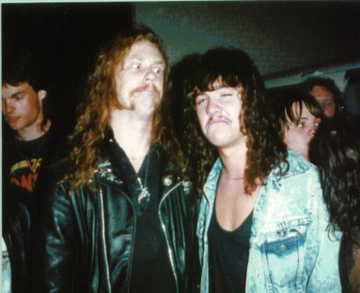
Binary molecular compounds are formed between two non-metal elements.
No metals??? No WAY!!
Yeah, dude. Metal rules.

Slide 37
Properties of Molecular Compounds
Not strong enough to take electrons
Share pairs of electrons (covalent bond)
3 main types
  nonmetal and nonmetal
  hydrogen and metal (not aqueous IE acid)
  Diatomic (2 of the same element bonded together)

Slide 38


Covalent Bonds – Sharing Electrons!
Remember that non-metals need to gain electrons to have a full outer shell.
When non-metal atoms combine, the only way this can be achieved is if they share their outer electrons.
a pair of shared electrons
two chlorine atoms
one chlorine molecule

Slide 39
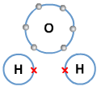

Since electrons are being shared, there is a strong force of attraction between the two atoms. This force is a covalent bond.
two pairs of shared electrons
an oxygen atom and two hydrogen atoms
a water molecule

Slide 40
Molecular Elements
The vast majority of elements exist in nature as single atoms. These are called monoatomic.
There are a few diatomic elements (exist as pairs of atoms), which you must memorize.
“I Bring Clay For Our New House.”

Slide 41
There are two polyatomic elements which also must be memorized:
“And four Paving stones for eight Steps.”

Slide 42
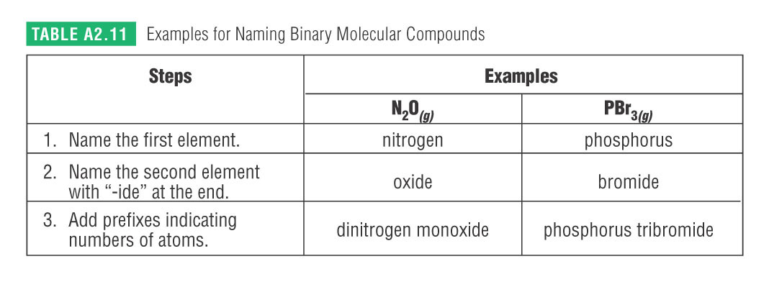
Naming Molecular Compounds
Steps for Naming Binary Molecular Compounds

Slide 43
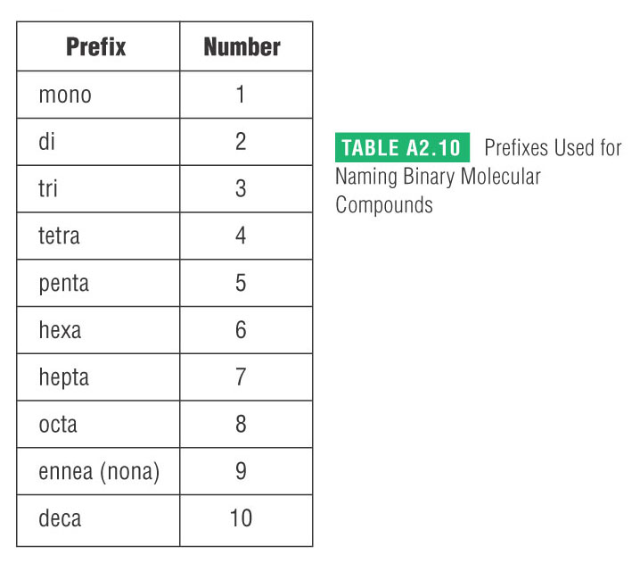
Memorize this Table!!!!!

Slide 44
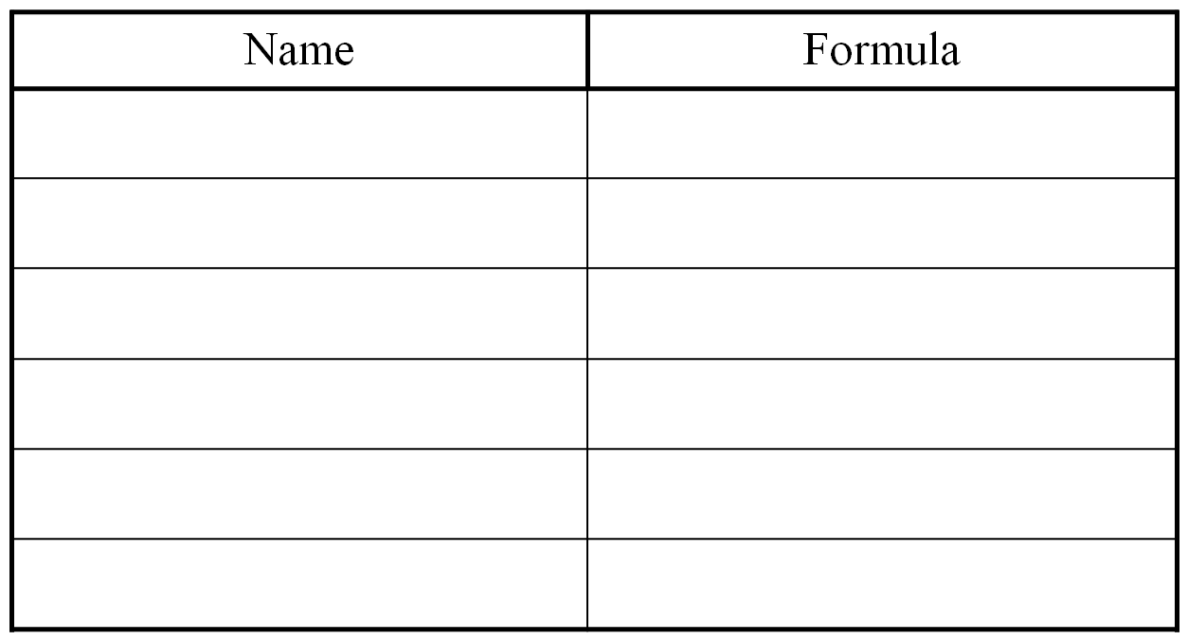
If no prefix on the first name it is assumed to be a one (don’t have to put mono)
Ex. CO → carbon monoxide
carbon dioxide
dinitrogen monoxide
phosphorus trichloride
oxygen difluoride
dinitrogen tetrasulfide
sulfur trioxide

Slide 45
Try these Problems:
SO_{2(g)} →
CS_{2(g)} →
N₂O_{3(g)} →
CCl_{4(l)} →
P₄O_{10(s)} →

Slide 46
Assignment:
Do Problems to the left
Do the Practice Problems on pg 49 of Text

Slide 47
Molecular Compounds that contain Hydrogen
water | H₂O (l)
hydrogen peroxide | H₂O₂ (l)
ammonia | NH₃ (g)
sucrose | C₁₂H₂₂O₁₁ (s)
methane | CH₄ (g)
propane | C₃H₈ (g)
methanol | CH₃OH (l)
ethanol | C₂H₅OH (l)
hydrogen sulfide | H₂S (g)
The names, formulas and states for the following molecular compounds containing hydrogen must be memorized!!!!

Slide 48
Assignment:
Complete pg 61-63 of Notepack
Do C&R pg 50 in Text #1-12
See pg 60 as a sheet to help you with naming Molecular compounds

Slide 49
Naming Acids
All acids will be considered as being dissolved in water, in aqueous solution and this must always be indicated by placing the subscript (aq) after the acid formula.
Acids can be named in two ways:
1) IUPAC System
The IUPAC system places the word aqueous in front of the name of the acid, named as if it were an ionic compound.
2) Classical System
The classical system uses three different rules, depending on what the acid ends in: – ide, – ate, or – ite.

Slide 50
When the name of the negative ion ends in -ide the acid begins with the prefix hydro- and the stem of the negative ion is given the ending –ic, in place of –ide. This is followed by the word acid.
Rule #1
When the negative ion ends in –ate the acid name is the stem of the negative ion given the ending –ic , in place of –ate , followed by the word acid.
Rule #2
When the negative ion ends in –ite the acid name is the stem of the negative ion given the ending –ous , in the place of –ite, followed by the word acid.
Rule #3
These rules are found on your periodic table: DO NOT MEMORIZE!!!

Slide 51
Examples:
Acid | IUPAC Name | Classical Name
aqueous hydrogen bromide
hydrobromic acid
aqueous hydrogen chromate
chromic acid
aqueous hydrogen nitrite
nitrous acid
aqueous hydrogen sulfate
sulfuric acid
aqueous hydrogen iodide
hydroiodic acid
aqueous hydrogen chlorite
chlorous acid

Slide 52
NAMING COMPOUNDS; REVIEW/SUMMARY
Examples: K₂Se, H₃BO₃, LiOH, Pb₃(PO₄)₄, S₃O₇
Ask the Questions: Is the compound:
IONIC?
metal/nonmetal
MOLECULAR?
two nonmetals
or
NAME IT!
Is “H” in the
Metal position?
YES
It’s an ACID … name it!
NO
Is the metal
multivalent?
Name it using the STOCK SYSTEM
YES
NO
YES
Name it using brackets if necessary
POLYATOMIC
COMPOUND?
BINARY IONIC
COMPOUND
NO
Name it!

Slide 53
Assignment
Complete Naming Worksheets
Prepare for Exam on Section 2.0

