Slide 1
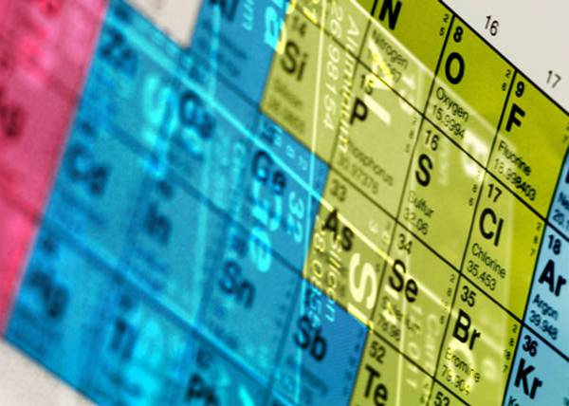
Acids
and
Bases

Slide 2
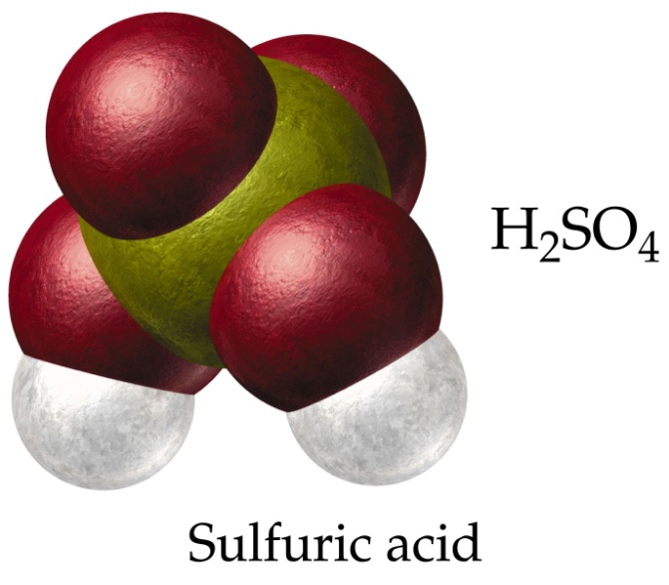
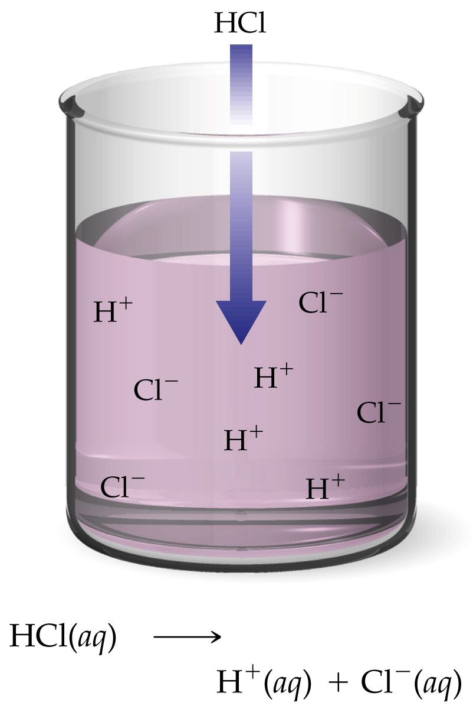
Acids
An acid is a compound that contains hydrogen and dissolves in water to form a solution that has a pH less than 7. Examples include vinegar, stomach acid
Properties of Acids
1) Acids have a sour taste.
2) Acids do not have a slippery feel.
3) Acids react with metals to form hydrogen gas.
4) Acids turn litmus paper red.
5) Acidic solutions conduct electricity. This is because all acids dissociate (separate into ions) when they dissolve.

Slide 3
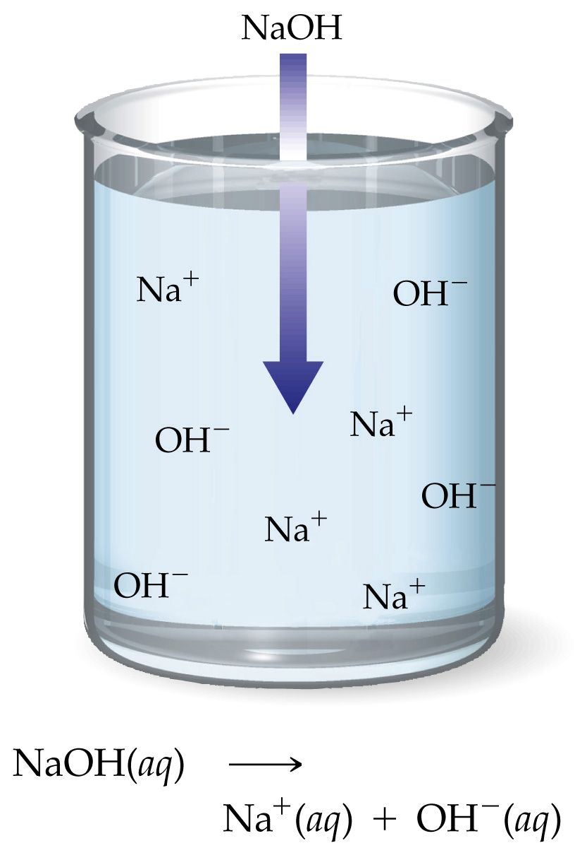
Bases
A base is a compound that dissolves in water to form a solution that has a pH more than 7. Example: Milk of Magnesia
Properties of Bases
1) Bases have a bitter taste.
2) Bases have a slippery feel.
3) Bases do not react with metals.
4) Bases turn litmus paper blue.
5) Basic solutions conduct electricity. They also dissociate into ions.
Many basic compounds contain the hydroxide ion (OH⁻).

Slide 4
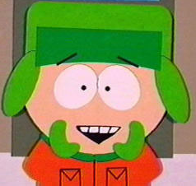
The pH Scale
pH means “power of hydrogen.”
Kyle sez:
The pH scale is a logarithmic scale.
This means that an decrease in one pH value means a 10 times increase in acidity.

Slide 5
Homework:
read pages 62 – 68
Line master 15 – Classifying and naming compounds
Read pages 70-75
Complete Check and reflect page 75
# 1-5
Prepare for section 2 Test
Section 2 review
# 1-22 even, 32, 33,
23-31 b,d,f,h,j,l,
35,36 b,d,f,h,j,l

