Slide 1
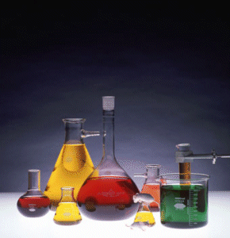
Types of
Chemical Reactions

Slide 2
Synthesis/Formation
Elements or compounds are joined together
A + B → AB
2H_{2(g)} + O_{2(g)} → 2H₂O_{(g)}

Slide 3
Synthesis/Formation
examples:
Write the balanced equation for the formation of lithium oxide from its elements.
4 Li (s) + O2 (g) → 2 Li2O (s)
Write a balanced chemical equation for each unfinished formation reaction:
calcium + nitrogen → . . .
3 Ca (s) + N2 (g) → Ca3N2 (s)
silver + oxygen → . . .
4 Ag (s) + O2 (g) → 2 Ag2O (s)

Slide 4
Decomposition
Compounds are separated into constituent parts
AB → A + B
CaCl_{2(s)} → Ca_{(s)} + Cl_{2(g)}

Slide 5
Decomposition
examples:
Write the balanced equation for the decomposition of solid magnesium sulfide into its elements.
8 MgS (s) → 8 Mg (s) + S8 (s)
Write the balanced equation for the decomposition of solid nickel (II) chloride into its elements.
NiCl2 (s) → Ni (s) + Cl2 (g)

Slide 6
Hydrocarbon Combustion
A hydrocarbon combines with oxygen and the products are always CO2 (g) and H2O(g).
C_{x}H_{x} + O₂ → CO₂ + H₂O
CH_{4 (g)} + 2 O_{2 (g)} → CO_{2 (g)}+ 2 H₂O _{(g)}

Slide 7
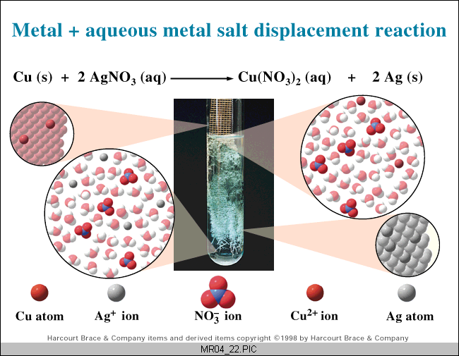
Single Replacement
A single element replaces an element in a compound.
A + BC → AC + B
Zn_{(s)} + 2 HCl_{(aq)} → ZnCl_{2(aq)} + H_{2(g)}

Slide 8
Single Replacement
examples: Write the balanced equations.
Chlorine gas is added to a solution of aqueous nickel (III) bromide and the mixture is stirred. This produces aqueous nickel (III) chloride and liquid bromine.
3 Cl2 (g) + 2 NiBr3 (aq) → 2 NiCl3 (aq) + 3 Br2 (l)
Zinc metal is placed into a solution of silver nitrate and allowed to sit. This produces aqueous zinc nitrate and solid silver metal.
Zn (s) + 2 AgNO3 (aq) → Zn(NO3)2 (aq) + 2 Ag (s)

Slide 9
Homework:
read pages 91 - 97
pg. 93 #’s 1 – 3
pg. 97 #’s 1 – 4
Answers in the back of the book

Slide 10
Double Replacement
An element from each of two compounds switch places.
AB + CD → AD +CB
H₂SO_{4(aq)} + 2 NaOH_{(aq)} → Na₂SO_{4(aq)} + 2H₂O_{(l)}

Slide 11
Double Replacement
examples: Write the balanced equations.
When aqueous copper (I) nitrate and aqueous potassium bromide are mixed, a precipitate of solid copper (I) bromide forms. Another product also forms.
CuNO3 (aq) + KBr (aq) → CuBr (s) + KNO3 (aq)
When aqueous aluminum chloride and aqueous sodium hydroxide are mixed, a precipitate of solid aluminum hydroxide forms. Another product also forms.
AlCl3 (aq) + 3 NaOH (aq) → Al(OH)3 (s) + 3 NaCl (aq)

Slide 12
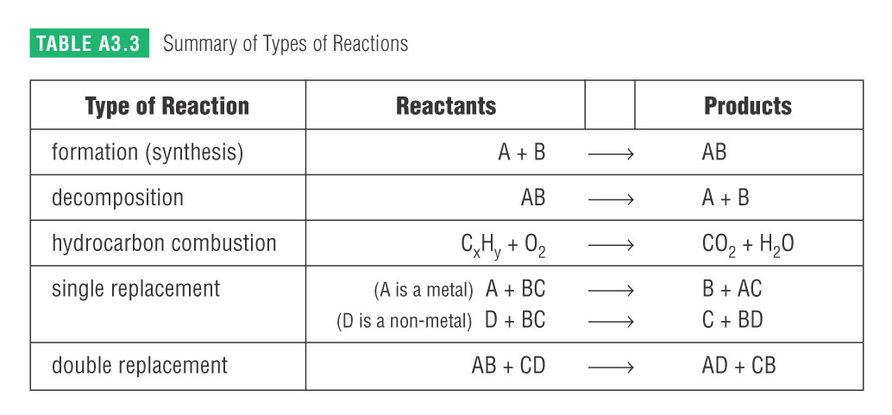
This table is found in your data booklet! USE IT!

Slide 13
Homework:
Read pages 98 – 105
Line Master 19- Classifying and Balancing Chemical Reactions
A3.3 Check and Reflect page 106
#’s 1 – 3 (a,c,e,g,i)
4-10 all

