Slide 1
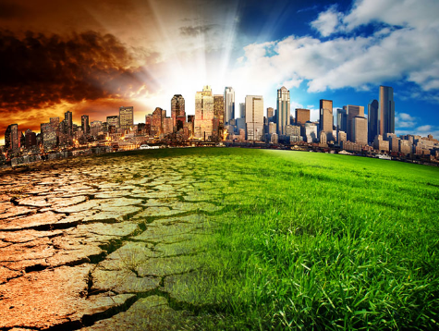
Unit D – Global Systems
Section 2: Energy transfer through the biosphere

Slide 2
Mechanism for Change
You’ve probably heard that greenhouse gases are to blame for climate change – that’s partly true.
Natural factors, including solar fluctuations, slight “wobbles” in the Earth’s orbit, and the movement of the continents have also influenced climate over Earth’s history.

Slide 3
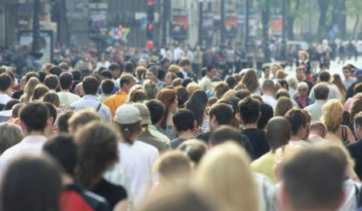
Mechanism for Change
However, in the case of current global warming, the speed and degree of change (how fast and how much) can only be explained by human activity.
to understand how heat becomes trapped in the atmosphere, we have to understand the sun’s energy.

Slide 4
Solar Energy
The sun’s energy is radiant energy – recall, that means energy that is transmitted in waves
Radiation: is the process by which solar energy reaches the Earth’s surface
There are a wide variety of waves radiating from the sun

Slide 5
Solar Energy
All waves from the sun travel at the same speed, but they vary in the amount of energy they carry.

Slide 6
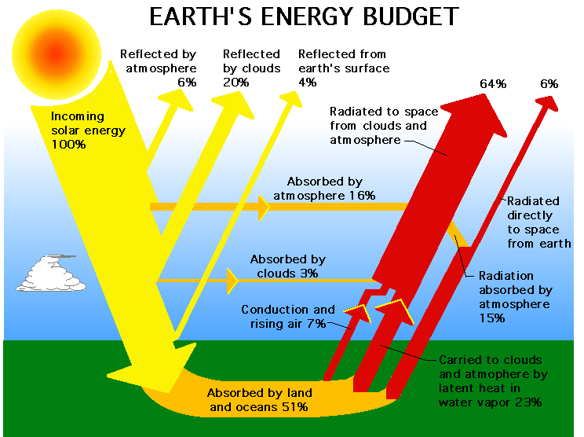

Slide 7
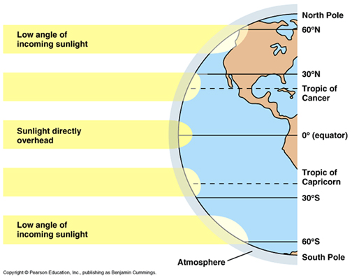
Insolation & the Angle of Inclination
Not all regions of the Earth receive the same amount of the Sun’s energy.
Insolation is the amount solar energy received by a region of the Earth’s surface.

Slide 8
Q: What causes the different seasons?
Some people think that Earth is closer to the Sun in the summer and that is what causes the hot weather, but this is not true.
Earth is actually further from the Sun in the summer and closer in the winter.
However, these minimal changes do not affect our seasons.
Earth orbits around the sun in an ellipse, not a circle.
Since Earth is tilted, different concentrations of sunlight reach the surface.
This change of concentration of sunlight rays is what creates our different seasons.

Slide 9
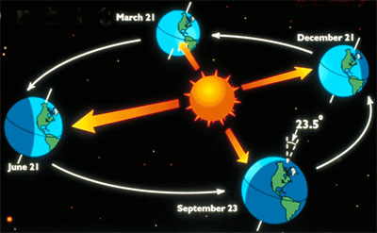
What causes the seasons?
It’s winter in the Northern Hemisphere when the north pole is tilted away from the sun
It’s summer in the Northern Hemisphere when the north pole is tilted toward the sun

Slide 10
Insolation & the Angle of Inclination
Angle of Inclination
while we often illustrate the Earth like this →
it’s actually on a tilt, like this →

Slide 11
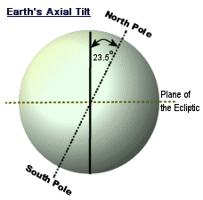
Insolation & the Angle of Inclination
Angle of Inclination
the angle of inclination refers to the angle of the Earth’s axis compared to the vertical.
while we have evidence that suggests the Earth wobbles a bit, the angle of inclination is 23.5º

Slide 12
Insolation & the Angle of Incidence
The Earth orbits the Sun once per year.
The Earth’s tilt is the reason for the seasons.
Remember, you have to distinguish between hemispheres when discussing seasons.

Slide 13
Earth / Sun Relationships
A equinox occurs when the Earth is tilted sideways relative to the sun
the number of daylight hours = the number of hours of darkness
Spring Equinox – March 21
Fall Equinox – September 21
*in the Northern Hemisphere

Slide 14
Earth / Sun Relationships
A solstice occurs when the Earth is tilted toward or away from the sun
Longest and shortest days of the year
Summer solstice – June 21
Winter solstice – December 21
*in the Northern Hemisphere

Slide 15
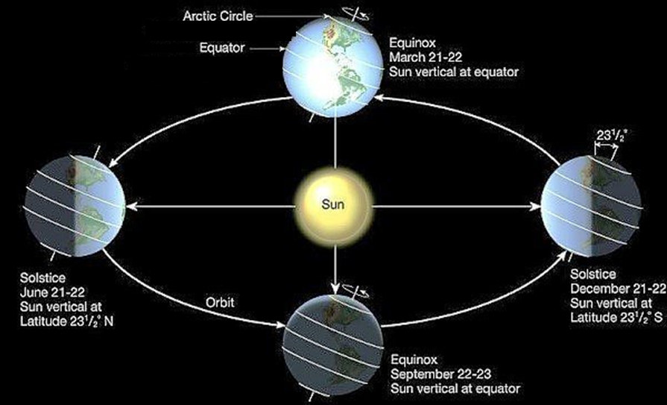
Earth / Sun Relationships

Slide 16
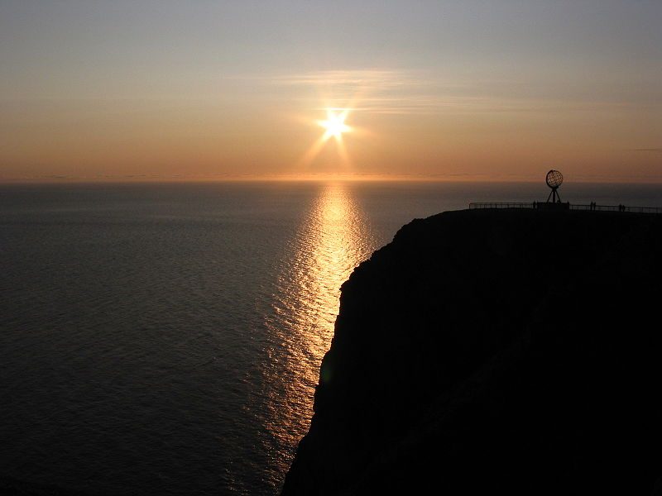
Earth/Sun Relationships
Areas close to the equator:
experience short sunrises and sunsets
have very little variance in their number of daylight hours from season to season
12 hours of daylight, 12 hours of darkness every day
Areas close to the poles:
experience long sunrises and sunsets
have significant variance in their number of daylight hours
in summer, more than 23 hours of daylight, 1 hour of darkness
in winter, less than one hour of daylight, 23 hours of darkness
Notes:
top photo – tropical sunset
middle photo – midnight sun, Norway
bottom video – “Arctic Sun” project by Tropicana Orange Juice

