Slide 1
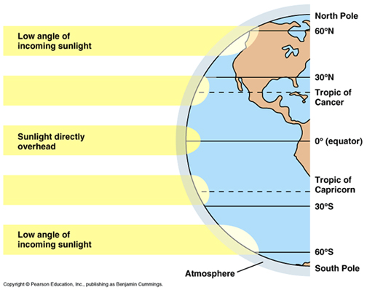
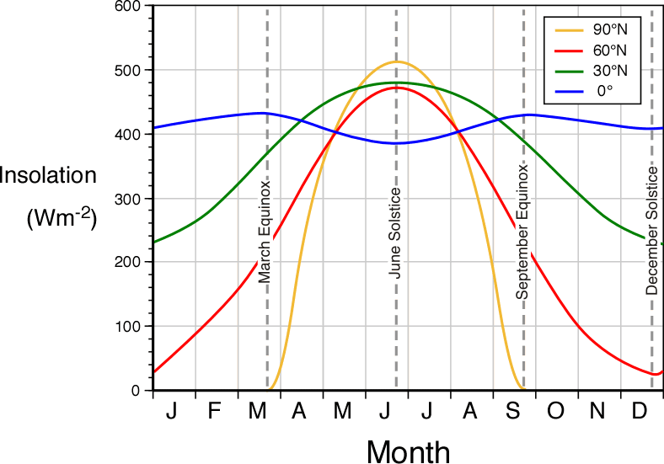
Angle of Incidence
The shape of the Earth also plays a part in insolation.
Because it’s spherical, a light ray hitting at the equator strikes the Earth with more intensity than a light ray hitting at a higher latitude.

Slide 2
Angle of Incidence
The Angle of Incidence is the angle between the incoming sun ray and a line perpendicular to the Earth’s surface.
Notes:
Demo: You will need a flashlight, a piece of grid paper. First, turn on the flashlight and hold the notebook paper a couple feet away from it. Hold the flashlight perfectly horizontal and hold the paper perfectly vertical. You should see a focused beam of light on the paper. Draw the outline of the beam of light. Now, tilt the paper backwards at a slight angle (23.5 degrees if you know how much that is!). You should now see that the same beam of light is spread over a greater area of the paper. Draw the outline of the beam hitting the tilted paper.
Now measure the area of the two beams (vertical and tilted) by counting the number of squares that were illuminated. Assume that the amount of light coming out of the flashlight equals 1 photons per square of grid paper (this number is totally fabricated but works for the purposes of the demo). Calculate the intensity of light per square in each situation.

Slide 3
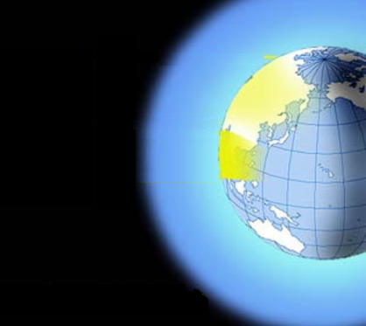
90º angle
sun is intense
40º angle
sun is diffuse
Notes:
Demo: You will need a flashlight, a piece of grid paper. First, turn on the flashlight and hold the notebook paper a couple feet away from it. Hold the flashlight perfectly horizontal and hold the paper perfectly vertical. You should see a focused beam of light on the paper. Draw the outline of the beam of light. Now, tilt the paper backwards at a slight angle (23.5 degrees if you know how much that is!). You should now see that the same beam of light is spread over a greater area of the paper. Draw the outline of the beam hitting the tilted paper.
Now measure the area of the two beams (vertical and tilted) by counting the number of squares that were illuminated. Assume that the amount of light coming out of the flashlight equals 1 photons per square of grid paper (this number is totally fabricated but works for the purposes of the demo). Calculate the intensity of light per square in each situation.

Slide 4
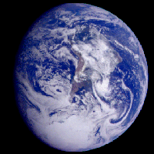
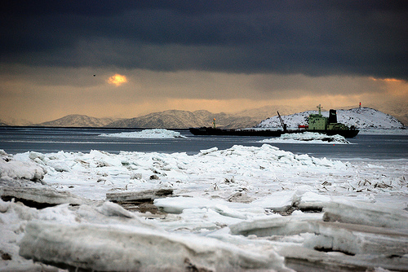
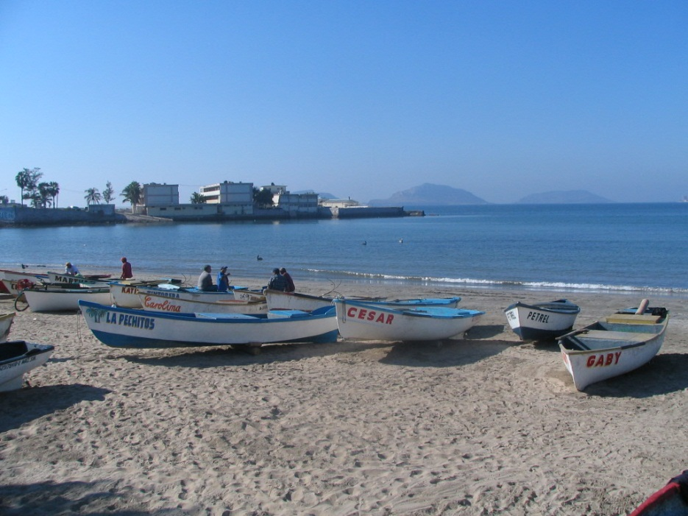
Less energy per m²
More energy per m²
December in Nunavut, Canada
December in Mazatlan, Mexico

Slide 5
Albedo
Ever notice when you go out on a hot day wearing a black t-shirt, you feel warmer than if you were wearing white?
Conversely, when you go snowboarding, notice how the sun reflects very brightly off the white snow than it does off rocks or exposed ground?
These two phenomena can be explained using a concept called albedo.

Slide 6
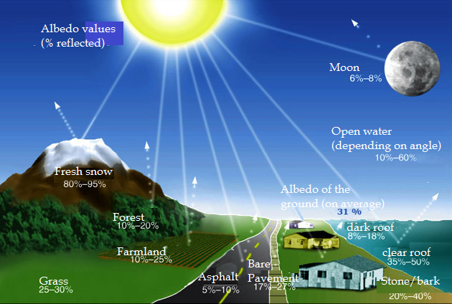
Albedo
The albedo of a surface is the percent of solar radiation that it reflects
a white shiny surface (e.g. snow) has a high albedo
a dark, dull surface (e.g. forest, dirt) has a low albedo
The average albedo for Earth’s surface is 30% (or 0.30).
Notes:
open water 10-60%
fresh snow 80 – 95%
forest 10-20%
farmland 10-25%
grass 25 – 30%
asphalt 5 – 10%
bare pavement 17-27%
dark roof 8 – 18%
light roof 35-50%
stone bark 20 – 40%
open water 10 – 60% (depending on angle of sun)

Slide 7
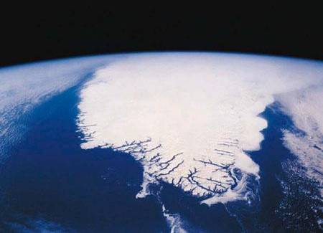
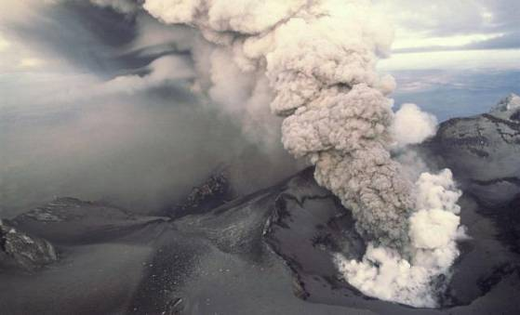
Albedo
Albedo is a measure of how much light is reflected by a surface.
Light from the sun is either absorbed and converted to heat, or reflected back to space.
Snow, ice, clouds and suspended particles (e.g. volcanic ash) have high albedos
When light is reflected back to space, it can have a global cooling effect.

Slide 8
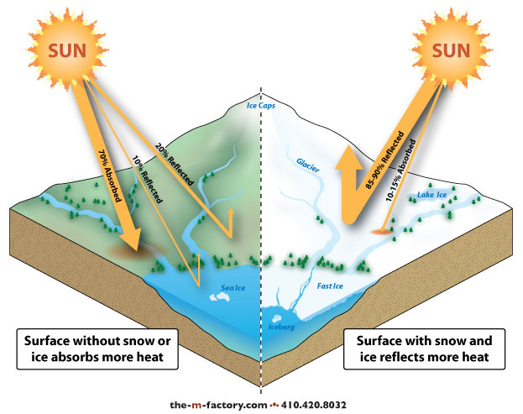
Implications of Albedo
Because snow and ice have a much higher albedo, regions that are frozen reflect more snow than regions without snow or ice
The albedo of most regions in Canada is significantly higher in winter than in summer
In the arctic, the albedo is high year-round
Deserts also have high albedo because they lack vegetation to absorb the sun’s rays

Slide 9
Summary of Earth/Sun Relationships
The climate of a region is largely determined by the insolation, or amount of sunlight, the area gets
Insolation is affected by
the Angle of Inclination – due to the tilt of the Earth, areas further from the equator see more variation in seasonal temperatures and the number of daylight hours
the Angle of Incidence – due to the spherical shape of the Earth, areas further from the equator get less direct and intense sun
Once the sun hits the Earth’s surface, it may be absorbed or reflected, depending on the albedo of the surface

Slide 10
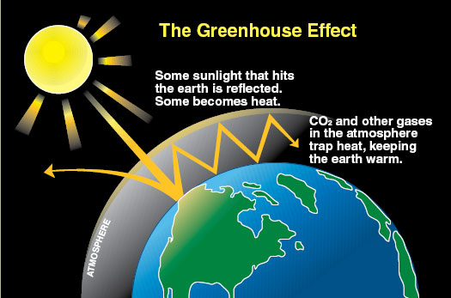
Natural Greenhouse Effect
Recall, energy cannot be destroyed – so if some/most of the sun’s rays reflect off the Earth’s surface, where do they go?
The energy gets radiated back into the atmosphere in the form of thermal energy

Slide 11
Natural Greenhouse Effect
Normally, a portion of this thermal energy is lost to space, and a portion is absorbed by the atmosphere
The trapping of this heat by the atmosphere is called the Natural Greenhouse Effect
Without this effect, the Earth would be 33ºC colder

Slide 12
Greenhouse Gases
Greenhouse gases are gases that contribute to the greenhouse effect
The main naturally-occurring greenhouse gas is water vapour. Other naturally-occurring greenhouse gases include

Slide 13
Net Radiation Budget
Before human activity made such an impact, the Earth’s radiation budget was balanced
that is, some thermal energy was reflected out into space, and some absorbed by the atmosphere
the net result was zero
net radiation budget = incoming radiation – outgoing radiation

Slide 14
Net Radiation Budget
It is important to note that the budget is balanced on a planetary basis, but some regions are in surplus and some in deficit.
The areas at the equator tend to have higher insolation, which gives them a surplus.
The areas closer to the poles tend to have lower insolation, which gives them a deficit.

Slide 15
Net Radiation Budget
If a build-up of greenhouse gases causes more radiation to be absorbed by the atmosphere, we have a surplus → this will cause global temperatures to rise.

Slide 17
Thermal Energy Transfer
Recall, thermal energy (or heat) moves from warm to cool
Radiation - emission of energy as waves
when radiant energy encounters particles of matter, those particles will either re-radiate the energy back into space or pass the energy on to other particles
two methods for passing energy onto other particles:
conduction
convection

Slide 18
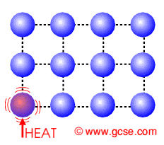
Conduction
Transfer of heat through direct contact between particles.
This is the most common method of heat transfer in solids, because it does not require movement of the particles to a different location.
Particles pass their energy on to neighbouring particles by vibrating against them.

Slide 19
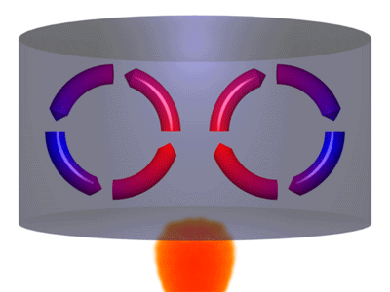
Convection
The transfer of thermal energy through the movement of particles from one location to another.
usually occurs in fluids – liquids and gases – by inducing a convection current in the fluid

Slide 20
Convection
Some of the particles heat up and begin moving faster
As the warm particles move apart, they become less dense and rise
When the particles contact cooler particles, they cool and fall back down

