Slide 1
Thermal Energy Transfer in the Atmosphere
The temperature of the air in the atmosphere near the equator warms and rises toward the poles
The air at the poles then cools and sinks back down
because the cool air has higher atmospheric pressure, it moves toward the equator where the pressure is lower
wind is the movement of this cooler air from an area of high pressure to an area of low pressure
if the Earth were still (and not spinning), their would be a continuous convection current between the equatorial and polar air

Slide 2
Thermal Energy Transfer in the Atmosphere
Convection currents causes air to move directly North-South.

Slide 3
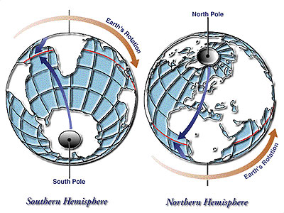
Thermal Energy Transfer in the Atmosphere
However, since the Earth is spinning, the winds are deflected to the right (in the Northern Hemisphere) or the left (in the Southern Hemisphere)
This deflection is called the Coriolis Effect.

Slide 4
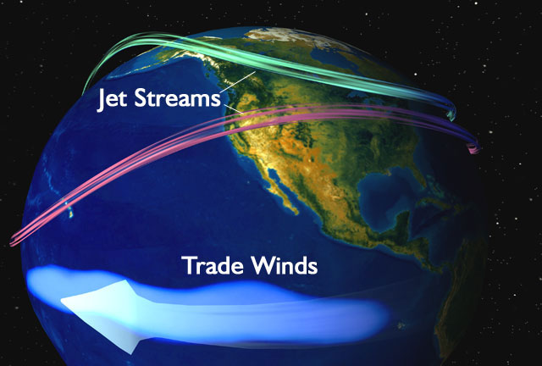
Global Wind Patterns
As a result of convection currents and the Coriolis Effect, global winds follow a predictable pattern
Trade winds are the normal wind patterns that transfer heat around the globe

Slide 5
Global Wind Patterns
Jet streams are bands of fast moving air in the stratosphere that travel much faster than wind in the troposphere
changes in normal jet stream patterns are important in predicting weather changes and extreme weather events such as storms and cyclones

Slide 6
Thermal Energy Transfer in the Hydrosphere
The hydrosphere transfers thermal energy in a similar way as in the atmosphere
Surface water is pushed by trade winds.
Deeper water travels by convection currents
Warmer waters near the equator are driven by convection currents toward the poles
currents in the Northern Hemisphere circle clockwise
currents in the Southern Hemisphere circle counterclockwise
Unlike air currents which don’t have to circulate around something, water currents are disrupted by the continents.

Slide 7
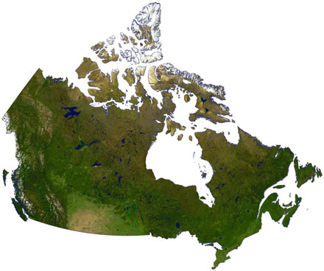
Consider This:
These three Canadian cities are at nearly the exact same latitude
Because they are all the same distance from the equator, they are subject to the same air currents, so we might expect that they all have the same average temperatures.
49ºN

Slide 8
However, this is what Environment Canada actually reports:
City | Latitude | Average Annual Temperature (ºC) | Average January Temperature (ºC) | Average July Temperature (ºC)
Vancouver, BC | 49.11ºN | 10.1 | 3.3 | 17.5
Lethbridge, AB | 49.38ºN | 5.7 | - 7.8 | 18.0
Gander, NF | 48.56ºN | 3.8 | - 7.4 | 16.0

Slide 9
Notice:
Vancouver has the warmest annual average, and the least monthly temperature variation
Gander has the coolest annual average, but also less variation
Lethbridge’s average annual temperature is between the other two, but sees the most variation
These three observations can all be explained by the presence or absence of a large body of water next to the city.

Slide 10
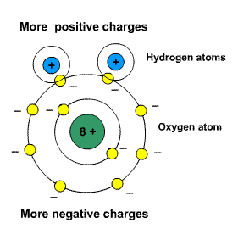
Specific Heat Capacity
At several points in this course, you’ve been asked to consider the special properties of water (e.g. good solvent, polar molecule, solid is less dense than the liquid, cohesive & adhesive, etc.)

Slide 11
Specific Heat Capacity
There is one more property of water that affects global energy transfer: water has an unusually high specific heat capacity.
Specific heat capacity refers to the ability of a substance to absorb thermal energy without changing temperature.
The high specific heat capacity of water means that it absorbs much of the sun’s radiant energy, but stays at a constant temperature.

Slide 12
What Does this Mean for the Three Cities?
Cities next to oceans experience more moderate (less extreme) temperatures because water can absorb heat without changing temperature.
Because Vancouver and Gander are located on oceans, the air temperature is moderated by the water
that means they will see less variation in their climate from month to month
Vancouver is located next to a warm ocean current coming from the equator
Gander is located next to a cool ocean current coming from the arctic
this explains why Vancouver has a warmer average temperature

Slide 13
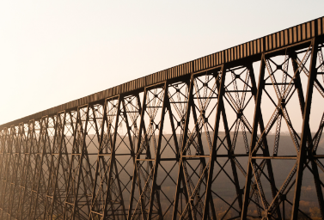
What Does this Mean for the Three Cities?
Because Lethbridge is land-locked, it does not benefit from the regulating effect of the ocean, and therefore experiences greater temperature variation from month to month

Slide 14
Quantity of Thermal Energy, Q
The quantity of thermal energy (Q) is the amount of thermal energy (measured in joules) that is absorbed or released when the temperature of a substance changes
It is affected by
the mass of the substance (measured in grams)
the amount of change in temperature (measured as the number of ºC it changes)
how easily the substance changes temperature (as indicated by its specific heat capacity)

Slide 15
Calculating Heat Transfers
The amount of energy gained by a substance as it increases in temperature:
Energy gained in Joules (J)
Mass in grams (g)
Specific heat capacity
(J/g•˚C)
Change in temperature in degrees C
NOTE THAT MASS IS IN GRAMS!!!!

Slide 16
Quantity of Thermal Energy, Q
The formula is Q = mc∆t , where:
Q = quantity of thermal energy (J)
m = mass of the substance (g)
c = specific heat capacity of the substance in (J/g•˚C)
∆t = change in temperature (ºC)

Slide 17
Understanding Specific Heat Capacity
The specific heat capacity of water is 4.19 J/g•ºC
this means it takes 4.19 J of energy to warm one gram (one milliliter) of water by one degree Celsius.
This number is quite high compared to other substances, for instance:
aluminium: 0.900 J/g•ºC
copper: 0.380 J/g•ºC
lead: 0.130 J/g•ºC
Which means, compared to these metals, it takes a lot more energy to make water change temperature
Or, put another way, water can absorb a lot more energy without changing temperature

Slide 18
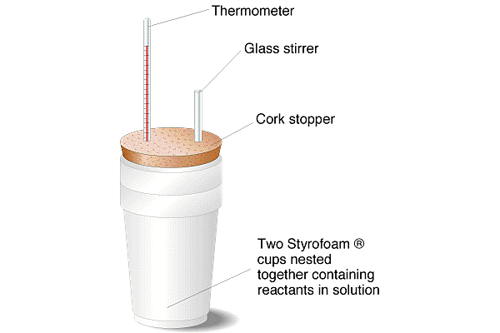
Finding the Specific Heat Capacity
The ‘c’ of other substances can be determined using a calorimeter
a calorimeter is a container that is insulated to avoid heat loss (it can be made of metal like a Thermos or as simple as two Styrofoam cups)
to determine the value of ‘c’ for another substance, it is massed, placed in the calorimeter, and heated
by knowing how much heat you used (Q) and measuring the temperature change (∆t) you can calculate ‘c’

Slide 19
Example:
50.0g of water at 25.0ºC is heated to 50.0ºC on a hot plate. Given that the theoretical specific heat capacity of water is 4.19 J/g•ºC, determine the value for Q.
Solution:
Q = mc∆t
= (50.0g)(4.19 J/g•ºC)(50.0 – 25.0ºC)
= 5237.5 J
= 5.24 x 10³ J or 5.24 kJ

Slide 20
Example:
How much thermal energy must be released to decrease the temperature of 1.00 kg of water by 10.0ºC?
Q = ?
m = 1.00 kg = 1000 g
c = 4.19 J/g•ºC (in data booklet)
∆t = 10.0ºC
Q = mc∆t = (1000g)(4.19 J/g•ºC)(10.0ºC) = 41 900J
= 4.19 x 10⁴ J or 41.9 kJ

Slide 21
Practice Problems:
1) a 200g mass of water at 4.00ºC is warmed to 22.0ºC. Determine the amount of thermal energy absorbed.
2) Determine the quantity of energy required to warm a 1.00-kg block of ice from – 15ºC to 0.0ºC. The theoretical specific heat capacity of ice is 2.00 J/g•ºC
3) 21.6 J of energy are used to heat a 2.0g piece of iron by 24.0ºC. What is the experimental specific heat capacity of iron?

Slide 22
Solutions:
1) A 200g mass of water at 4.00ºC is warmed to 22.0ºC. Determine the amount of thermal energy absorbed.
Q = mc∆t
= (200g)(4.19 J/g•ºC)(22.0 – 4.00ºC)
= 15 084 J
= 1.51 x 10⁴J

Slide 23
Solutions:
2) Determine the quantity of energy required to warm a 1.00-kg block of ice from – 15ºC to 0.0ºC. The theoretical specific heat capacity of ice is 2.00 J/g•ºC
Q = mc∆t
= (1000g)(2.00 J/g•ºC)(0.0 – -15ºC)
= 30 000J
= 3.0 x 10⁴J

Slide 24
Solutions:
3) 21.6 J of energy are used to heat a 2.0g piece of iron by 24.0ºC. What is the experimental specific heat capacity of iron?
Q = mc∆t
c = Q/m∆t
= 21.6 J / (2.0g)(24.0ºC)
= 0.45 J/g•ºC
This is slightly different than the theoretical specific heat capacity of iron (0.449 J/g•ºC) because of limits in the accuracy of the experiment

