Slide 1
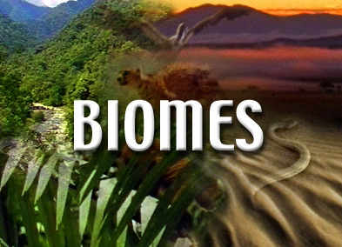
Unit D
D2.4 - Biomes

Slide 2
Biomes are Open Systems
A biome is a large geographical region with particular climactic conditions.
A description of a biome includes
the typical range of temperature and precipitation
the plants and animals that are adapted to those conditions

Slide 3
Biomes are Open Systems
Biomes function as a system – a set of interconnected parts that may exchange energy and/or matter with the surroundings
open systems – exchange energy AND matter with the surroundings
examples – the human body, a home, a fish tank, cells
closed systems – exchange energy, but not matter with the surroundings
examples – a sealed Tupperware container, the hydrosphere

Slide 4
Biomes are Open Systems
A biome gets input energy from the sun, and loses energy through heat, or chemical energy to other biomes.
A biome exchanges matter such as air, water, and plants and animals with other biomes
Because they exchange both energy and matter with the surroundings, biomes are considered to be open systems

Slide 5
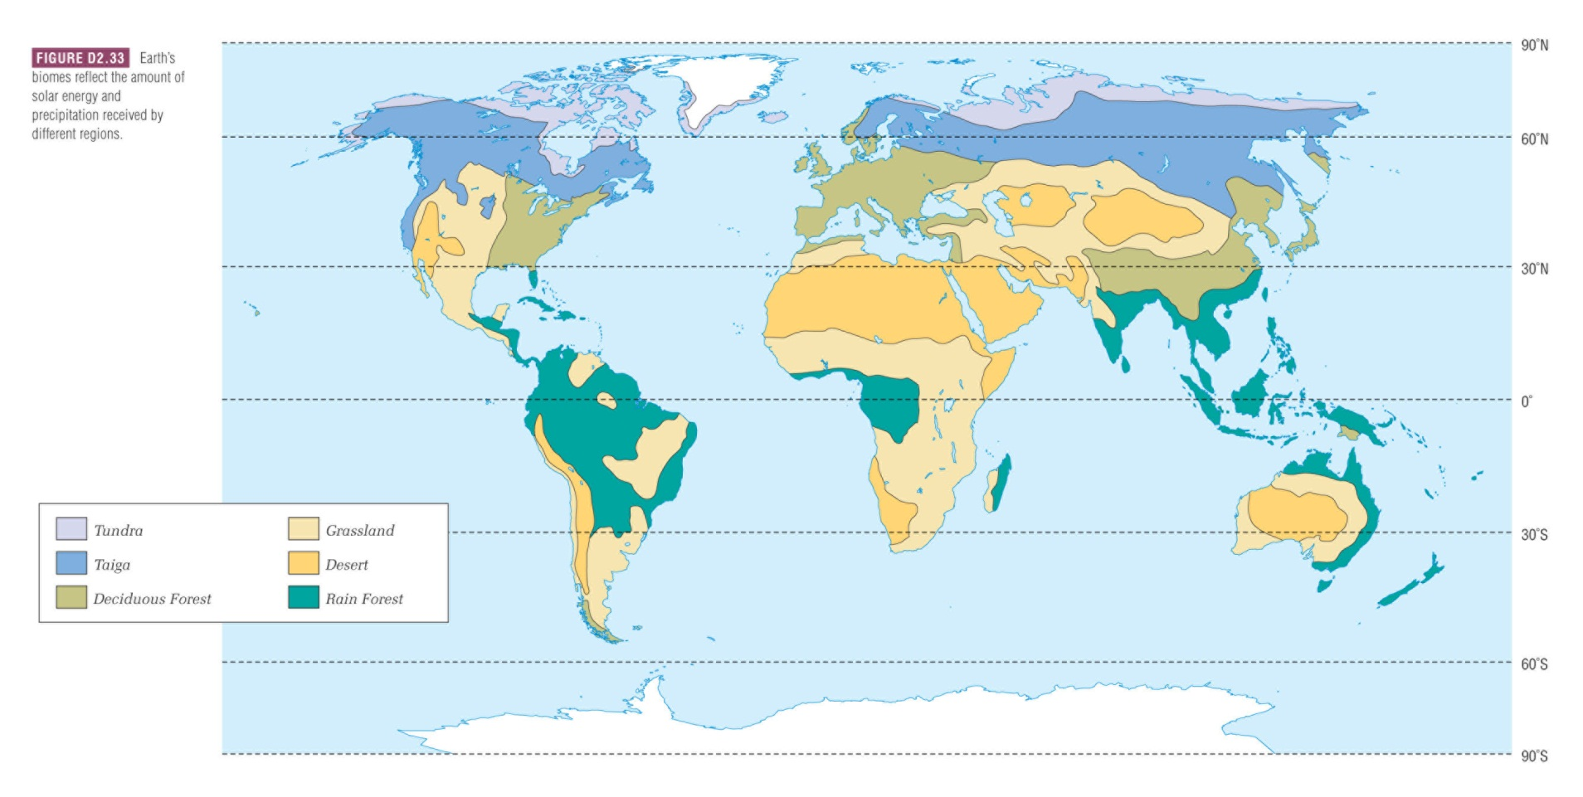
Earth’s Biomes
Different classification systems exist for biomes – some textbooks define as many as 20 different biomes
In this course we classify the Earth according to SIX biomes

Slide 6
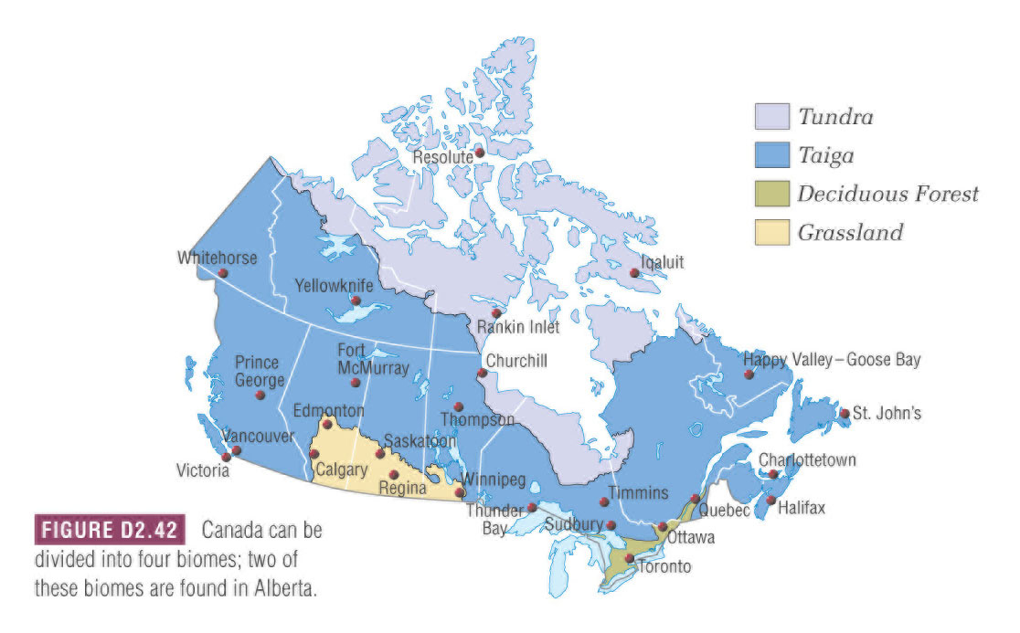
Canada’s Biomes

Slide 7
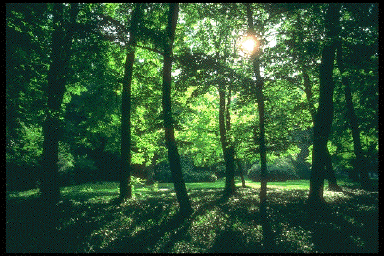
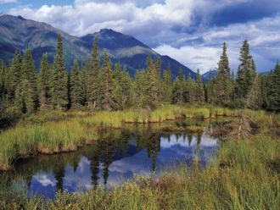
The Six Biomes
Each biome has a typical range of temperature & precipitation
They can be plotted on a graph
deserts are hot and dry
rain forests are hot and wet
tundra are cold and dry
cold TEMPERATURE hot
dry PRECIPITATION wet

Slide 8
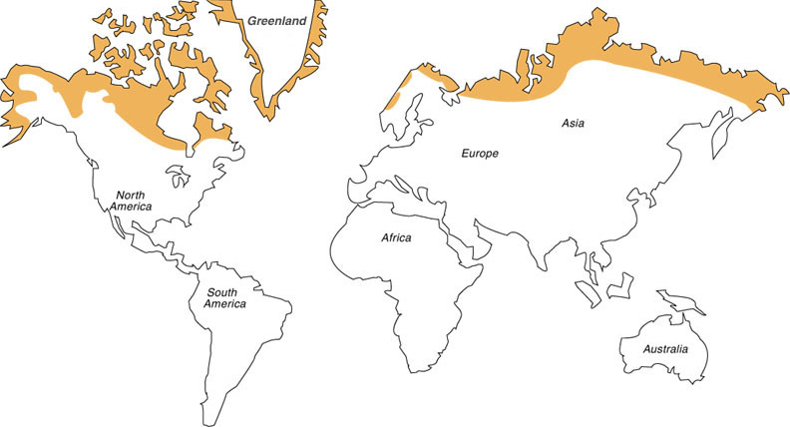
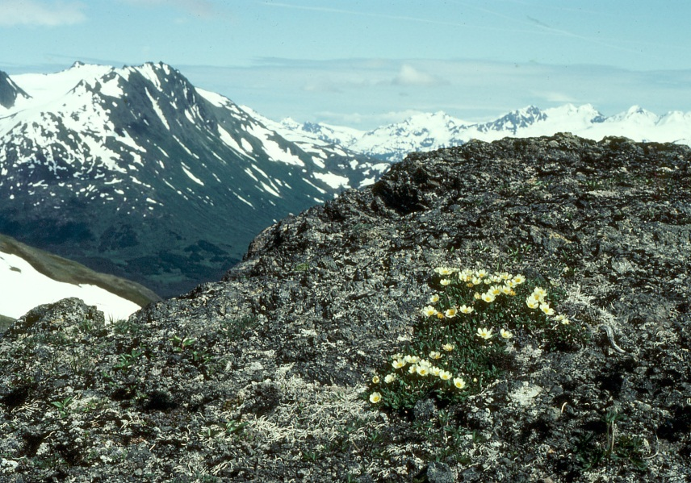
Tundra
Most tundra is found around the Arctic circle
The number of hours of daylight vary greatly and in winter, this biome receives little to no isolation.
Ice and snow cover most of the tundra year-round, known as permafrost.
This means the region has high albedo and therefore reflects most radiation back into space

Slide 9
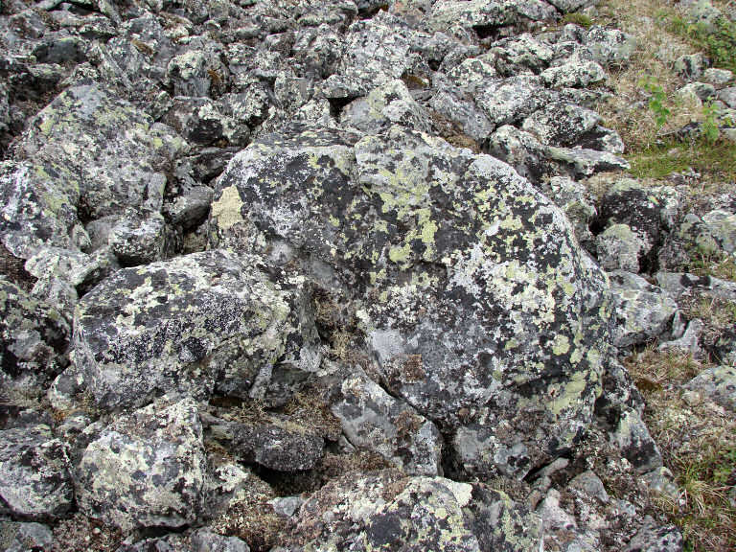
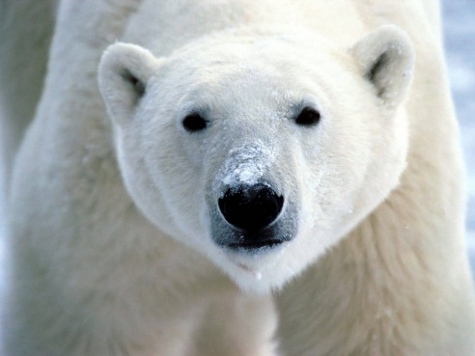
Tundra
Because of a lack sun, the tundra is characterized by the coldest and driest conditions of any biome
plants
short life cycle (to reproduce during short summer)
small and lie close to ground
animals
feed mostly on fish
protect themselves by burrowing underground or with thick coats and squat bodies
cold TEMPERATURE hot
dry PRECIPITATION wet

Slide 10
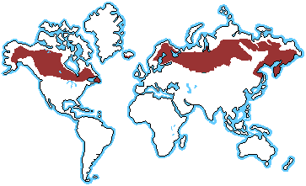
Taiga
Typically found just south of the tundra
Also called the boreal forest, due to the abundance of conifer (evergreen) trees.
Taiga’s conditions are similar but less extreme than tundra
longer growing season
slightly warmer and wetter

Slide 11
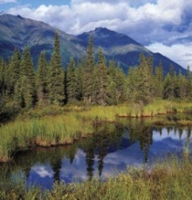
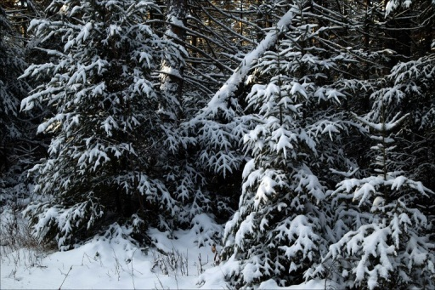
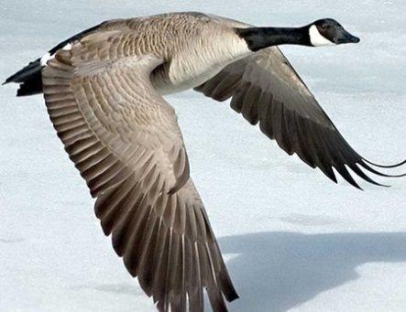
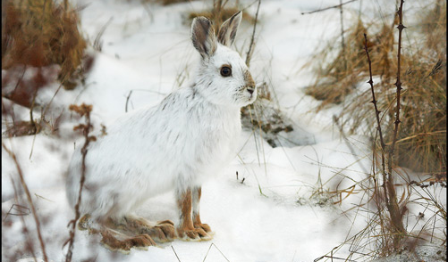
Taiga
Plants
most have needles to make them resistant to drought and freezing during long winters
“evergreen” means they can do photosynthesis year-round
Animals
tend to be inactive during winter (burrow or hibernate)
may have colour-changing coats for camouflage
birds tend to migrate south for winter
cold TEMPERATURE hot
dry PRECIPITATION wet

Slide 12
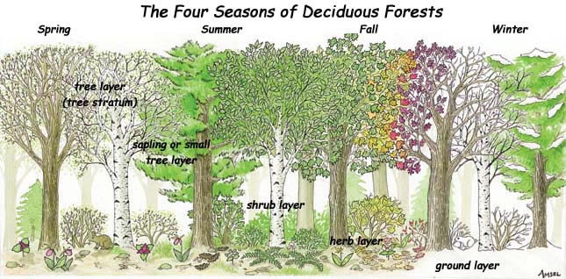
Deciduous Forest
Distinguished by trees that lose their leaves in the fall
Found on N and S America, Asia, Europe and Australia
More moderate climate and longer growing season than taiga
Due to a variation in insolation, this biome has very distinct winter and summer seasons
Rich mixture of plants and animals are supported by this type of forest.

Slide 13
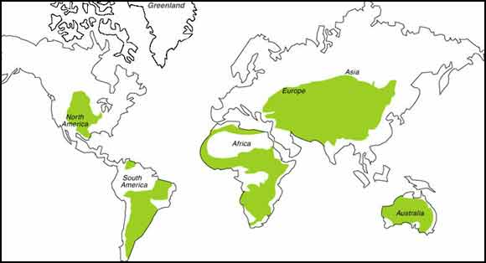
Deciduous Forest
Roughly the same precipitation as taiga but with warmer temperatures
Plants
broad-leaved trees
forests have lots of undergrowth
Animals
most are active year round, but tend to reproduce in spring and summer
cold TEMPERATURE hot
dry PRECIPITATION wet

Slide 14
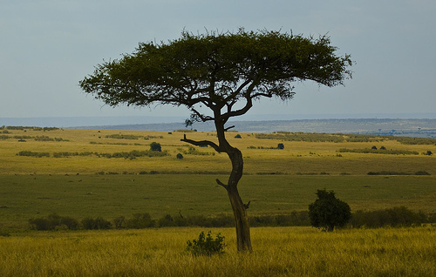
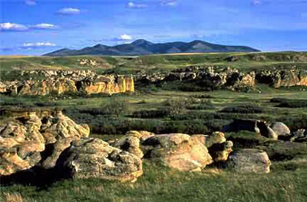
Grassland
Grasslands occur on all continents and may have different names such as prairie or savanna.
Characterized by grasses and few trees
Temperature range can vary greatly depending on the continent, however it always receives little precipitation.

Slide 15
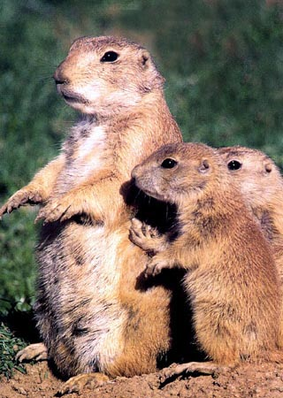
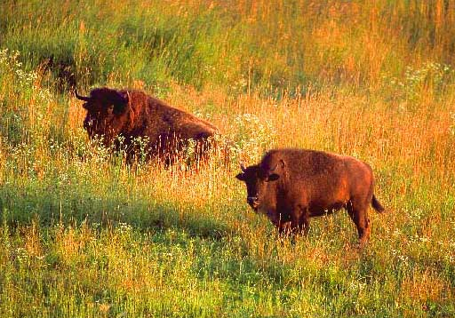
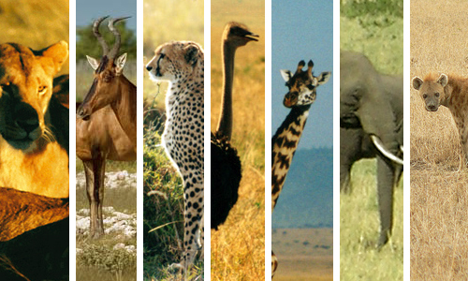
Grassland
Plants
drought-tolerant with extensive root systems
Animals
tend to be grazers, and able to travel long distances
cold TEMPERATURE hot
dry PRECIPITATION wet

Slide 16
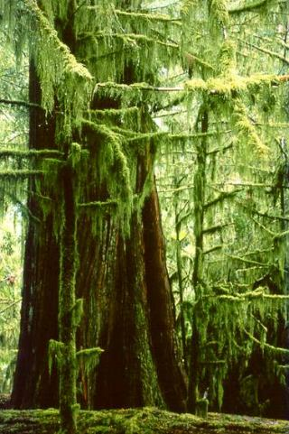
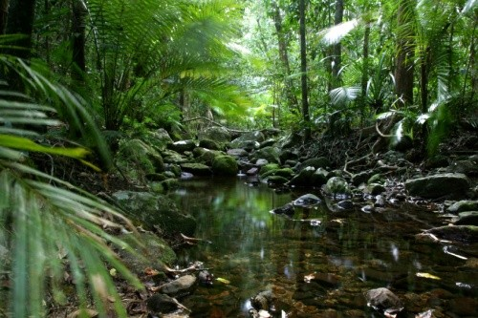
Rainforest
The warmest and wettest biome, also characterized by the richest variety of plants and animals.
Plants grow year-round
Amount of shade varies at different levels of the forest

Slide 17
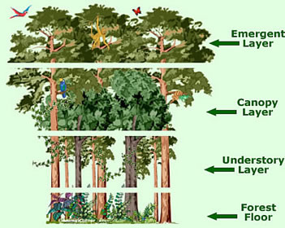
Rainforest
Plants
maximize their access to sunlight
grow tall, high
leaves are broad and dark green
Animals
active year-round
adapted to a particular part / level of the rain forest
ground
mid-tree level
treetops
cold TEMPERATURE hot
dry PRECIPITATION wet

Slide 18
Desert
Like tundra, the dry conditions mean little plant life.
Unlike tundra, deserts receive high insolation and are marked by hot temperatures during the day.
Since there is a lack of water and plant life to hold the day’s heat, deserts tend to be quite cold at night
cold TEMPERATURE hot
dry PRECIPITATION wet

Slide 19
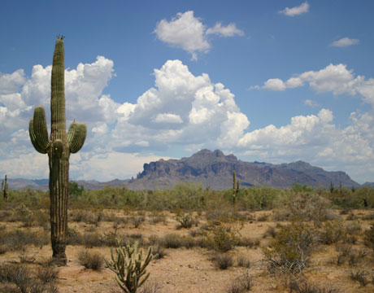
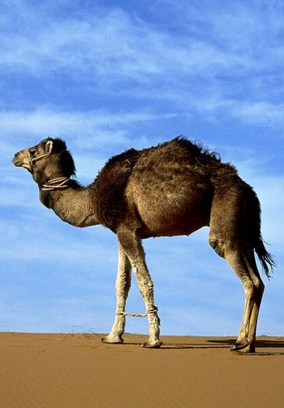
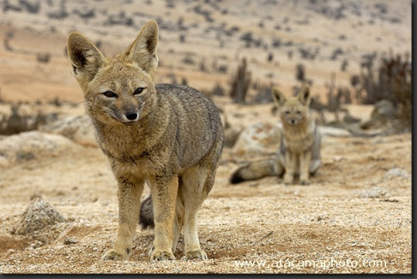
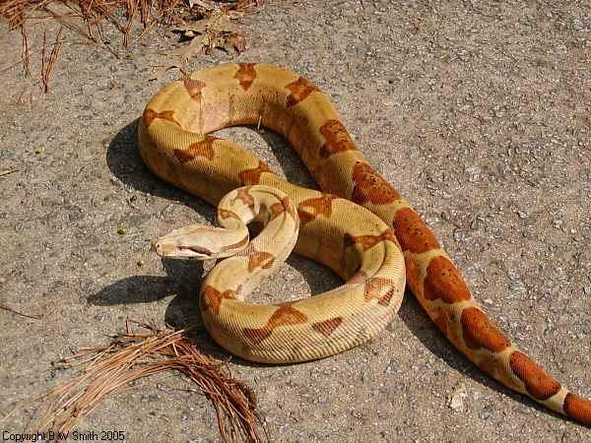
Desert
plants
cacti are adapted to retain water and minimize transpiration
animals
require very little water
tend to be more active at night
one concern about climate change is the growth of the desert biome as other biomes become hotter and drier

Slide 20
My Biome

Slide 21
Climatographs
Climatographs are summary graphs that describe the average temperature and precipitation each month for a given region
the horizontal axis is divided by month
average precipitation is marked along the left vertical axis and is represented by bars on the graph
average temperatures are marked along the right vertical axis and are represented by a line graph

Slide 22
Uses of Climatographs
Climatographs are most useful when they are used to compare the climate of two different areas
They can also help identify the factors that determine the climate, such as
insolation – mostly due to the latitude of the region
patterns of global winds
patterns of warm and cold ocean’s currents
You can also use climatographs to predict the biome of the region

Slide 23
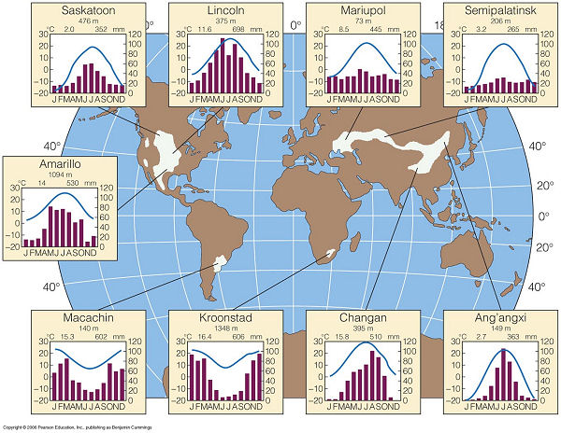
Practice Problem:
Grasslands vary in plants and animals and are located all over the world
What general trends do you notice in these grassland climatographs?

Slide 24
Practice Problems:
Below are five climatographs that represent five Canadian cities.
1) Match each climatograph with the biome it represents
2) Which biome is not represented?
3) Match the biome with its city. The five cities are:
Ottawa, ON
Grande Prairie, AB
Whitehorse, YT
Nanaimo, BC
Calgary, AB

Slide 26
City A represents the grassland biome
CALGARY, AB

Slide 27
City B represents the taiga biome
GRANDE PRAIRIE, AB

Slide 28
City C represents the tundra biome
WHITEHORSE, YT

Slide 29
City D represents the (temperate) rainforest biome
NANAIMO, BC

Slide 30
City E represents the deciduous forest biome
OTTAWA, ON The biome not represented is the desert biome.

