Slide 1
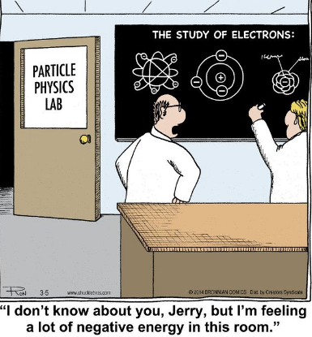
Unit D
Energy Flow in Global Systems

Slide 2

Unit D – Global Systems
D1 – The Biosphere

Slide 3
Major Themes of This Unit:
The Earth is a big place – how can we divide it up from a geological and ecological point of view?
Climate change is a “hot” topic – how do we know what we know and why are we worried?
If energy cannot be created or destroyed, how is it transferred throughout the biosphere?
Can we calculate this energy transfer?

Slide 4

Earth – Our Biosphere
The biosphere refers to the thin layer of Earth that has conditions suitable for life, includes:
  all living things
  the physical environment that supports those living things.

Slide 5
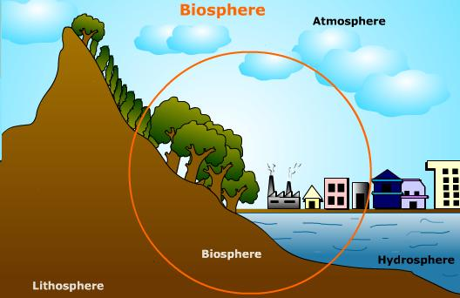
Earth-Our Biosphere
  subdivided into three components that interact:
    atmosphere – layer of gases that surround the Earth
    lithosphere – a.k.a. Earth’s crust – the solid portion off the Earth (includes the land under the oceans)
    hydrosphere – all the water on Earth (includes liquid, vapour and ice)

Slide 6
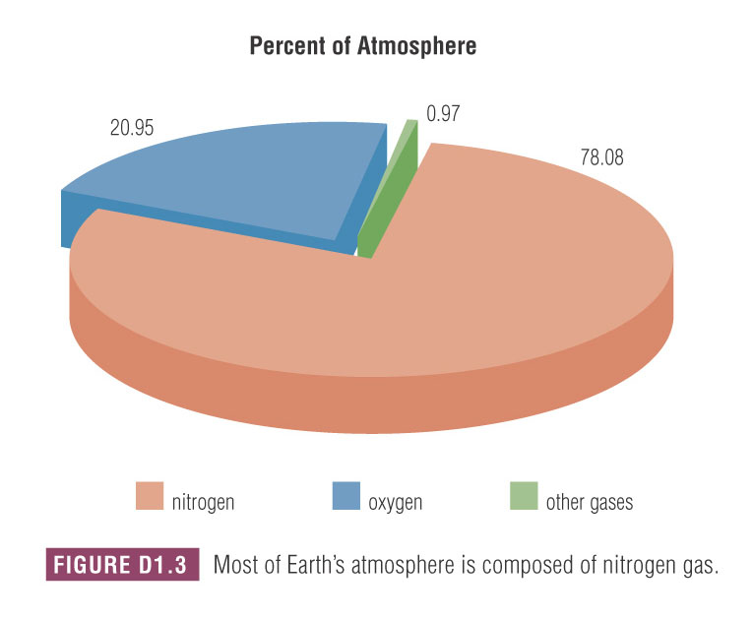
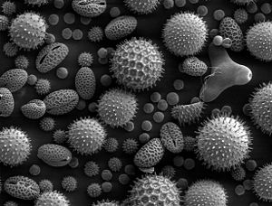
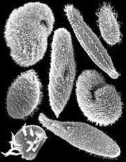
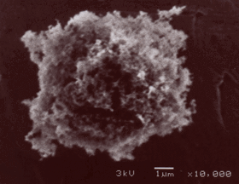
Atmosphere
Made up of a mixture of gases,
  78% N_{2(g)}, 21% O_{2(g)}, 1% other
  “other” includes Ar, CO₂, Ne, He, CH₄ and Kr
  does not include H₂O because it is considered to be part of the hydrosphere
Also includes tiny solid particles called atmospheric dust.
  including living things (e.g. pollen, micro-organisms) and non-living (e.g. soot)

Slide 7
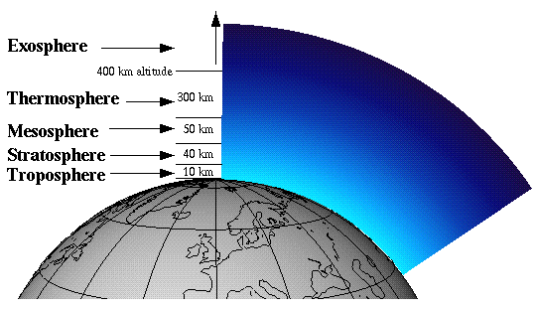
Atmosphere
Divided up into four layers based on altitude (distance from sea level)

Slide 8
Atmosphere Layer #1 - Troposphere
  From 0 to 10 km
  Temperature 15ºC to – 60ºC
only layer of the atmosphere with a mix of gases and temperature to support a variety of life (including humans).

Slide 9
Atmosphere Layer #1 - Troposphere
contains most of the CO₂, H₂O and atmospheric dust present in the atmosphere.
where most of our weather occurs, including wind and precipitation

Slide 10
Atmosphere Layer #2 - Stratosphere
  From 10 to 50 km
  Temperature – 60ºC to 0ºC
only isolated clumps of living cells found living in this layer

Slide 11
Atmosphere Layer #2 - Stratosphere
contains most of the ozone layer
  ozone is a molecule made up of three oxygen atoms (O_{3(g)})
  protects living organisms from sun’s UV radiation

Slide 12
Atmosphere layer #3 - Mesosphere
  From 50 to 80 km
  Temperature 0ºC to – 100ºC

Slide 13
Atmosphere layer #4 - thermosphere
  From 80 to 300 km
  Temperature – 100ºC to 1500ºC
named for the high temperatures near the edge of the layer (closest to the sun)

Slide 14
Lithosphere
Floats on top of the fluid layer called the mantle.
Extends from the Earth’s surface inward.
  as thin as 5 km, as thick as 100 km in places.
Warmed both by the heat from the sun and the heat from Earth’s core.

Slide 16
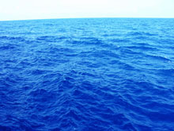

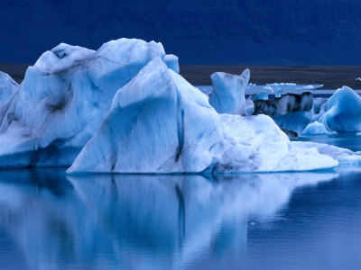
Hydrosphere
The total amount of water on Earth remains constant.
Warmed mostly by the sun, but also by the Earth’s core.

Slide 17
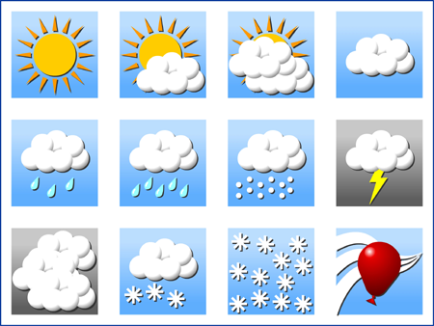
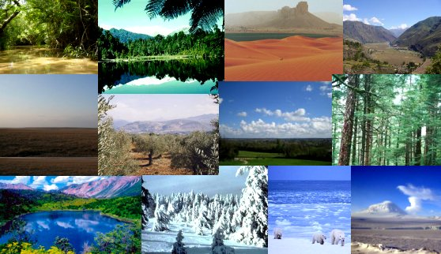
Weather vs. Climate
Weather
Climate
Average conditions occurring over a period of 30 years or longer
  e.g. Alberta has a relatively cold and dry climate compared to Brazil, which is warm and humid
Day-to-day conditions, including
  temperature & air pressure
  cloud cover & humidity
  precipitation

Slide 18
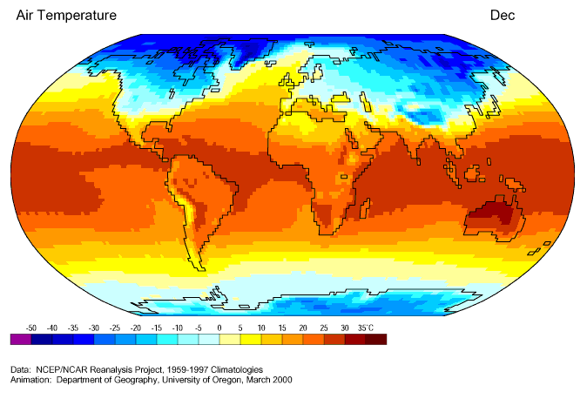
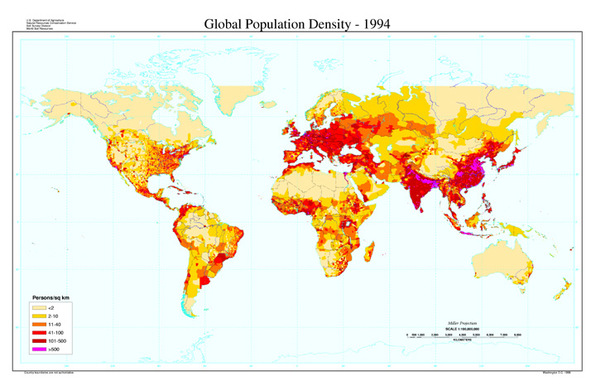
Effect of Climate on Humans
The climate of a region (map #1) - average air temperatures) has several effects on the humans that live there, including
  population distribution (map #2)
  clothing & shelter considerations

Slide 19
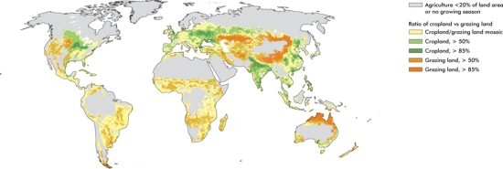
Effect of Climate on Humans
  heating & cooling requirements
  food availability & agricultural options (map)
  economic opportunities

Slide 20
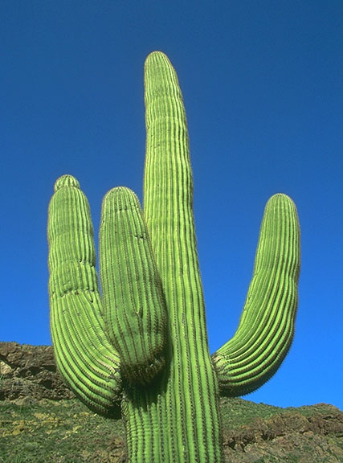
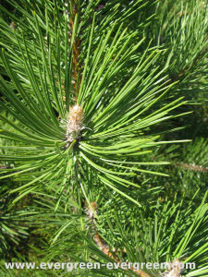
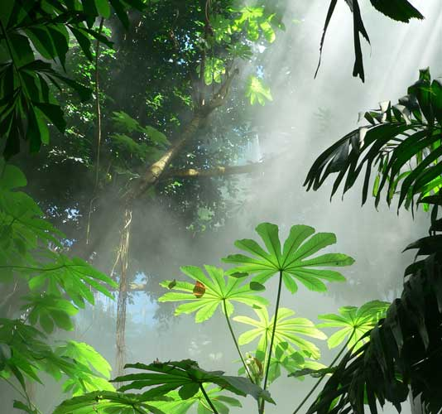
Effect of Climate on Other Organisms
The better suited to its climate an organism is, the better its chances of survival.
an adaptation is a change in the structure or functioning of an organism that makes it more suited to its environment.

Slide 21
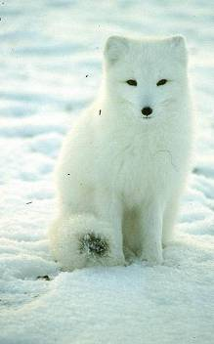
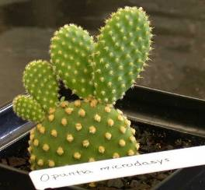
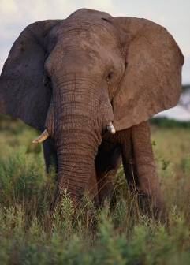
Organisms are Adapted to Deal with Climate
Describe the climate that goes with each adaptation:
Cold: Tiny ears prevent heat loss
Dry: fat leaves prevent water lose
Wet: air filled bladders for floatation
Hot: large, thin ears maximize heat loss

Slide 22
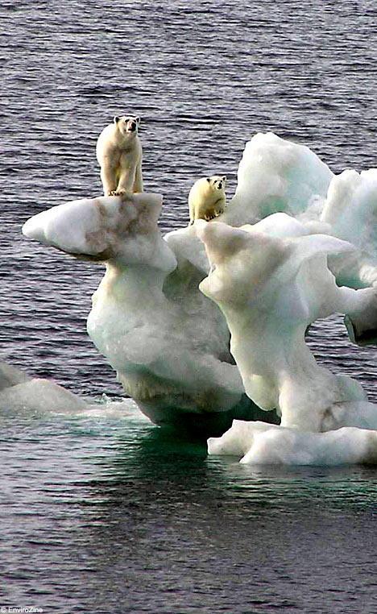
Climate Change
Climate is long term – climate change refers to a noticeable change in average temperatures in a region over time.
A few common questions arise when discussing climate change:
  is climate change really happening, or are environmentalists using scare tactics?
  if climate change is occurring over such long terms, how do we know for sure?
  if climate change has occurred several times over Earth’s history, why are we so worried now?

Slide 23
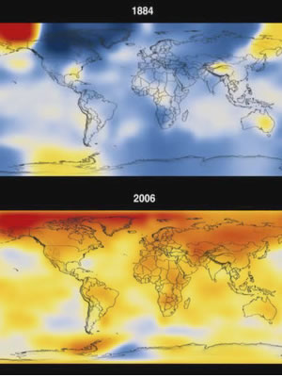
Climate Change
Global warming IS happening – no educated scientist, politician or environmentalist disputes this
  what IS up for debate is why it is happening and if it is cause for concern.

Slide 24
Climate Change
Since 1990, the global average temperature has risen by 0.6ºC,
  the northern hemisphere is substantially warmer than at any point during the past 1,000 years
  the key is that its GLOBAL AVERAGE temperatures – it doesn’t necessarily mean all regions of the world will experience warming at all
  in Canada, it could actually result in cooling temperatures and more extreme weather events

Slide 25
Changing Climates
A variety of evidence exists to demonstrate that the climate of the Earth has varied throughout its history.
This change continues today, and is often referred to as global warming.
  some of the evidence we use depends upon humans, so only describes the last few thousand years
  some of the evidence allows us to look back at the Earth’s conditions prior to humans arriving

Slide 26
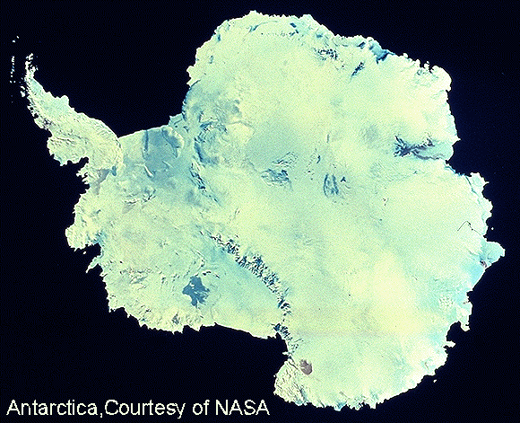
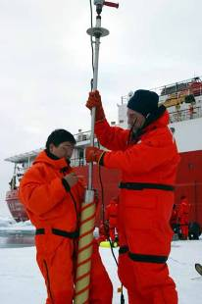
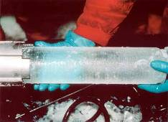
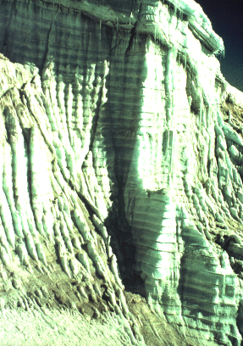
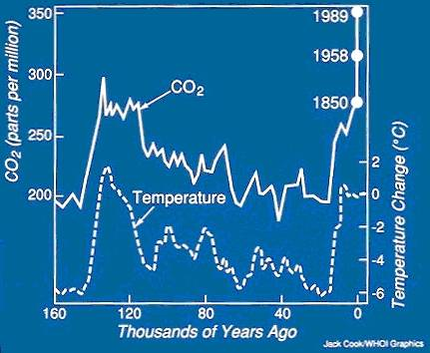
Historical data is collected by analyzing tiny bubbles in yearly layers of ice.
Average yearly temperature can also be measured this way.

Slide 27

Types of Evidence
Two general categories of evidence exist:
  1. anecdotal evidence
    evidence based on stories people tell,
    from the word “anecdote”, meaning a short, personal story of an individual’s experiences
    is most often qualitative in nature

Slide 28

Types of Evidence
Two general categories of evidence exist:
  2. instrumental evidence
    includes any evidence that comes as a result of measurement
    may require special equipment,
    is most often quantitative in nature
Which one is more reliable? Why?

Slide 29
Instrumental Evidence
When trying to measure something, there are two approaches:
  measure the factor directly (e.g. if you want to find out how far it is to Calgary, measure the distance)
  measure some other factor, and use it to make conclusions (e.g. calculate the distance based on your speed of travel and the time it takes).

Slide 30
Instrumental Evidence
Tracking climate change is the same way:
  direct evidence
    explicitly indicates global warming is occurring, based on an actual measured change in global temperatures.
  indirect evidence
    evidence that seems to support the idea of climate change but does not involve a direct measurement of temperature.

Slide 31
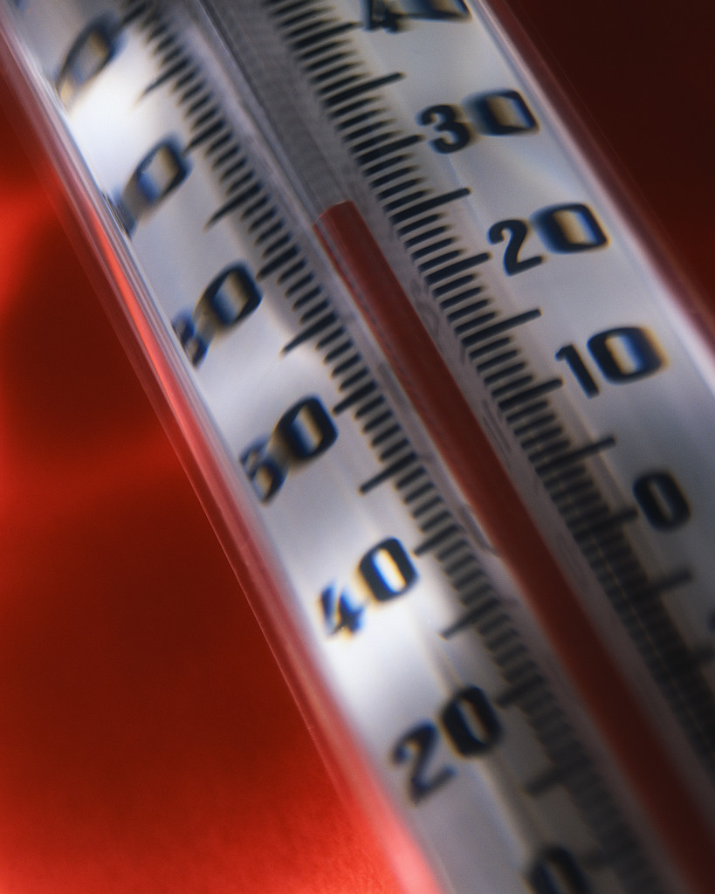
Direct Evidence
Uses historical data
  from scientists to farmers, people have been recording weather and temperature information for hundreds of years
  patterns emerge and are often used to predict future weather, such as in the Farmers’ Almanac
limited in how far back a written record goes; restricted only to the last few hundred years

Slide 32
Indirect Evidence
Different types of evidence exist that support the idea of climate change, though are not direct measurement of temperature
These include:
  tree ring analysis
  ice core sampling
  fossil record of insects
  pollen sampling from the bottom of lakes

Slide 33
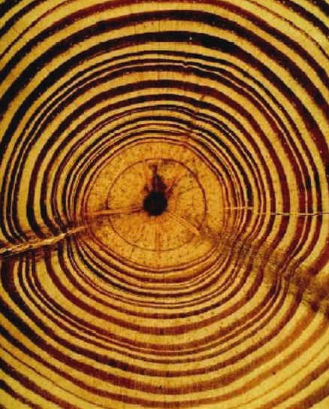
Tree Ring Analysis
Tree rings reflect the changing seasons of cold and drought, warmth and precipitation during the life of a tree

Slide 34
Tree Ring Analysis
By examining wood from trees of different ages and from different time periods, a continuous record of climate changes can be established that goes back a few thousand years.

Slide 35
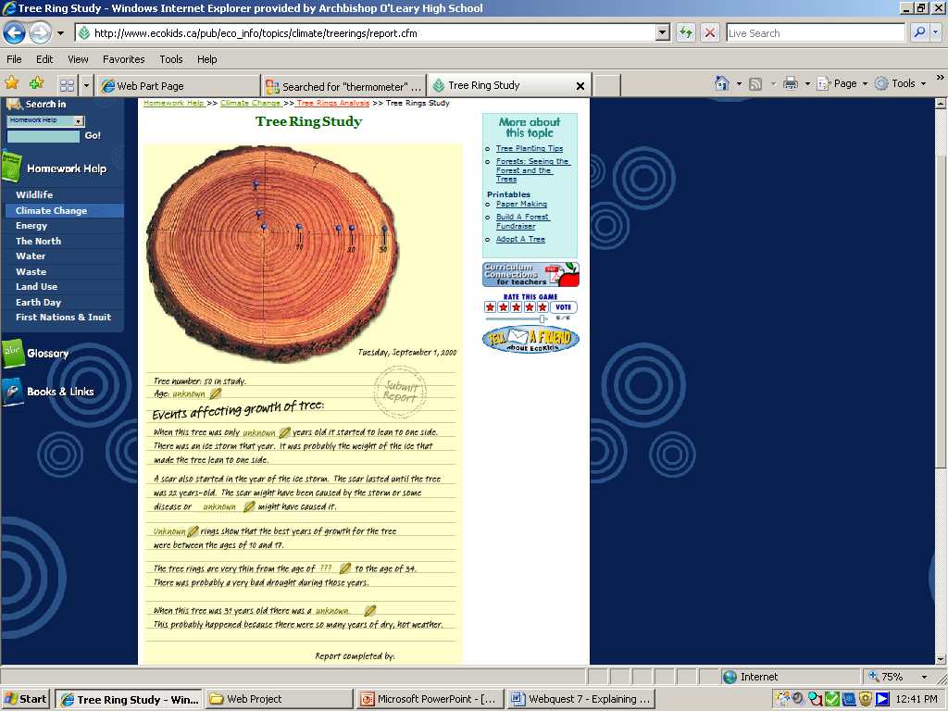
Tree Ring Analysis
The tree's age can be figured out by counting the pairs of light and dark rings. It's easier to see the dark rings so they are usually the ones used for counting.
To help figure out what climate the tree grew in and what the environment was like, the scientist looks at each ring:
  thickness:
    How wide a ring is can tell you if the environment was good or bad for the tree to grow in.
    In years when the amount of rain and temperature were good a tree's rings are wider.
    In bad years a tree's rings are thinner.

Slide 36
Tree Ring Analysis
Sample tree ring analysis
  shape:
    if rings start to become thinner on one side than the other it probably means the tree is leaning over to one side.
    High winds or a big storm can cause a tree to lean.
  strange marks or scars,
    can be left by insects or disease.
    a forest fire can leave burnt marks.
Scientists use a computer to measure the width of rings up to 0.01 mm and to find other things they can't see by just looking at the tree.

Slide 37
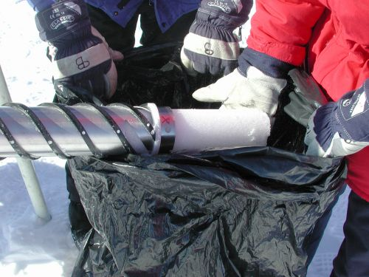
Ice Core Sampling
By obtaining a sample of a column of ice 10,000 feet down in our ice sheets, we are looking at ice made over 700,000 years ago.
By analyzing the tiny bubbles of air trapped in this ice, scientists can collect information about
  the quality of the air at that time,
  CO₂ levels
  approximate air temperature.
Ice core sampling

Slide 38
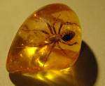

Fossil Records & Pollen Samples
By examining fossil records or pollen samples from the past, we can determine what plants and insects existed at that point in Earth’s history

Slide 39
Fossil Records & Pollen Samples
Since we know that plants and animals are adapted to particular climates (temperature, humidity, amount of sunlight), we can make conclusions about the conditions in the area in which they were found

Slide 40
Assignment
Check and Reflect Pg 348 #1,3,5,7,10
Section Review Pg 355 #1-14 (even)

Slide 41
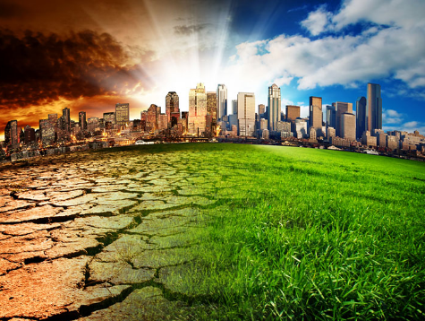
Unit D – Global Systems
D2 – Energy transfer through the biosphere

Slide 42
Mechanism for Change
You’ve probably heard that greenhouse gases are to blame for climate change – that’s partly true.
Natural factors, including solar fluctuations, slight “wobbles” in the Earth’s orbit, and the movement of the continents have also influenced climate over Earth’s history.

Slide 43
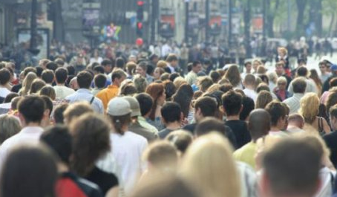
Mechanism for Change
However, in the case of current global warming, the speed and degree of change (how fast and how much) can only be explained by human activity.
  to understand how heat becomes trapped in the atmosphere, we have to understand the sun’s energy.

Slide 44
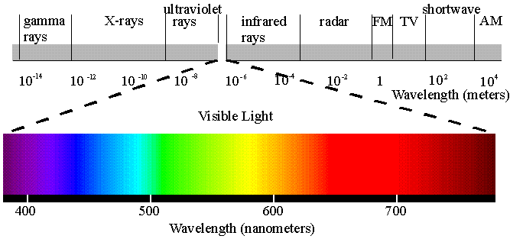
Solar Energy
The sun’s energy is radiant energy – recall, that means energy that is transmitted in waves
  There are a wide variety of waves radiating from the sun

Slide 45
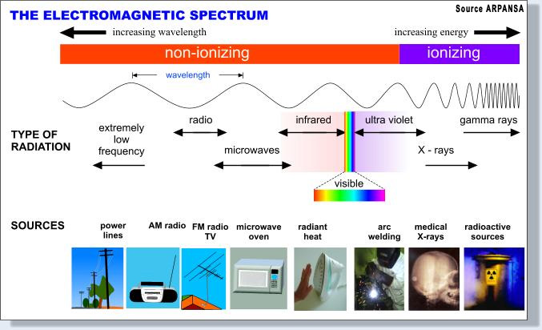
Solar Energy
  All waves from the sun travel at the same speed, (the speed of light, 3.00x10⁸ m/s), but they vary in the amount of energy they carry.

Slide 46
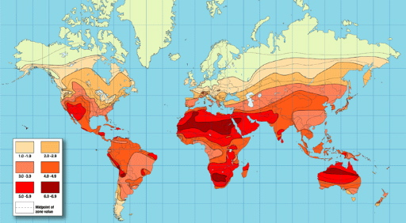
Insolation & the Angle of Inclination
Not all regions of the Earth receive the same amount of the Sun’s energy.
  Insolation is the amount solar energy received by a region of the Earth’s surface.

Slide 47
Q: What causes the different seasons?
Some people think that Earth is closer to the Sun in the summer and that is what causes the hot weather, but this is not true.
  Earth is actually further from the Sun in the summer and closer in the winter.
  However, these minimal changes do not affect our seasons.
Earth orbits around the sun in an ellipse, not a circle.
  Since Earth is tilted, different concentrations of sunlight reach the surface.
  This change of concentration of sunlight rays is what creates our different seasons.

Slide 48


Insolation & the Angle of Inclination
Angle of Inclination
  while we often illustrate the Earth like this →
  it’s actually on a tilt, like this →

Slide 49
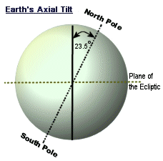
Insolation & the Angle of Inclination
Angle of Inclination
  the angle of inclination refers to the angle of the Earth’s axis compared to the vertical.
  while we have evidence that suggests the Earth wobbles a bit, the angle of inclination is 23.5º

Slide 50
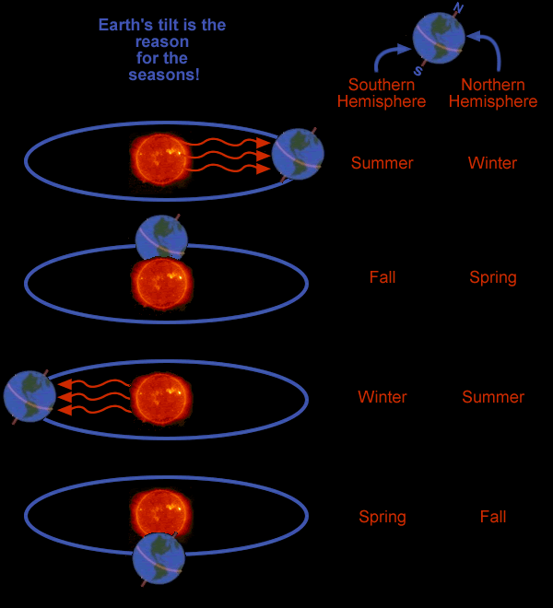
Insolation & the Angle of Incidence
The Earth orbits the Sun once per year.
The Earth’s tilt is the reason for the seasons.
  Remember, you have to distinguish between hemispheres when discussing seasons.

Slide 51
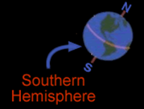
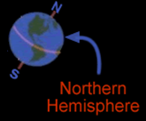

Slide 52
Earth / Sun Relationships
A equinox occurs when the Earth is tilted sideways relative to the sun
  the number of daylight hours = the number of hours of darkness
    Spring Equinox – March 21
    Fall Equinox – September 21
      *in the Northern Hemisphere

Slide 53
Earth / Sun Relationships
A solstice occurs when the Earth is tilted toward or away from the sun
  the number of daylight hours are at their maximum or minimum
    Summer solstice – June 21
    Winter solstice – December 21
      *in the Northern Hemisphere

Slide 54
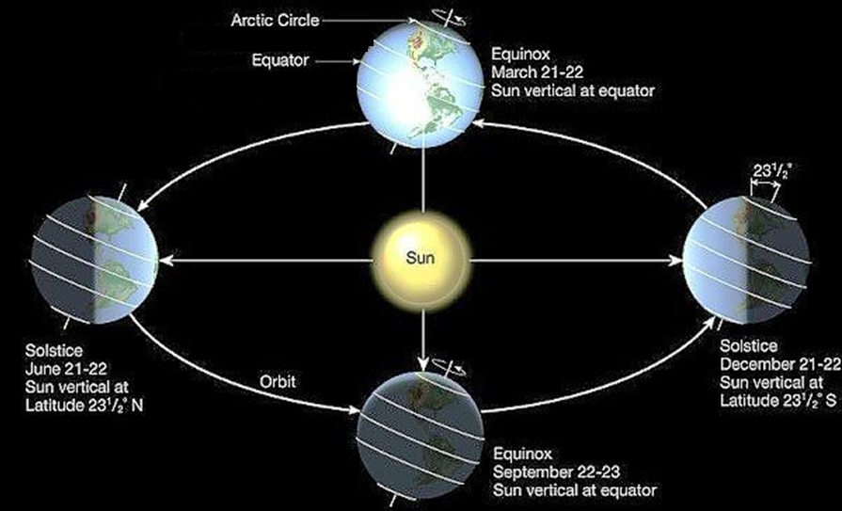
Earth / Sun Relationships

Slide 55
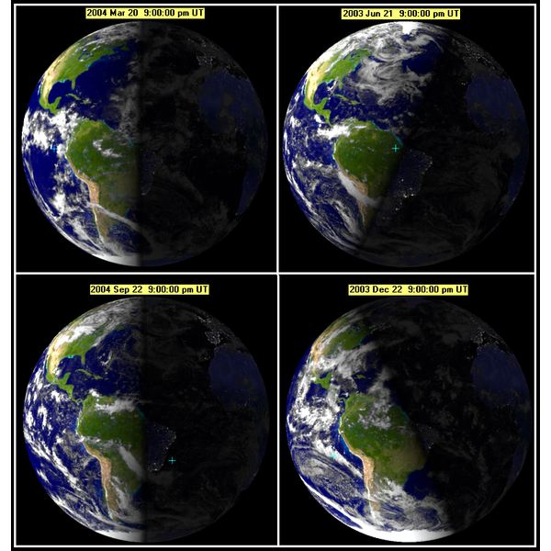

Slide 57
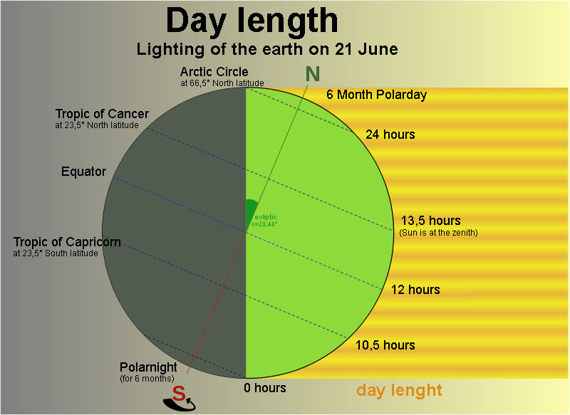
Earth/Sun Relationships

Slide 58
Angle of Incidence
The shape of the Earth also plays a part in insolation.
  Because it’s spherical, a light ray hitting at the equator strikes the Earth with more intensity than a light ray hitting at a higher latitude.

Slide 59
Angle of Incidence
The Angle of Incidence is the angle between the incoming sun ray and a line perpendicular to the Earth’s surface.
Notes:
Demo: You will need a flashlight, a piece of grid paper. First, turn on the flashlight and hold the notebook paper a couple feet away from it. Hold the flashlight perfectly horizontal and hold the paper perfectly vertical. You should see a focused beam of light on the paper. Draw the outline of the beam of light. Now, tilt the paper backwards at a slight angle (23.5 degrees if you know how much that is!). You should now see that the same beam of light is spread over a greater area of the paper. Draw the outline of the beam hitting the tilted paper.
Now measure the area of the two beams (vertical and tilted) by counting the number of squares that were illuminated. Assume that the amount of light coming out of the flashlight equals 1 photons per square of grid paper (this number is totally fabricated but works for the purposes of the demo). Calculate the intensity of light per square in each situation.

Slide 60
90º angle
sun is intense
40º angle
sun is diffuse
Notes:
Demo: You will need a flashlight, a piece of grid paper. First, turn on the flashlight and hold the notebook paper a couple feet away from it. Hold the flashlight perfectly horizontal and hold the paper perfectly vertical. You should see a focused beam of light on the paper. Draw the outline of the beam of light. Now, tilt the paper backwards at a slight angle (23.5 degrees if you know how much that is!). You should now see that the same beam of light is spread over a greater area of the paper. Draw the outline of the beam hitting the tilted paper.
Now measure the area of the two beams (vertical and tilted) by counting the number of squares that were illuminated. Assume that the amount of light coming out of the flashlight equals 1 photons per square of grid paper (this number is totally fabricated but works for the purposes of the demo). Calculate the intensity of light per square in each situation.

Slide 61
Albedo
Ever notice when you go out on a hot day wearing a black t-shirt, you feel warmer than if you were wearing white?
Conversely, when you go snowboarding, notice how the sun reflects very brightly off the white snow than it does off rocks or exposed ground?
These two phenomena can be explained using a concept called albedo.

Slide 62
Albedo
The albedo of a surface is the percent of solar radiation that it reflects
  a white shiny surface (e.g. snow) has a high albedo
  a dark, dull surface (e.g. forest, dirt) has a low albedo
The average albedo for Earth’s surface is 30% (or 0.30).
Notes:
open water 10-60%
fresh snow 80 – 95%
forest 10-20%
farmland 10-25%
grass 25 – 30%
asphalt 5 – 10%
bare pavement 17-27%
dark roof 8 – 18%
light roof 35-50%
stone bark 20 – 40%
open water 10 – 60% (depending on angle of sun)

Slide 63
Implications of Albedo
Because snow and ice have a much higher albedo, regions that are frozen reflect more snow than regions without snow or ice
The albedo of most regions in Canada is significantly higher in winter than in summer
In the arctic, the albedo is high year-round
Deserts also have high albedo because they lack vegetation to absorb the sun’s rays

Slide 64
Summary of Earth/Sun Relationships
The climate of a region is largely determined by the insolation, or amount of sunlight, the area gets
Insolation is affected by
  the Angle of Inclination – due to the tilt of the Earth, areas further from the equator see more variation in seasonal temperatures and the number of daylight hours
  the Angle of Incidence – due to the spherical shape of the Earth, areas further from the equator get less direct and intense sun
Once the sun hits the Earth’s surface, it may be absorbed or reflected, depending on the albedo of the surface

Slide 65
Natural Greenhouse Effect
Recall, energy cannot be destroyed – so if some/most of the sun’s rays reflect off the Earth’s surface, where do they go?
The energy gets radiated back into the atmosphere in the form of thermal energy

Slide 66
Natural Greenhouse Effect
  Normally, a portion of this thermal energy is lost to space, and a portion is absorbed by the atmosphere
  The trapping of this heat by the atmosphere is called the Natural Greenhouse Effect
  Without this effect, the Earth would be 33ºC colder

Slide 68
Net Radiation Budget
Before human activity made such an impact, the Earth’s radiation budget was balanced
  that is, some thermal energy was reflected out into space, and some absorbed by the atmosphere
  the net result was zero
net radiation budget = incoming radiation – outgoing radiation

Slide 69
Net Radiation Budget
  It is important to note that the budget is balanced on a planetary basis, but some regions are in surplus and some in deficit.
  The areas at the equator tend to have higher insolation, which gives them a surplus.
  The areas closer to the poles tend to have lower insolation, which gives them a deficit.

Slide 70
Net Radiation Budget
Net radiation budget = incoming radiation – outgoing radiation
If a build-up of greenhouse gases causes more radiation to be absorbed by the atmosphere, we have a surplus → this will cause global temperatures to rise.

Slide 71
Assignment
Pg 369 # 1-16 even (omit #14)

Slide 72
Thermal Energy Transfer
Recall, thermal energy (or heat) moves from warm to cool
Radiation - emission of energy as waves
  when radiant energy encounters particles of matter, those particles will either re-radiate the energy back into space or pass the energy on to other particles
  two methods for passing energy onto other particles:
    conduction
    convection

Slide 73
Conduction
Transfer of heat through direct contact between particles.
This is the most common method of heat transfer in solids, because it does not require movement of the particles to a different location.
Particles pass their energy on to neighbouring particles by vibrating against them.

Slide 74
Convection
The transfer of thermal energy through the movement of particles from one location to another.
usually occurs in fluids – liquids and gases – by inducing a convection current in the fluid

Slide 75
Convection
  Some of the particles heat up and begin moving faster
  As the warm particles move apart, they become less dense and rise
  When the particles contact cooler particles, they cool and fall back down

Slide 76
Thermal Energy Transfer in the Atmosphere
The temperature of the air in the atmosphere near the equator warms and rises toward the poles
The air at the poles then cools and sinks back down
  because the cool air has higher atmospheric pressure, it moves toward the equator where the pressure is lower
  wind is the movement of this cooler air from an area of high pressure to an area of low pressure
  if the Earth were still (and not spinning), their would be a continuous convection current between the equatorial and polar air

Slide 77
Thermal Energy Transfer in the Atmosphere
Convection currents causes air to move directly North-South.

Slide 78
Thermal Energy Transfer in the Atmosphere
However, since the Earth is spinning, the winds are deflected to the right (in the Northern Hemisphere) or the left (in the Southern Hemisphere)
  This deflection is called the Coriolis Effect.

Slide 80
Global Wind Patterns
As a result of convection currents and the Coriolis Effect, global winds follow a predictable pattern
  Trade winds are the normal wind patterns that transfer heat around the globe

Slide 81
Global Wind Patterns
  Jet streams are bands of fast moving air in the stratosphere that travel much faster than wind in the troposphere
    changes in normal jet stream patterns are important in predicting weather changes and extreme weather events such as storms and cyclones

Slide 82
Thermal Energy Transfer in the Hydrosphere
The hydrosphere transfers thermal energy in a similar way as in the atmosphere
Surface water is pushed by trade winds.
Deeper water travels by convection currents
  Warmer waters near the equator are driven by convection currents toward the poles
    currents in the Northern Hemisphere circle clockwise
    currents in the Southern Hemisphere circle counterclockwise
Unlike air currents which don’t have to circulate around something, water currents are disrupted by the continents.

Slide 83
Consider This:
These three Canadian cities are at nearly the exact same latitude
Because they are all the same distance from the equator, they are subject to the same air currents, so we might expect that they all have the same average temperatures.
49ºN

Slide 85
Notice:
Vancouver has the warmest annual average, and the least monthly temperature variation
Gander has the coolest annual average, but also less variation
Lethbridge’s average annual temperature is between the other two, but sees the most variation
  These three observations can all be explained by the presence or absence of a large body of water next to the city.

Slide 86
Specific Heat Capacity
At several points in this course, you’ve been asked to consider the special properties of water (e.g. good solvent, polar molecule, solid is less dense than the liquid, cohesive & adhesive, etc.)

Slide 87
Specific Heat Capacity
There is one more property of water that affects global energy transfer: water has an unusually high specific heat capacity.
  Specific heat capacity refers to the ability of a substance to absorb thermal energy without changing temperature.
  The high specific heat capacity of water means that it absorbs much of the sun’s radiant energy, but stays at a constant temperature.

Slide 88
What Does this Mean for the Three Cities?
Cities next to oceans experience more moderate (less extreme) temperatures because water can absorb heat without changing temperature.
Because Vancouver and Gander are located on oceans, the air temperature is moderated by the water
  that means they will see less variation in their climate from month to month
  Vancouver is located next to a warm ocean current coming from the equator
  Gander is located next to a cool ocean current coming from the arctic
  this explains why Vancouver has a warmer average temperature

Slide 89
What Does this Mean for the Three Cities?
Because Lethbridge is land-locked, it does not benefit from the regulating effect of the ocean, and therefore experiences greater temperature variation from month to month

Slide 90
Assignment
C&R pg 375 #1-10

Slide 91
Quantity of Thermal Energy, Q
The quantity of thermal energy (Q) is the amount of thermal energy (measured in joules) that is absorbed or released when the temperature of a substance changes
It is affected by
  the mass of the substance (measured in grams)
  the amount of change in temperature (measured as the number of ºC it changes)
  how easily the substance changes temperature (as indicated by its specific heat capacity)

Slide 92
Quantity of Thermal Energy, Q
The formula is Q = mc∆t , where:
  Q = quantity of thermal energy (J)
  m = mass of the substance (g)
  c = specific heat capacity of the substance in (J/g•˚C)
  ∆t = change in temperature (ºC)

Slide 93
Understanding Specific Heat Capacity
The specific heat capacity of water is 4.19 J/g•ºC
  this means it takes 4.19 J of energy to warm one gram (one milliliter) of water by one degree Celsius.
This number is quite high compared to other substances, for instance:
  aluminium: 0.900 J/g•ºC
  copper: 0.380 J/g•ºC
  lead: 0.130 J/g•ºC
Which means, compared to these metals, it takes a lot more energy to make water change temperature
  Or, put another way, water can absorb a lot more energy without changing temperature

Slide 94
Finding the Specific Heat Capacity
The ‘c’ of other substances can be determined using a calorimeter
  a calorimeter is a container that is insulated to avoid heat loss (it can be made of metal like a Thermos or as simple as two Styrofoam cups)
  to determine the value of ‘c’ for another substance, it is massed, placed in the calorimeter, and heated
  by knowing how much heat you used (Q) and measuring the temperature change (∆t) you can calculate ‘c’

Slide 95
Example:
50.0g of water at 25.0ºC is heated to 50.0ºC on a hot plate. Given that the theoretical specific heat capacity of water is 4.19 J/g•ºC, determine the value for Q.
Solution:
Q = mc∆t
= (50.0g)(4.19 J/g•ºC)(50.0 – 25.0ºC)
= 5237.5 J
= 5.24 x 10³ J or 5.24 kJ

Slide 96
Example:
How much thermal energy must be released to decrease the temperature of 1.00 kg of water by 10.0ºC?
  Q = ?
  m = 1.00 kg = 1000 g
  c = 4.19 J/g•ºC (in data booklet)
  ∆t = 10.0ºC
  Q = mc∆t = (1000g)(4.19 J/g•ºC)(10.0ºC) = 41 900J
  = 4.19 x 10⁴ J or 41.9 kJ

Slide 97
Practice Problems:
1) a 200g mass of water at 4.00ºC is warmed to 22.0ºC. Determine the amount of thermal energy absorbed.
2) Determine the quantity of energy required to warm a 1.00-kg block of ice from – 15ºC to 0.0ºC. The theoretical specific heat capacity of ice is 2.00 J/g•ºC
3) 21.6 J of energy are used to heat a 2.0g piece of iron by 24.0ºC. What is the experimental specific heat capacity of iron?

Slide 98
Solutions:
1) A 200g mass of water at 4.00ºC is warmed to 22.0ºC. Determine the amount of thermal energy absorbed.
Q = mc∆t
= (200g)(4.19 J/g•ºC)(22.0 – 4.00ºC)
= 15 084 J
= 1.51 x 10⁴J

Slide 99
Solutions:
2) Determine the quantity of energy required to warm a 1.00-kg block of ice from – 15ºC to 0.0ºC. The theoretical specific heat capacity of ice is 2.00 J/g•ºC
Q = mc∆t
= (1000g)(2.00 J/g•ºC)(0.0 – -15ºC)
= 30 000J
= 3.0 x 10⁴J

Slide 100
Solutions:
3) 21.6 J of energy are used to heat a 2.0g piece of iron by 24.0ºC. What is the experimental specific heat capacity of iron?
Q = mc∆t
c = Q/m∆t
= 21.6 J / (2.0g)(24.0ºC)
= 0.45 J/g•ºC
This is slightly different than the theoretical specific heat capacity of iron (0.449 J/g•ºC) because of limits in the accuracy of the experiment

Slide 101
Assignment
Practice Problems Text 379-380 (#1-8)

Slide 102
The Hydrologic Cycle and Energy Transfer
We’ve seen how liquid water is able to absorb / release thermal energy and its effect on climate, but this only describes part of the hydrologic cycle
The hydrologic cycle is the movement of water molecules throughout the biosphere
  besides the movement of liquid water in convection currents, water in the cycle also changes from solid → liquid → gas and vice versa

Slide 103
Practice Problem:
Using this image as a guide, identify a process where water goes from:
  solid to liquid
  liquid to solid
  liquid to gas
  gas to liquid
  gas to solid

Slide 104
Phase Changes
During a phase change, water changes state without changing temperature
  this occurs because the thermal energy is going toward breaking the bonds between water molecules, rather than making the water molecules move faster

Slide 105
Phase Changes
Since water molecules undergo many phase changes in the cycle, a lot of energy is transferred in the biosphere without any change in temperature
  this helps to keep average global temperatures relatively stable.

Slide 106
Heat of Fusion
The heat of fusion of a substance is the amount of energy absorbed when 1 mol of the substance melts from solid to liquid without changing temperature
  it is equal to the heat of solidification, which is the amount of heat released when 1 mol of the substance freezes

Slide 107
Heat of Vaporization
The heat of vaporization of a substance is the amount of energy absorbed when 1 mol of the substance evaporates from liquid to gas without changing temperature
  it is equal to the heat of condensation, which is the amount of heat released when 1 mol of the substance condenses from gas to liquid

Slide 108
Heating Curve of Water
Temp change
Phase change
Temp change
Phase change
Temp change

Slide 109
Calculating the Heat of Fusion or Vaporization
The amount of energy absorbed or released during a phase change can be calculated from the following two formulas
or
where
  H_{fus} = heat of fusion, or H_{vap} = heat of vaporization, in kJ/mol
  Q = quantity of thermal energy, in kJ
  n = number of moles, in mol

Slide 110
Theoretical Heat of Fusion and Vaporation
The theoretical Heat of Fusion of ice is 6.01 kJ/mol
  that means it takes 6.01 kJ of thermal energy per mole of ice that is melting
The theoretical Heat of Vaporization of water is 40.65 kJ/mol
  that means it takes 40.65 kJ of thermal energy per mole of water that is evaporating

Slide 111
Example:
Calculate the amount of energy absorbed when 10.0 mol of ice at 0.0ºC melts. The theoretical heat of fusion of water is 6.01 kJ/mol
H_{fus} = Q/n
Q = H_{fus}n
= (6.01 kJ/mol)(10.0mol)
= 60 kJ

Slide 112
Recall: Calculating the Number of Moles
Recall from the Chemistry unit, you can calculate the number of moles if the mass and molar mass of the substance is known
The formula is n = m/M
  m = mass (in g)
  M = molar mass (in g/mol)

Slide 113
Example:
In an experiment, it is found that when 150 g of water evaporates, 339 kJ of energy is absorbed. (Recall, the molar mass of water is 18.02 g/mol). Determine the experimental heat of vaporization of water.
n = m = 150g = 8.32 mol
M 18.02 g/mol
H_{vap} = Q = 339 kJ = 40.7 kJ/mol
n 8.32 mol

Slide 114
Practice Problems:
1) When 8.70 kJ of thermal energy is added to 2.50 mol of liquid methanol, it vaporizes. Determine the heat of vaporization of methanol.
2) If the theoretical heat of fusion of ice is 6.01 kJ/mol, how much thermal energy is required to melt a 100 g ice cube?

Slide 115
Solutions:
1) When 8.70 kJ of thermal energy is added to 2.50 mol of liquid methanol, it vaporizes. Determine the heat of vaporization of methanol.
H_{vap} = Q/n
= 8.70 kJ / 2.50 mol
= 3.48 kJ/mol

Slide 116
Solutions:
2) If the theoretical heat of fusion of ice is 6.01 kJ/mol, how much thermal energy is required to melt a 100 g ice cube?
n = m/M
= 100g / 18.02 g/mol
= 5.55 mol
H_{fus} = Q/n
Q = H_{fus}n
= (6.01 kJ/mol)(5.55 mol)
= 33.4 kJ

Slide 117
Assignment
Practice Problems 386-387 #9-15
Pg 390 # 1-4, 6-13, 22-23

Slide 118
Unit D
D2.4 - Biomes

Slide 119
Biomes are Open Systems
A biome is a large geographical region with particular climactic conditions.
A description of a biome includes
  the typical range of temperature and precipitation
  the plants and animals that are adapted to those conditions

Slide 120
Biomes are Open Systems
Biomes function as a system – a set of interconnected parts that may exchange energy and/or matter with the surroundings
  open systems – exchange energy AND matter with the surroundings
    examples – the human body, a home, a fish tank, cells
  closed systems – exchange energy, but not matter with the surroundings
    examples – a sealed Tupperware container, the hydrosphere

Slide 121
Biomes are Open Systems
A biome gets input energy from the sun, and loses energy through heat, or chemical energy to other biomes.
A biome exchanges matter such as air, water, and plants and animals with other biomes
  Because they exchange both energy and matter with the surroundings, biomes are considered to be open systems

Slide 122
Earth’s Biomes
Different classification systems exist for biomes – some textbooks define as many as 20 different biomes
In this course we classify the Earth according to SIX biomes

Slide 123
Canada’s Biomes

Slide 124
The Six Biomes
Each biome has a typical range of temperature & precipitation
They can be plotted on a graph
  deserts are hot and dry
  rain forests are hot and wet
  tundra are cold and dry
cold TEMPERATURE hot
dry PRECIPITATION wet

Slide 125
Tundra
Most tundra is found around the Arctic circle
The number of hours of daylight vary greatly and in winter, this biome receives little to no isolation.
Ice and snow cover most of the tundra year-round, known as permafrost.
  This means the region has high albedo and therefore reflects most radiation back into space

Slide 126
Tundra
Because of a lack sun, the tundra is characterized by the coldest and driest conditions of any biome
plants
  short life cycle (to reproduce during short summer)
  small and lie close to ground
animals
  feed mostly on fish
  protect themselves by burrowing underground or with thick coats and squat bodies
cold TEMPERATURE hot
dry PRECIPITATION wet

Slide 127
Taiga
Typically found just south of the tundra
Also called the boreal forest, due to the abundance of conifer (evergreen) trees.
Taiga’s conditions are similar but less extreme than tundra
  longer growing season
  slightly warmer and wetter

Slide 128
Taiga
Plants
  most have needles to make them resistant to drought and freezing during long winters
  “evergreen” means they can do photosynthesis year-round
Animals
  tend to be inactive during winter (burrow or hibernate)
  may have colour-changing coats for camouflage
  birds tend to migrate south for winter
cold TEMPERATURE hot
dry PRECIPITATION wet

Slide 129
Deciduous Forest
Distinguished by trees that lose their leaves in the fall
Found on N and S America, Asia, Europe and Australia
More moderate climate and longer growing season than taiga
Due to a variation in insolation, this biome has very distinct winter and summer seasons
Rich mixture of plants and animals are supported by this type of forest.

Slide 130
Deciduous Forest
Roughly the same precipitation as taiga but with warmer temperatures
Plants
  broad-leaved trees
  forests have lots of undergrowth
Animals
  most are active year round, but tend to reproduce in spring and summer
cold TEMPERATURE hot
dry PRECIPITATION wet

Slide 131
Grassland
Grasslands occur on all continents and may have different names such as prairie or savanna.
Characterized by grasses and few trees
Temperature range can vary greatly depending on the continent, however it always receives little precipitation.

Slide 132
Grassland
Plants
  drought-tolerant with extensive root systems
Animals
  tend to be grazers, and able to travel long distances
cold TEMPERATURE hot
dry PRECIPITATION wet

Slide 133
Rainforest
The warmest and wettest biome, also characterized by the richest variety of plants and animals.
  Plants grow year-round
  Amount of shade varies at different levels of the forest

Slide 134
Rainforest
Plants
  maximize their access to sunlight
    grow tall, high
    leaves are broad and dark green
Animals
  active year-round
  adapted to a particular part / level of the rain forest
    ground
    mid-tree level
    treetops
cold TEMPERATURE hot
dry PRECIPITATION wet

Slide 135
Desert
Like tundra, the dry conditions mean little plant life.
Unlike tundra, deserts receive high insolation and are marked by hot temperatures during the day.
  Since there is a lack of water and plant life to hold the day’s heat, deserts tend to be quite cold at night
cold TEMPERATURE hot
dry PRECIPITATION wet

Slide 136
Desert
plants
  cacti are adapted to retain water and minimize transpiration
animals
  require very little water
  tend to be more active at night
one concern about climate change is the growth of the desert biome as other biomes become hotter and drier

Slide 137
Climatographs
Climatographs are summary graphs that describe the average temperature and precipitation each month for a given region
  the horizontal axis is divided by month
  average precipitation is marked along the left vertical axis and is represented by bars on the graph
  average temperatures are marked along the right vertical axis and are represented by a line graph

Slide 138
Uses of Climatographs
Climatographs are most useful when they are used to compare the climate of two different areas
They can also help identify the factors that determine the climate, such as
  insolation – mostly due to the latitude of the region
  patterns of global winds
  patterns of warm and cold ocean’s currents
You can also use climatographs to predict the biome of the region

Slide 139
Practice Problem:
Grasslands vary in plants and animals and are located all over the world
What general trends do you notice in these grassland climatographs?

Slide 140
Practice Problems:
Below are five climatographs that represent five Canadian cities.
1) Match each climatograph with the biome it represents
2) Which biome is not represented?
3) Match the biome with its city. The five cities are:
  Ottawa, ON
  Grande Prairie, AB
  Whitehorse, YT
  Nanaimo, BC
  Calgary, AB

Slide 147
Unit D
D3 – Climate Change

Slide 148
Changes in Greenhouses Gases
Recall, water vapour is the most abundant naturally-occurring greenhouse gas.
Other greenhouse gases also play a role, and are produced by human activity, such as industry and agriculture.

Slide 149
Changes in Greenhouses Gases
You can compare the effect of a specific greenhouse gas based on two factors:
  Persistence reflects the number of years the gas remains in the atmosphere.
  The Global Warming Potential (GWP) of a gas represents its ability to trap thermal energy in the atmosphere.
Gas | GWP | Persistence (years)
carbon dioxide (CO₂) | 1 | 50-200
methane (CH₄) | 23 | 10
nitrous oxide (N₂O) | 296 | 120

Slide 150
Changes in Greenhouse Gases
Although water vapour plays the largest role in the greenhouse effect, it is naturally kept in balance by the hydrologic cycle.
The greenhouse gases that we’re most concerned about, therefore, are the gases that aren’t kept in balance, especially carbon dioxide.

Slide 151
Measuring a Change in Greenhouse Gases
Evidence of increasing atmospheric CO_{2,} N₂O, and CH₄ comes from a combination of ice core samples and atmospheric measurements by weather balloons

Slide 152
Carbon Sinks & Carbon Sources
CARBON SINKS
CARBON SOURCES
Any process that removes carbon dioxide from the atmosphere
The most significant carbon sink is photosynthesis
Other carbon sinks include:
  dissolving of CO₂ in the ocean
  carbon sequestration initiatives
Any process that releases carbon dioxide into the atmosphere
The most significant carbon source is fossil fuel production and combustion
Other carbon sources include:
  cellular respiration
  weathering of rock
  decomposition of living organisms

Slide 153
Other Sources
Agriculture contributes to the greenhouse effect because
  manure and fertilizers release nitrous oxide
  livestock contribute methane
Halocarbons are man-made chemicals used in coolants
  though their chemical structure makes them ideal for use in fridges and air conditioners, their ability to absorb thermal energy also makes them powerful greenhouse gases
  one category of halocarbons, called CFCs, have a GWP of 12 000 (recall, this is 12 000x more than CO₂)
  fortunately, CFCs have been banned worldwide since the 1980s, when it was discovered that they break down the ozone layer

Slide 154
Global Warming
The line at 0.0 represents the global average temperature between 1951 and 1980
From the graph, we can conclude that:
  Global temperatures are at a 100 year-high
  The start of this change in temperature coincides with the Industrial Revolution

Slide 155
Political Collaboration on Climate Change
The Montreal Protocol was an international agreement signed in 1987 by 182 nations
  agreement was made to replace CFCs with less harmful chemicals in products such as refrigerators and air conditioners
  CFCs had been found to cause a significant loss in ozone in the stratosphere
  this agreement was the first international agreement concerning an environmental issue
Top: The ozone layer in 2008. Bottom: The ozone layer in 2008 had the Montreal Protocol not been signed.

Slide 156
Political Collaboration on Climate Change
United Nations Framework Convention on Climate Change was an agreement to stabilize greenhouse gas emissions caused by human activity
  the UNFCCC was not an action plan – it set out a process for future actions on climate change, specifically that future plans
    could not threaten global food production
    could not jeopardize the economic interests of any nation
    must support sustainable development (the meeting of today’s needs without jeopardizing future generations’ ability to meet their needs)

Slide 157
Political Collaboration on Climate Change
Kyoto Protocol
  in 1998, 161 countries signed an agreement to reduce the production of greenhouse gases
  the countries agreed to reduce their emissions to 5% lower than they were in 1990, by 2012
  countries could also earn “credits” toward their reduction by
    helping other countries lower their emissions
    contributing to a carbon sink (e.g. planting trees)

Slide 158
Canada and Kyoto
Pledging to reduce its emissions below 1990 levels meant that at the time of signing, Canada had to reduce its CO₂ by 6%
However, since we didn’t make any significant changes to our industry practices, the target levels became further and further to meet
In 2010, Canada became the first nation to publicly quit the agreement

Slide 159
Impacts of Climate Change
As a result of climate change, ecologists predict that we will see a change to the distribution of biomes in Canada
These maps illustrate the predicted changes:
  the appearance of desert in southern Alberta
  the reduction of tundra and taiga biomes
  the redistribution of grassland from southern Alberta to Saskatchewan and Manitoba

Slide 160
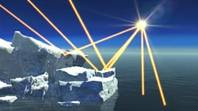
Impacts of Climate Change
With the reduction of permafrost and snow cover, we will also see a significant reduction in albedo
  As open water reflects less radiation than ice, global warming is expected to accelerate

Slide 161
Impacts on Alberta
Some of the predicted consequences of global warming that will directly affect our province are:
  an increase in the frequency and severity of droughts, which could mean a loss or change in crops
  an increase in insect populations
  an increased risk of forest fires
  a loss of species biodiversity
  an increase in diseases associated with warmer climates, such as Lyme disease

Slide 162
Practice Problem
Suggest two methods of reducing greenhouse gases in each economic sector below
Then, refer to page 429 of your textbook to fill in any actions you missed
Sector | Actions
Transportation
Energy
Buildings / infrastructure
Agriculture & Forestry
Industry

Slide 163
Practice Problem
With a partner, brainstorm
  Five steps the AVERAGE Canadian could take to reduce their carbon footprint
  Five steps that you YOURSELF could take to reduce your carbon footprint

